Slide 1
Title of presentation: Bioeconomy Effects in Rural Ghana
Presenters Name: Moses Nganwani Tia
Affiliation: SavaNet
B4A Final Conference/BLP 2025,
28-30 January, Montpellier

Slide 2
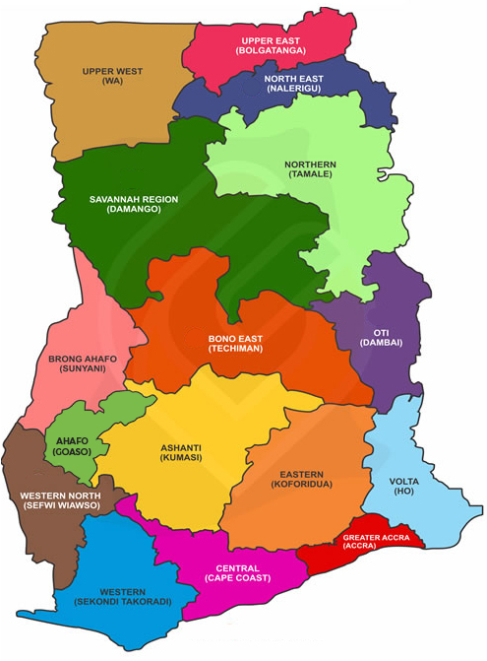
Bioeconomy Effects in Rural Ghana
The Bio4Africa (Diversifying Revenue in Rural Africa through Circular, Sustainable, and Replicable Bio-Based Solutions and Business Models) project sets off to support the deployment of bio-based technologies in rural Africa to drive the cascading use of local resources to diversify the incomes of farmers. www.bio4africa.eu
SavaNet is an International Agriculture and Rural development organization committed to building the needed structures and serve as a leverage to promote Africa’s accelerated Agriculture and Rural development. SavaNet is a consortium member of the Bio4Africa Project and the lead in the project’s implementation in Ghana.
At SavaNet-Ghana, we build bridges between research and practical Agriculture with the development of products and services in partnership with other users.
SavaNet has created an innovation ecosystem where various Agriculture value chain actors interact for the adoption and upscale of Agriculture technologies and food systems. We are therefore Ghana’s Agriculture technology corridor.

Slide 3
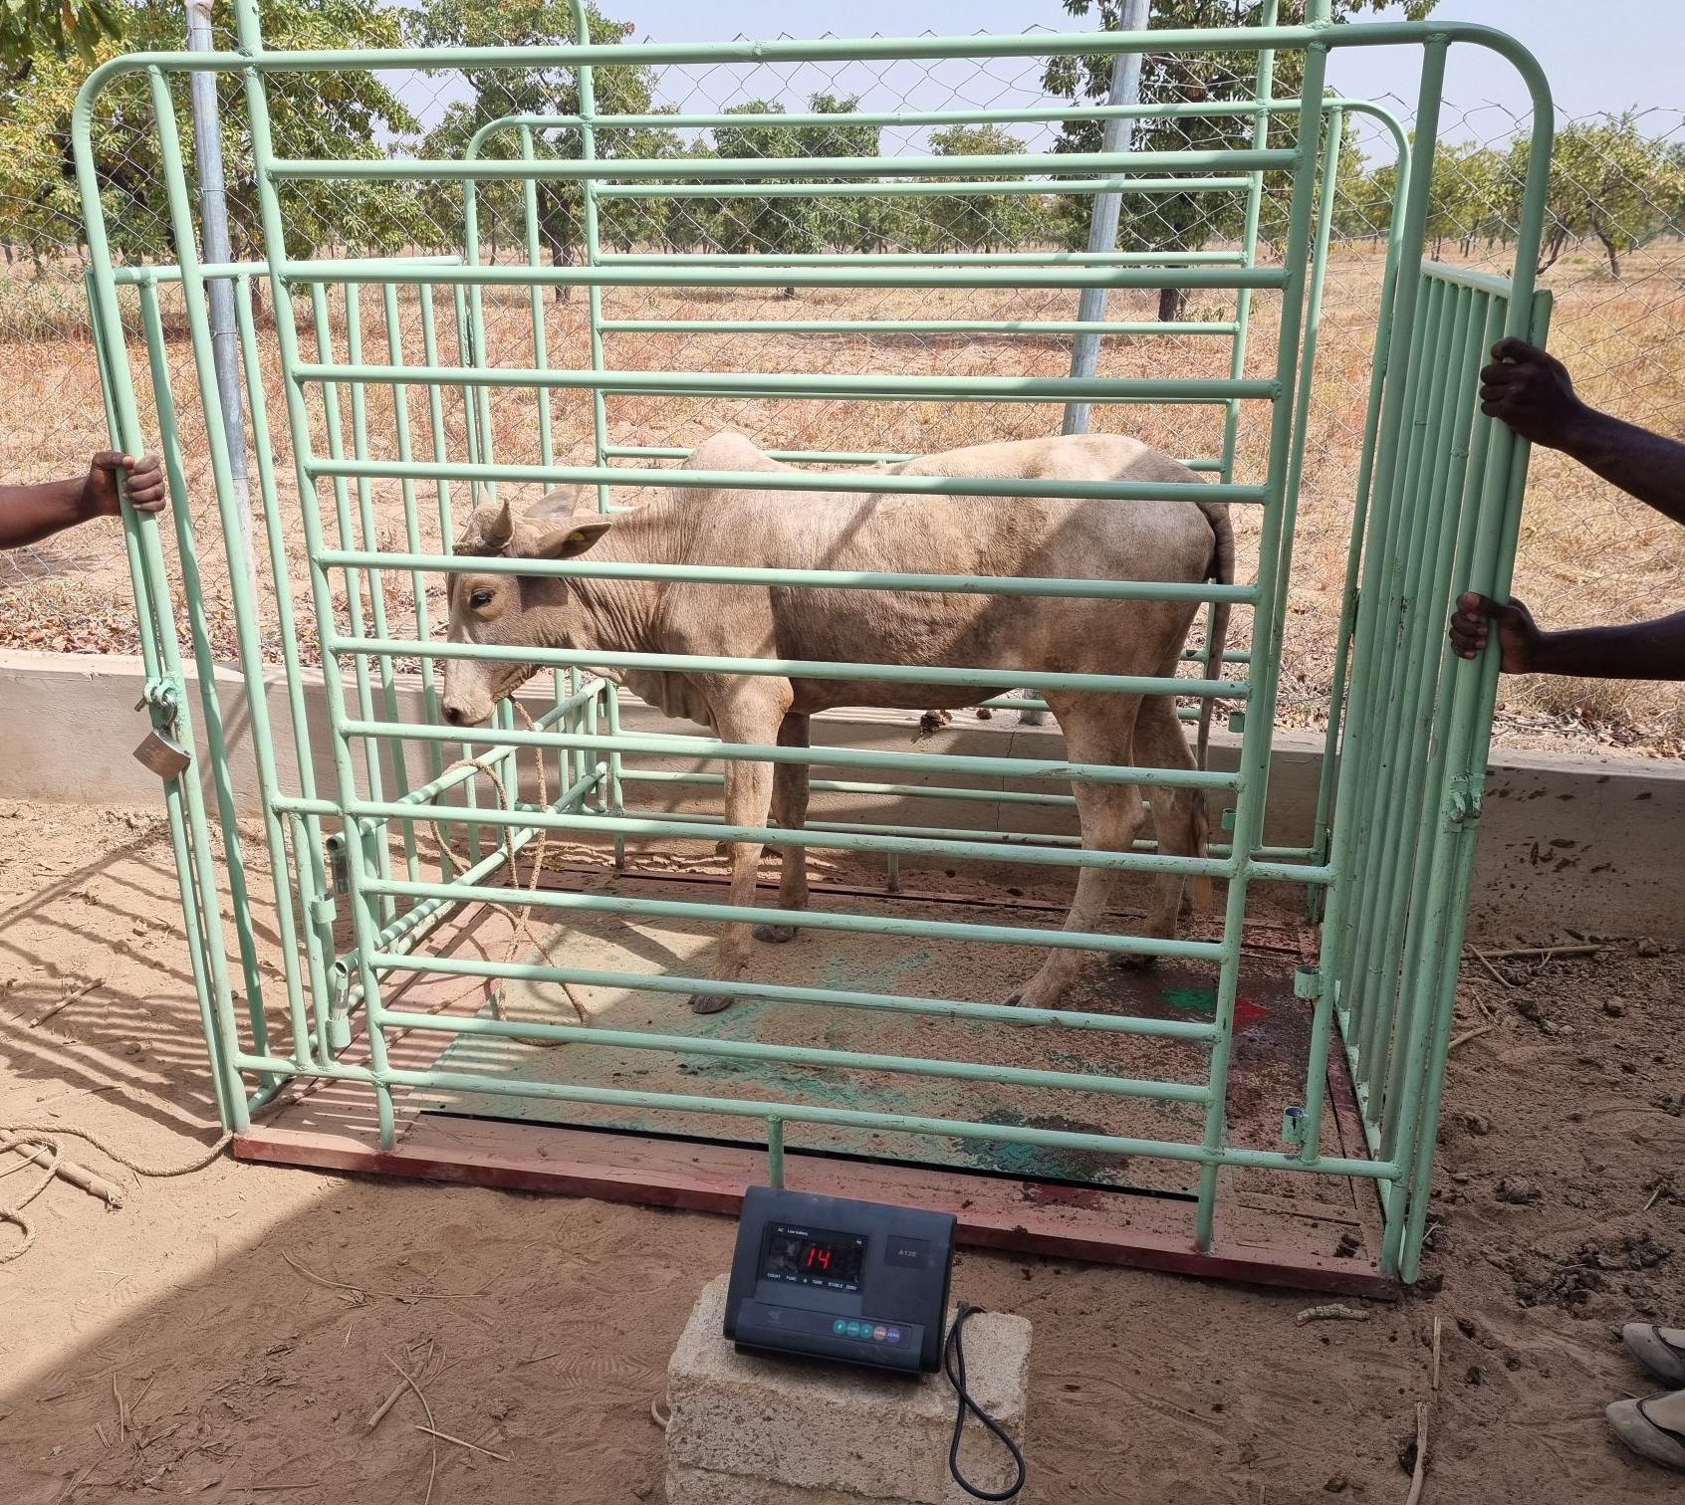
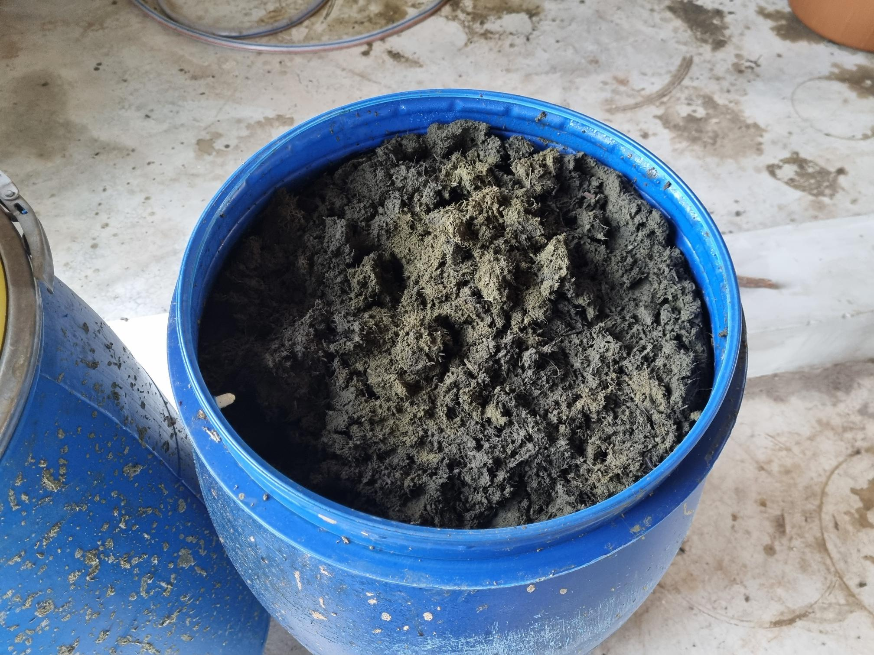
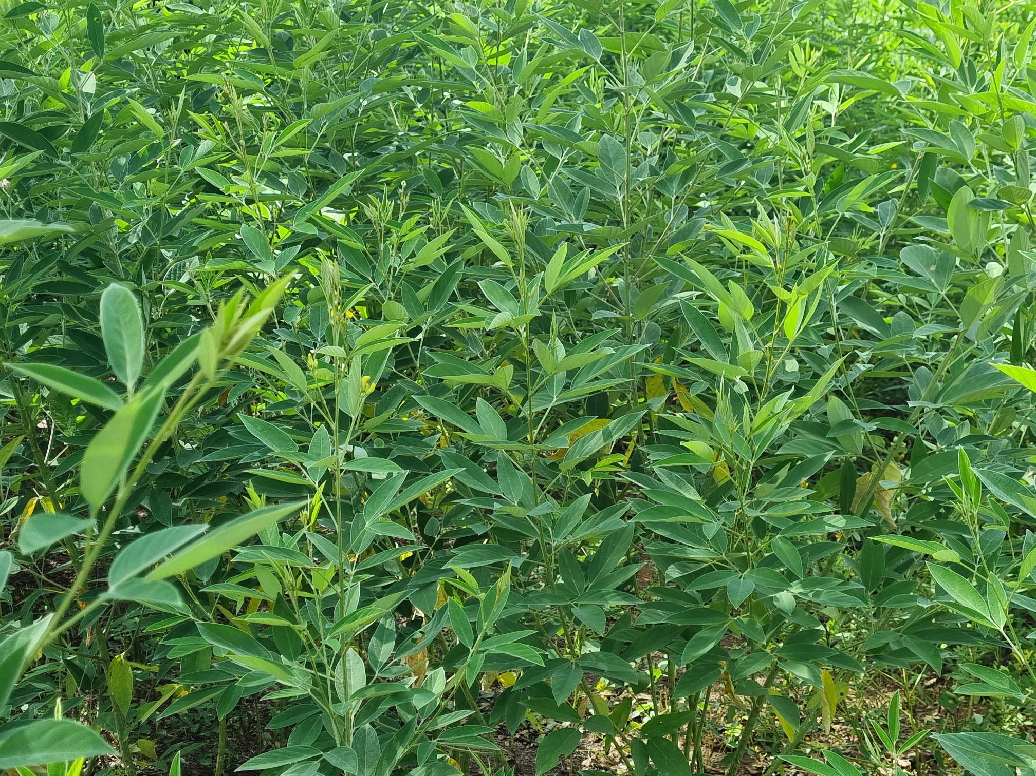
Bio – based technologies piloted in Ghana have been established at the SavaNet Agriculture Technology and Climate Change Research centre in Loagri in the North East Region of Ghana.
Bio – Based technologies piloted in Ghana are the small scale green biorefinery technology, Brazilian Kiln technology, and the Extruder pelletization technology. Various fresh and dry biomass e.g. cowpea, cajanus, groundnut husk, rice husk, and biorefined products were used as raw materials for production of livestock feed, biochar, and fish feed pellets.
These products were used to conduct field-based livestock feed trials, soil amendment trials, and fish feed trials. Laboratory analysis was conducted on biomass and products (biochar, fish feed pellets and biorefined).
Field based trials were conducted at various regions in Ghana: soil amendment trials in the Northern Region, animal field trials in the North East Region and fish feed trials in the Eastern Region of Ghana respectively.

Slide 4
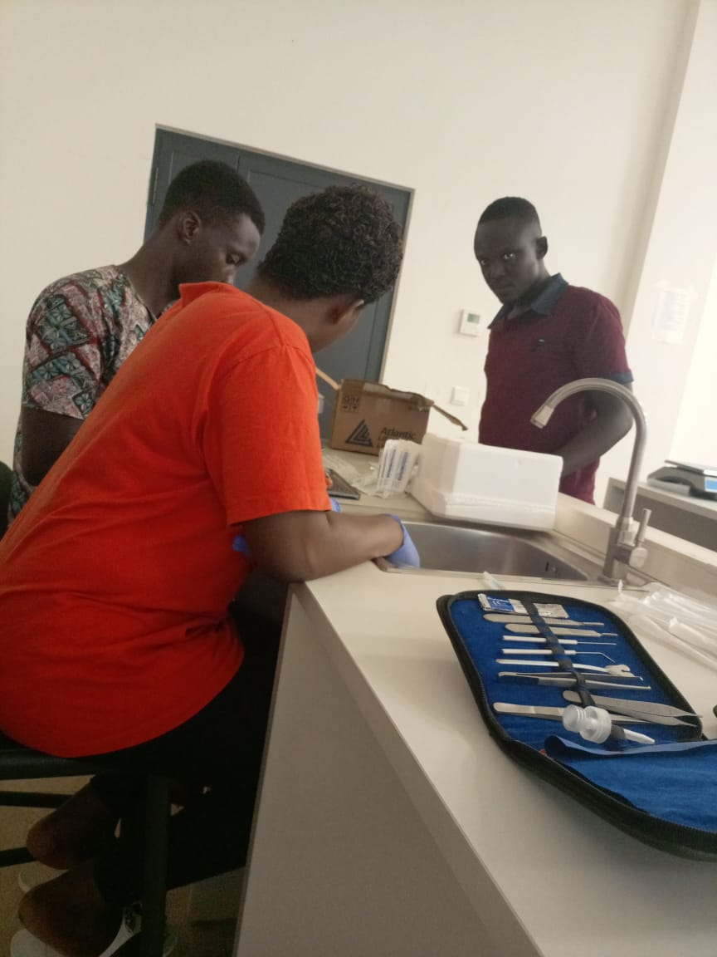
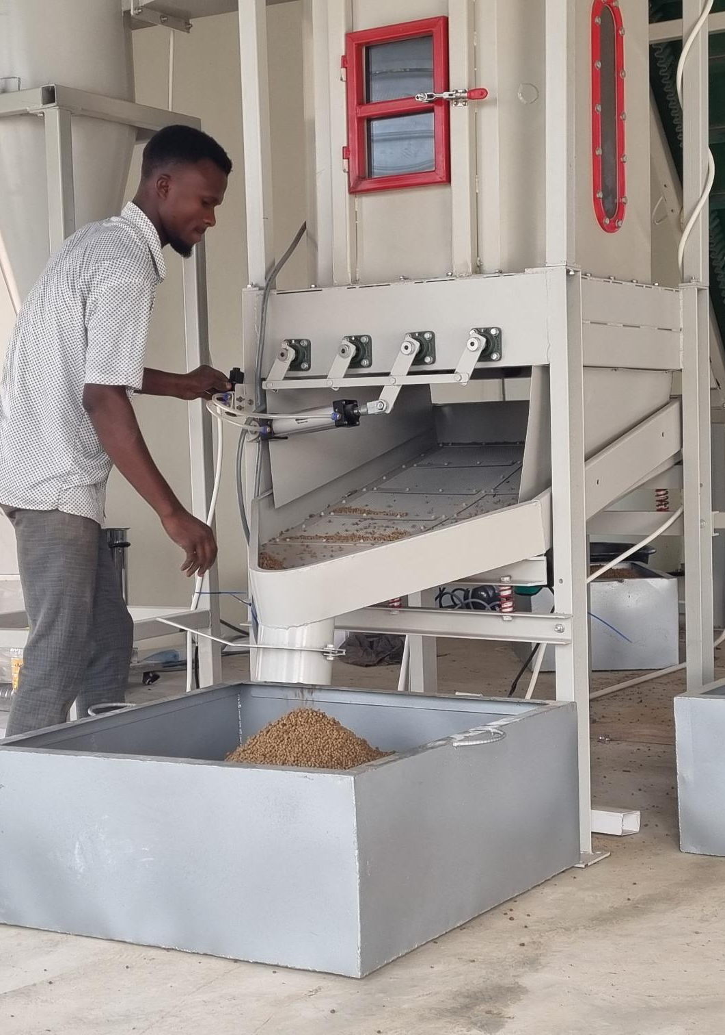
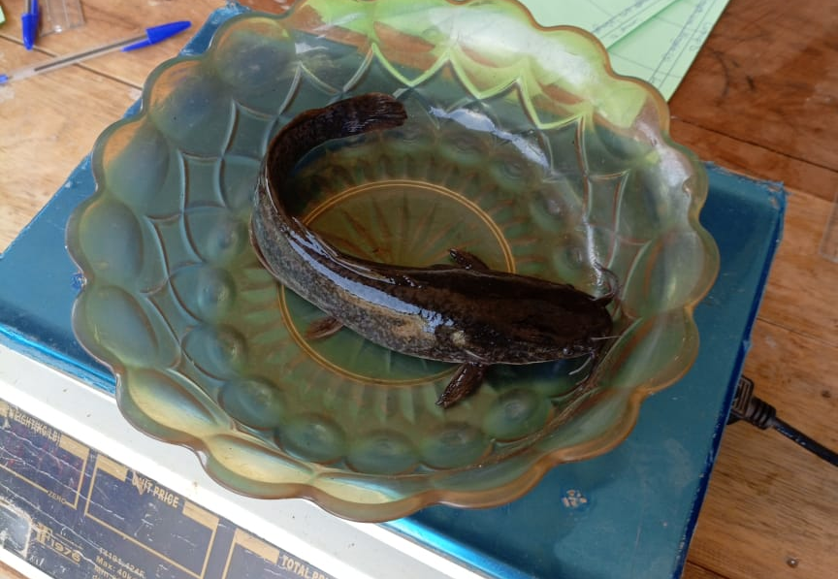

Slide 5
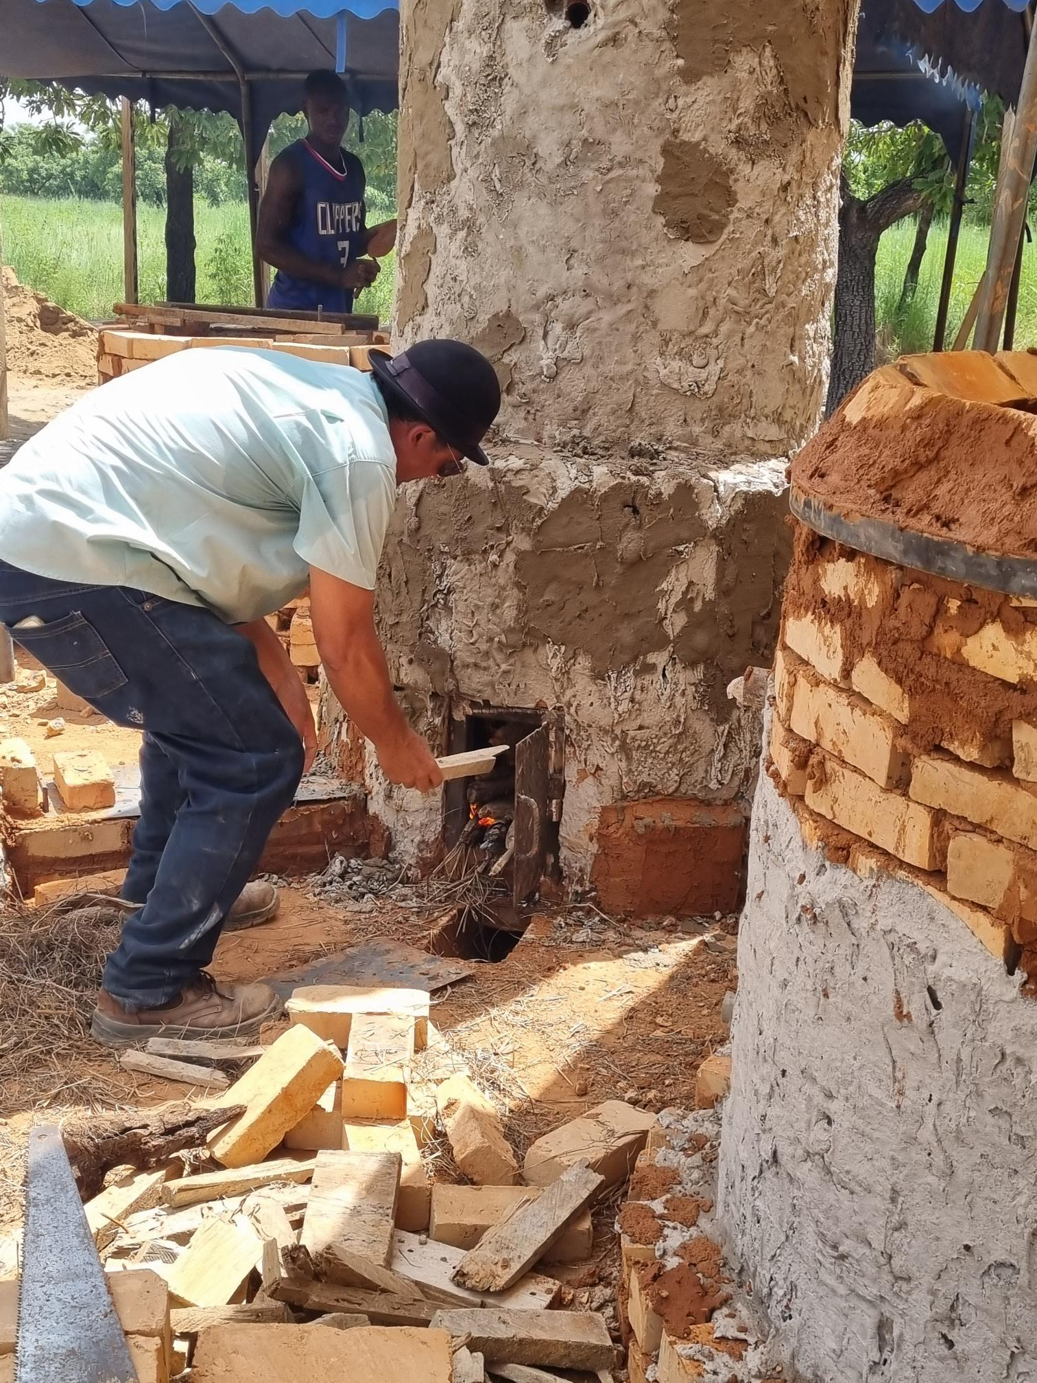
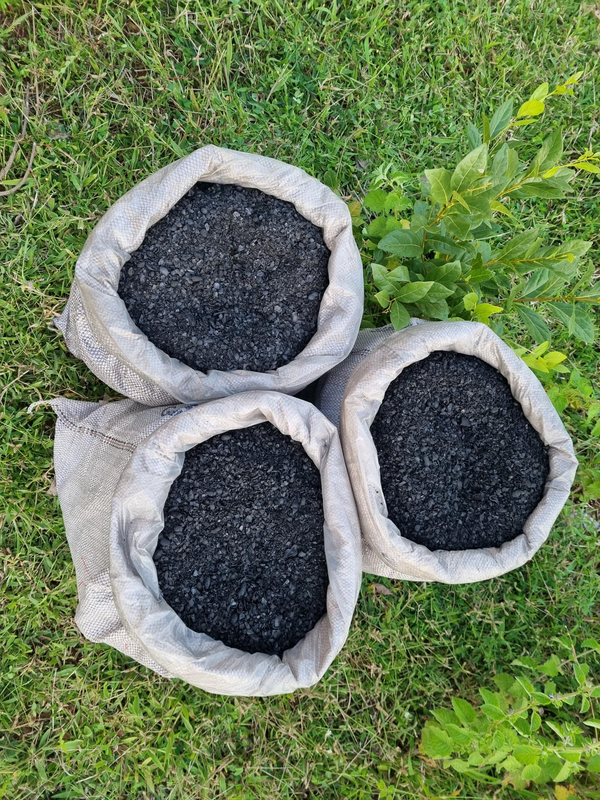
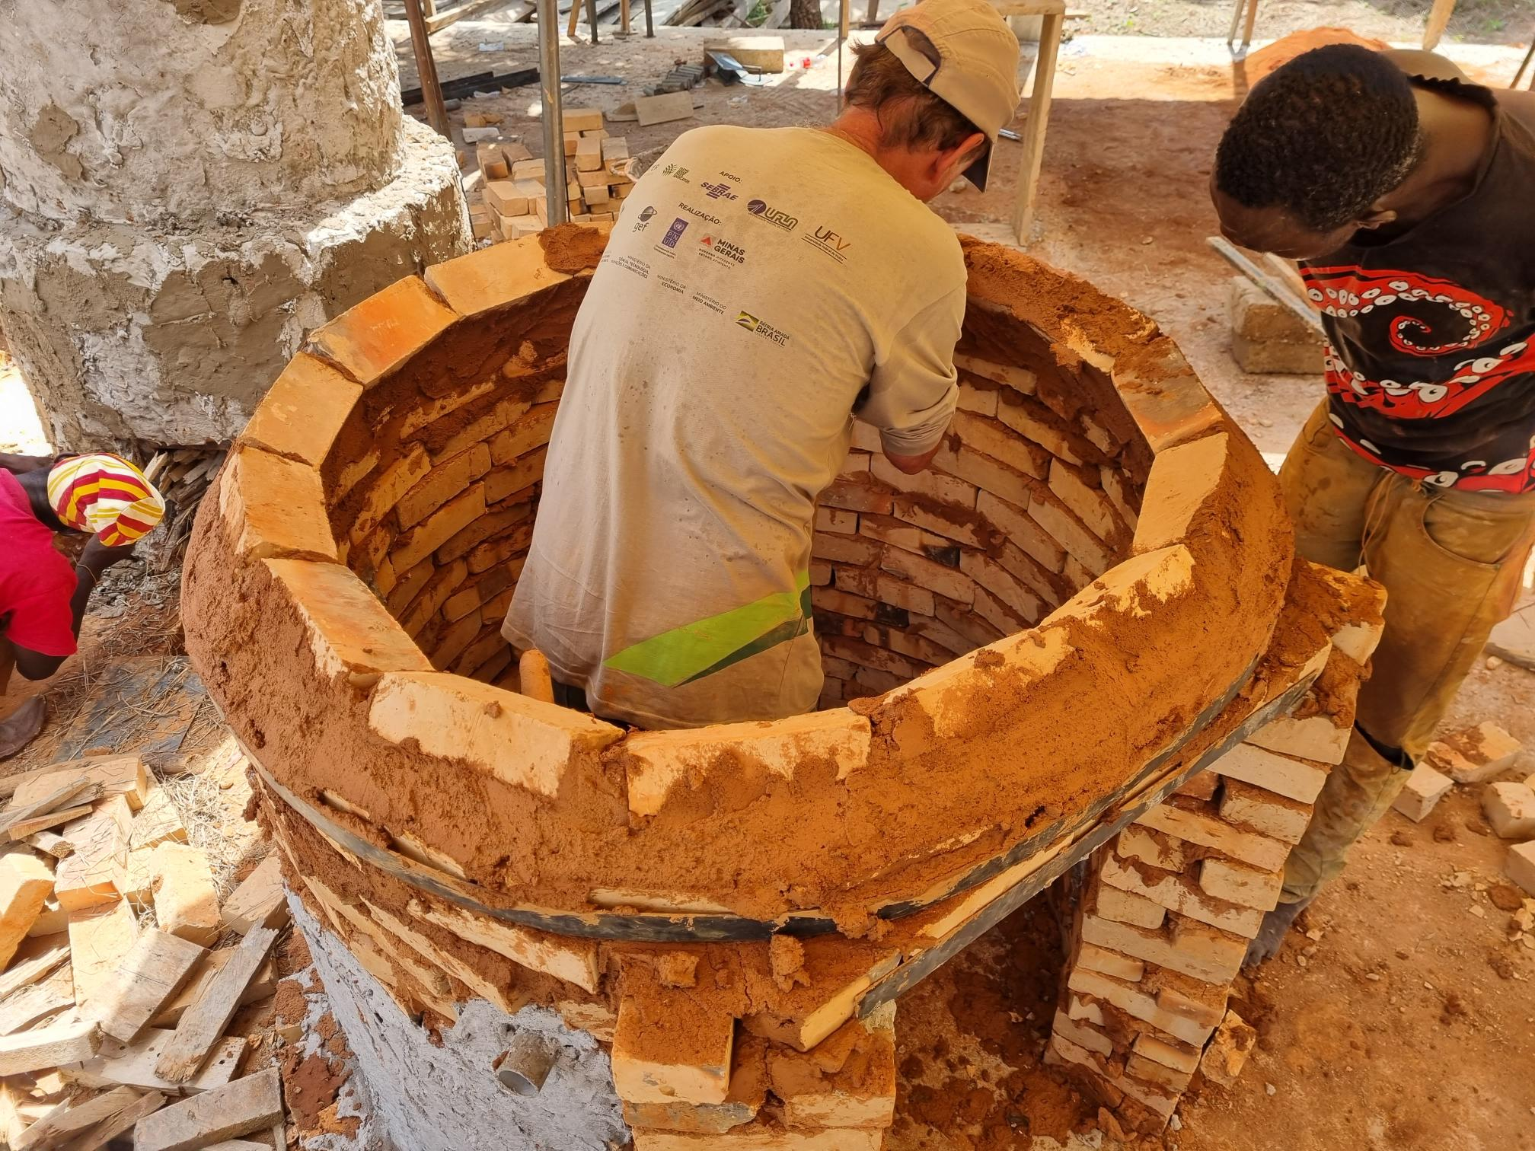
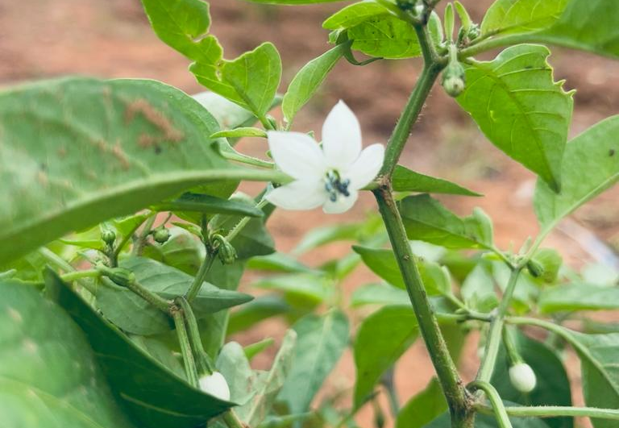
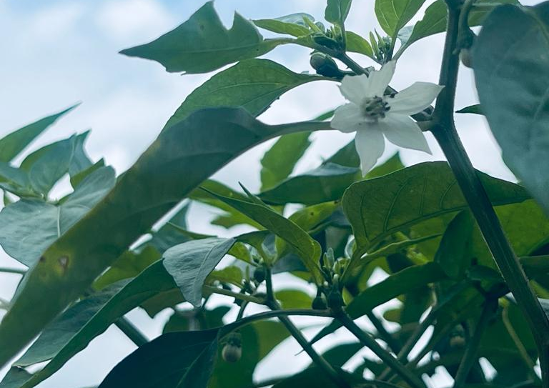

Slide 6
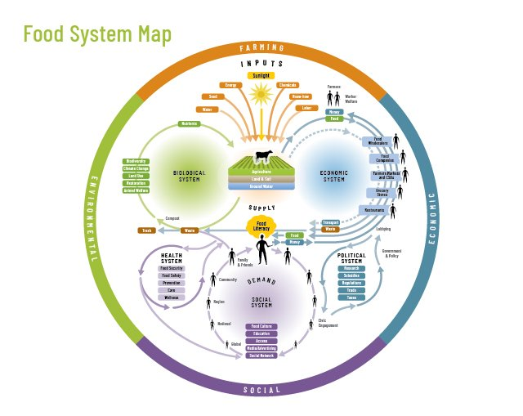
Bioeconomy Effects in Rural Ghana
Biomass – rich Ghana acknowledges the economic potential of the transition to a bio-based economy.
Bioeconomy has the potential of influencing the development of food systems in Ghana including the traditional food systems, transitional food systems and the modern or high-tech food systems; by increasing efficiency and sustainability in production, processing, marketing, consumption, etc.
The success of bioeconomy development hinges on the availability of, and access to appropriate technology within the agricultural and food subsectors. https://www.mamopanel.org/media/uploads/files/MaMo_Panel-Bioeconomy_Report-Ghana_Case_Study_gdbYLAF.pdf
Developing a sustainable bioeconomy requires adequate production and availability of biomass; thus, an increase in the availability of traditional cropping system is a significant precondition for the successful development of a bioeconomy.

Slide 7
Bioeconomy Effects in Rural Ghana
Increased Livestock production and reduced emission of Green House Gases – GHG from livestock production. Ghana meat import volume for 2424 was forecast at 234.4 thousand metric tons. Year – on – Year the forecast value shows incremental rise in 2025 by 2.23%. Green House Gas emission form livestock are projected to rise by 6% by 2033. https://www.reportlinker.com/dataset/9df35fdcb3795c8cafeebccec9a66eba9713655
Increased crop yield resulting in increased food and nutrition security and human security. On – farm biochar soil amendment vegetable trials by the Bio4Africa project indicate good impact of biochar in improving soil conditions and yield of vegetables (tomatoes, pepper and okro). The upper East, upper West, North East, and Savannah Regions of Ghana account for about 42.3% of Ghana’s projected food insecure populations. https://ghana.un.org/en/279825-united-nations-ghana-launches-joint-program-enhance-food-security-nutrition-and-resilience
Increased fish growth rate and Aquaculture development. On-farm fish feed trials using cowpea and Cajanus husk and protein ingredient indicate good impact on fish growth rate and reduced cost of feed in fish production.In January 2024 Ghana imported 927 fish shipment, this makes a year-on-year growth of 99% compared to January 2023. https://www.volza.com/p/fish/import/import-in-ghana/
The establishment and development of bio-based enterprises. Bio-based business models developed by the Bio4Africa project will provide Agriculture value chain actors the leverage to establish and grow profitable bio-based enterprises.
Promote Agroecology development in rural Ghana. The activities of the Bio4Africa project in Ghana has contributed significantly in protecting, restoring, and improving Agriculture and food systems in the face of climate shocks and stressors.

