Slide 1

Valorization of Agricultural Residues or Wastes into Biochar for a Circular Economy
Presenters name(s):
Affiliation : INP-HB
B4A Final Conference/BLP 2025,
28-30 January, Montpellier

Slide 2

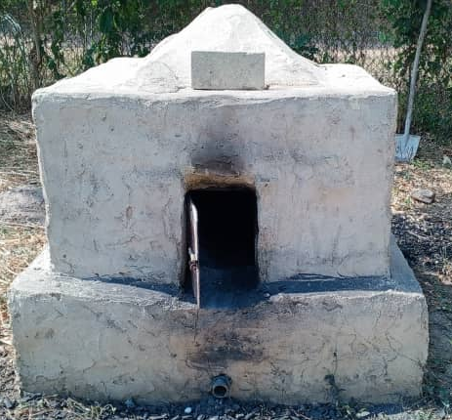

PRODUCTION OF BIOCHAR
SOIL AMENDMENT
WATER FILTRATION

Slide 3


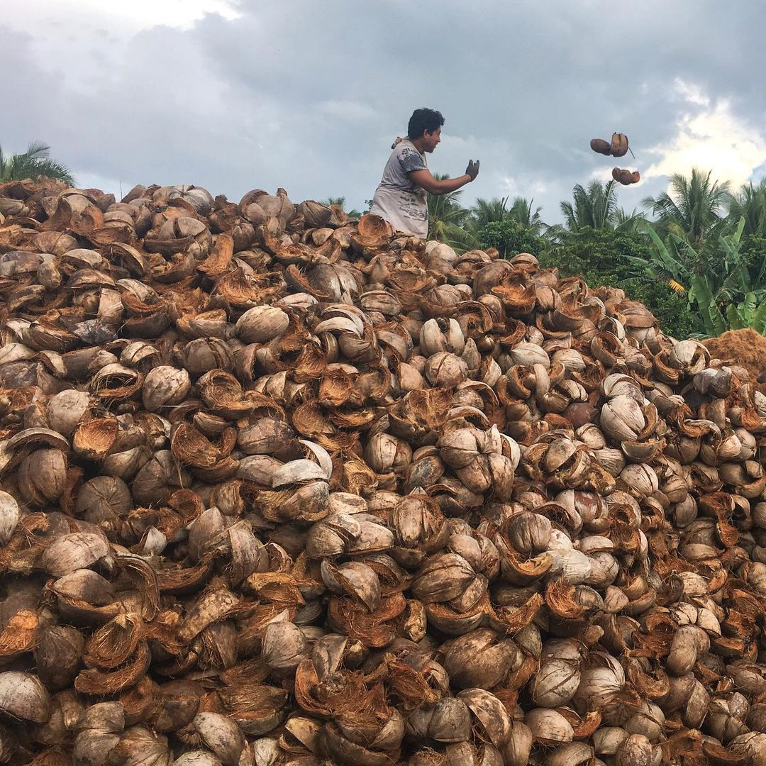

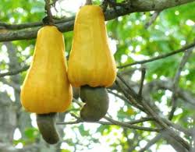
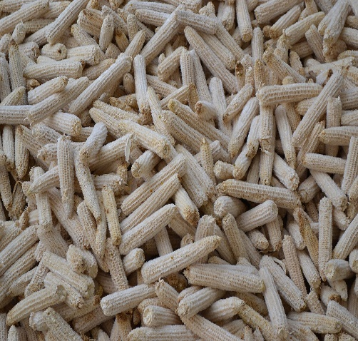
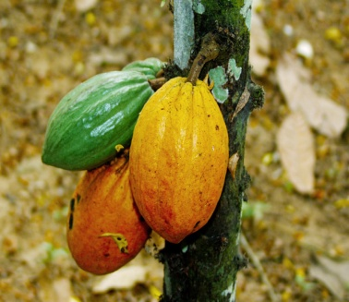
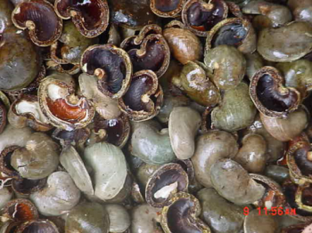


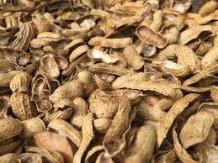
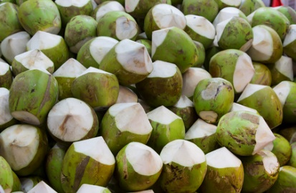
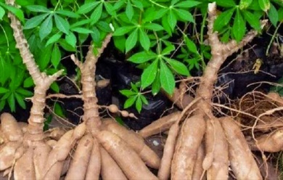
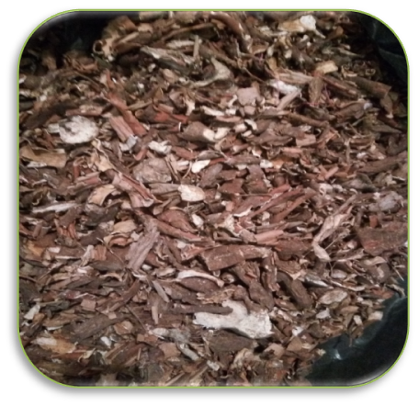
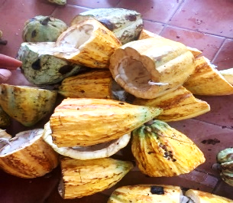
Productor in the word of
Cocoa and cashew
Agriculture wastes materials

Slide 4
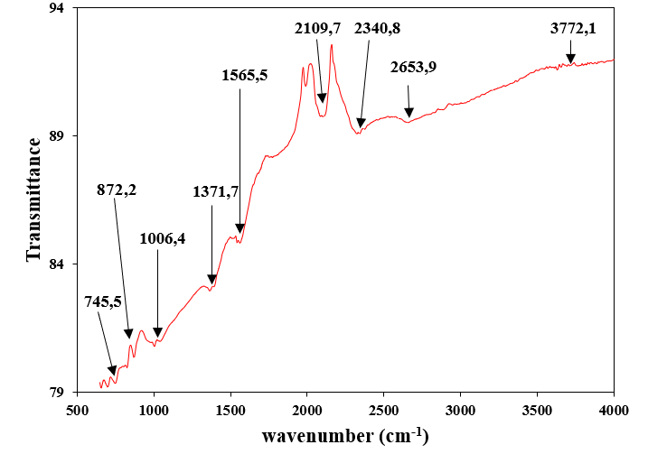
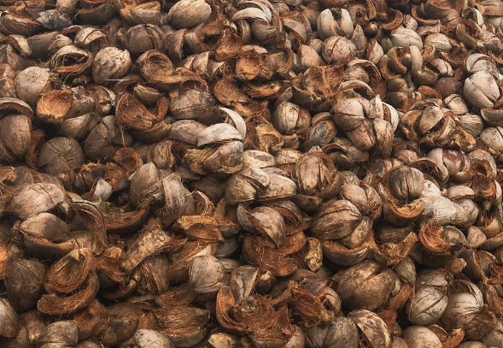
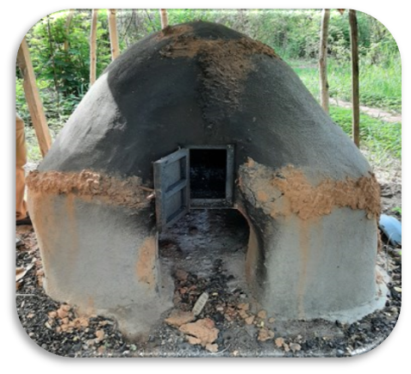
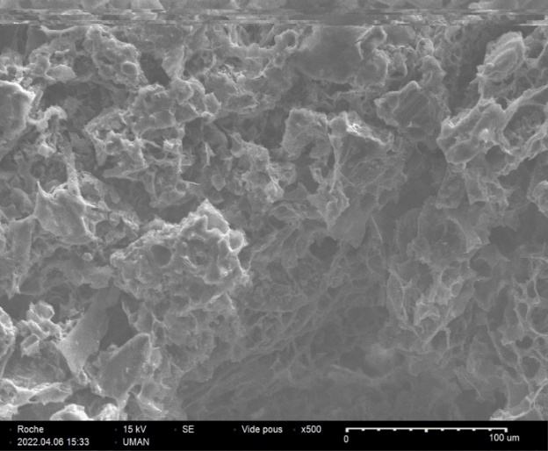
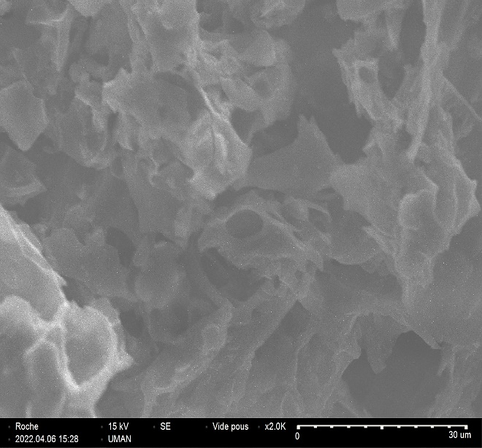
Raw materials
Chemical analysis
Elements | Values (%)
C | 76,65
O | 18,65
P | 0,26
K | 1,91
Ca | 0,30
Mg | 0,13
Si | 0,10
FTIR analysis
BET analysis
Specifique Surface (m²/g) | total Volume of pores (cm³/g) | Mean dameter of pores(nm)
341,11 | 0,80 | 1,44
Bresilen kiln
Biochar
Traditionnel kiln
SEM analysis

Slide 5
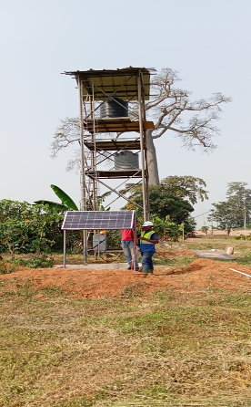
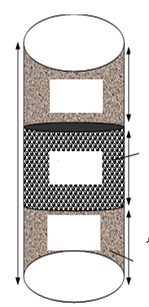
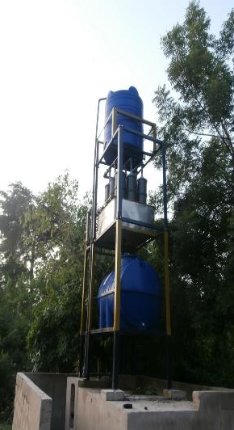
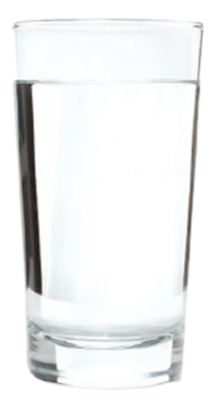
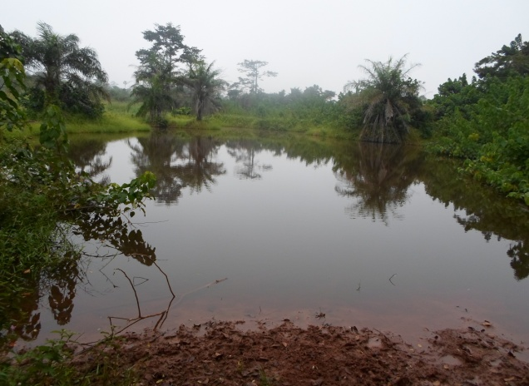

Water filtration
Rural area device in installed in the village of Dougba. Filtration tests will begin soon
Filtration tests on the INP-HB experimental site have been completed
 | Before Trait. | After Trait. | Before Trait. | After Trait. | Normes OMS
pH | 6,69 | 6,4 | 6,63 | 6,3 | 6,5-8,5 | -
DCO | 610,1 | 10 | 518,4 | 13 | 30 | mg/L
AMMONIAQUE | 0,49 | 0,19 | 0,21 | 0,16 | 1,5 | mg/L
SULFATE | 33,6 | 20,76 | 36,54 | 25,85 | 250 | mg/L
CHLORURE | 60,35 | 21,3 | 49,7 | 24,85 | 200 | mg/L
MES | 56 | 0 | 62 | 0 | 25 | mg/L
NITRATE | 69,35 | 3,11 | 57,54 | 3,6 | 50 | mg/L
Sand
Biochar
Sand
Treated water
River

Slide 6
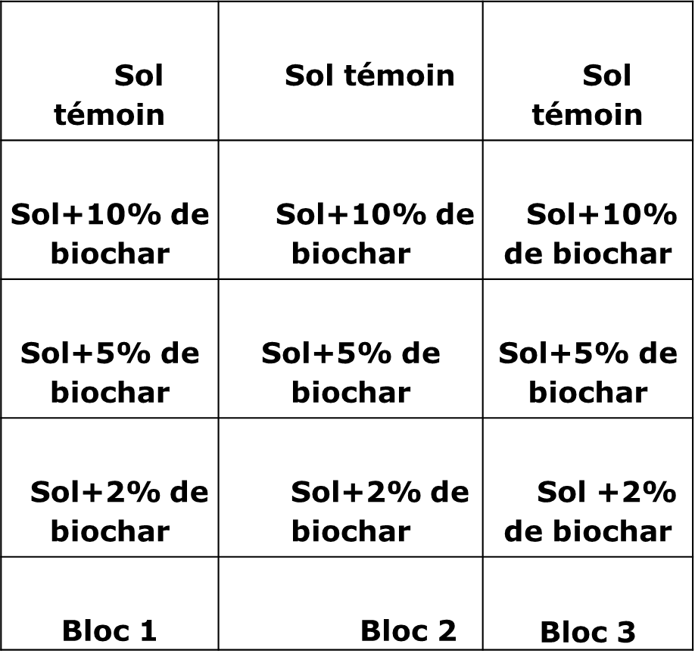
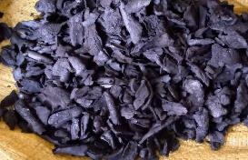
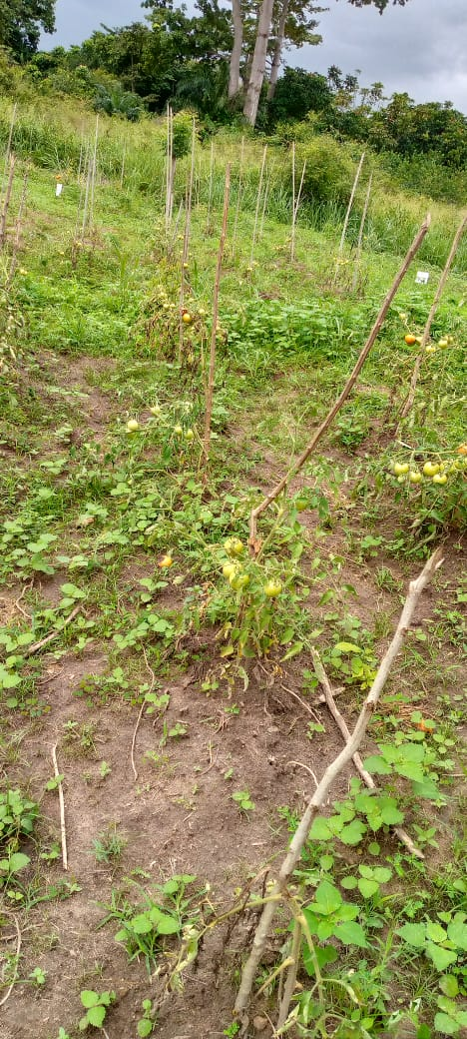
SOIL AMENDMENT
Evolution of the high of tomatos plants
Biochar soil amendment trials
Tableau XII: Rendement moyen de tomate en grammes(g)
 | 0% biochar | 2% biochar | 5% biochar | 10% biochar
Sol-K | 700±0,2 | 2836,7±0,7 | 1856,7±0,2 | 316,7±0,6
Sol-D | 733,3±0,5 | 1866,7±1,3 | 1600±1;0 | 168,3±0,6
Sol-Y | 220,3±0,7 | 840±0,3 | 658,3±1,2 | 136,7±0,5
Biochar
Biochar soil amendment trials in the farm

Slide 7
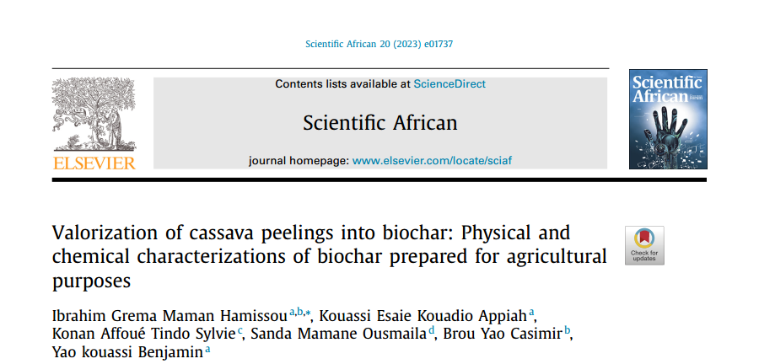
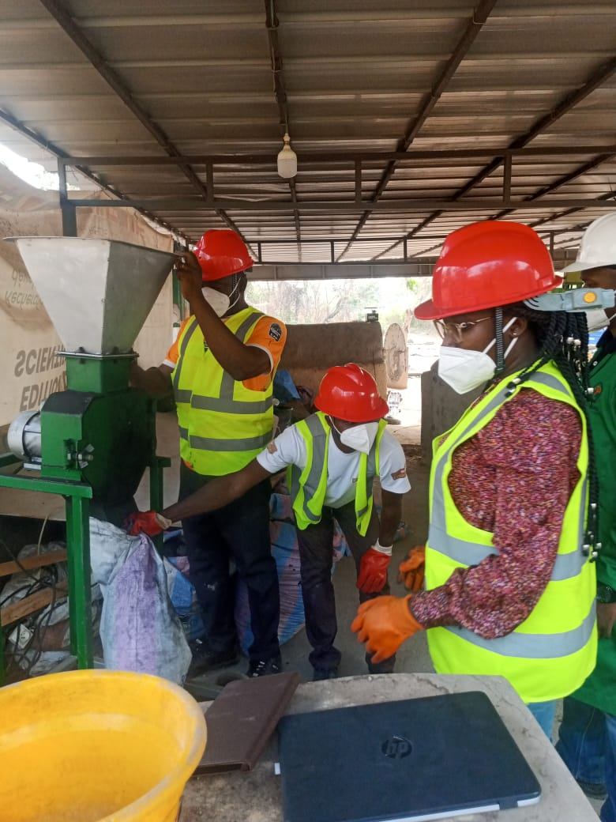
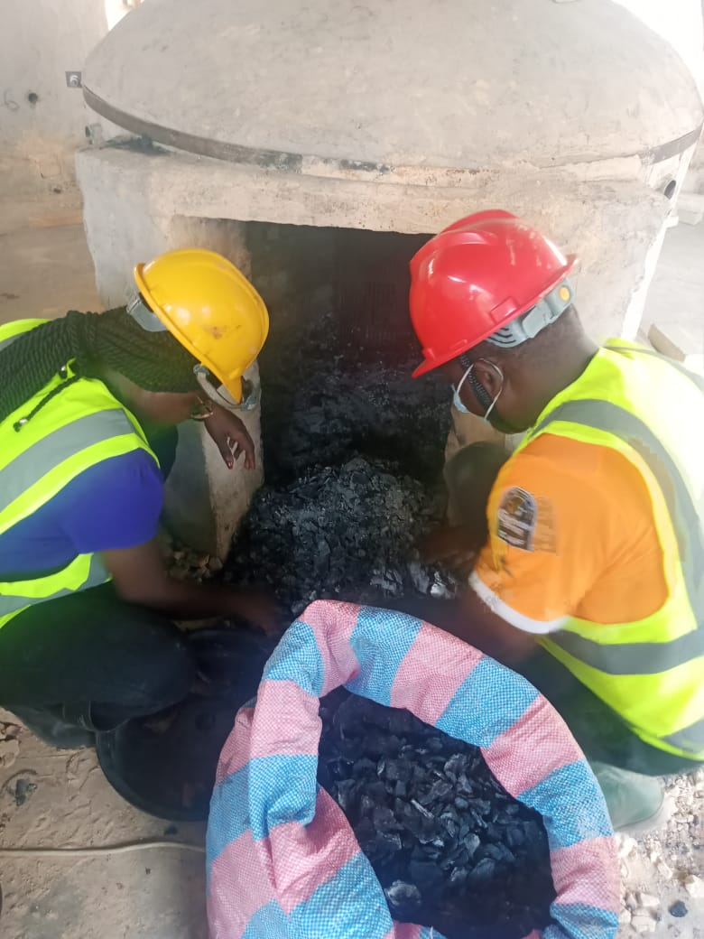
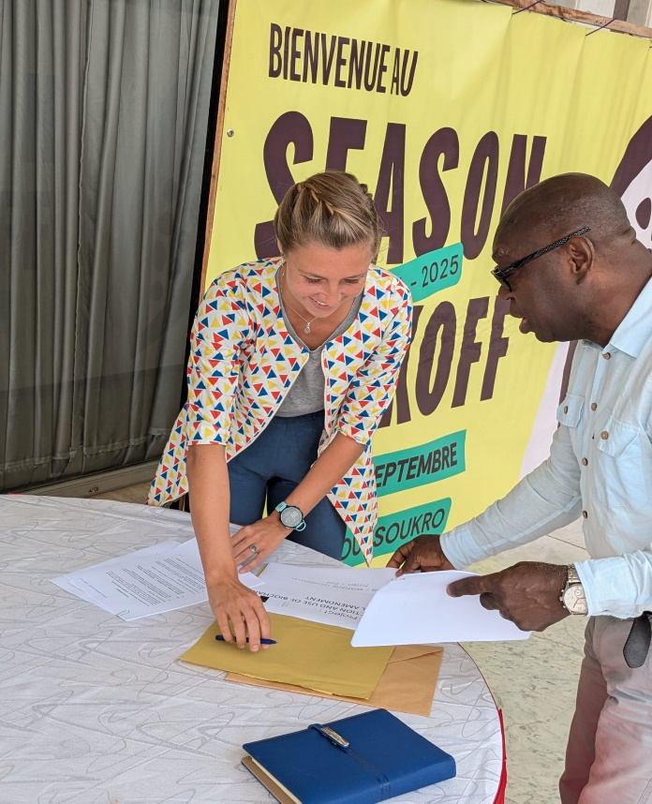
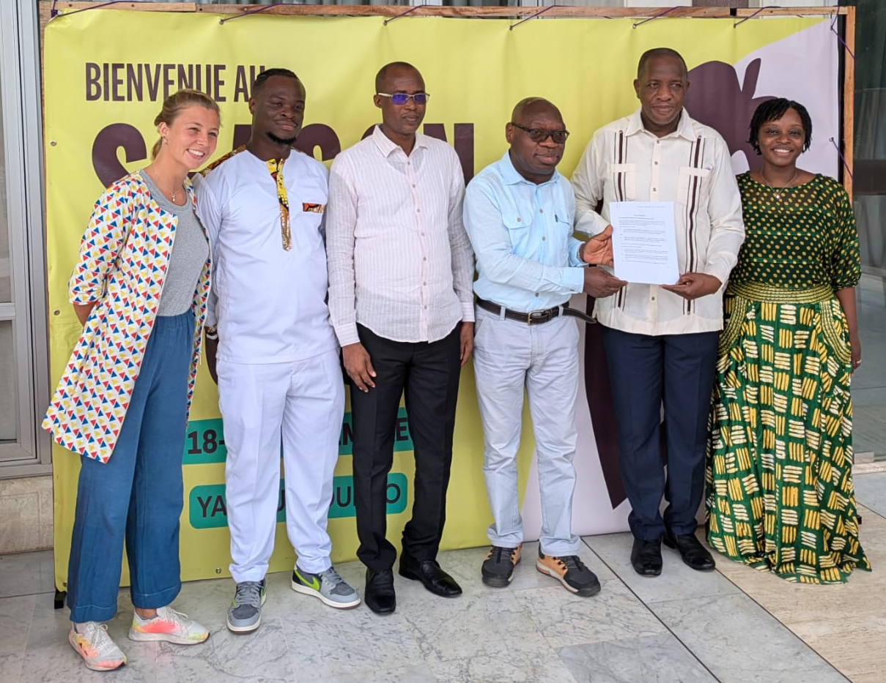
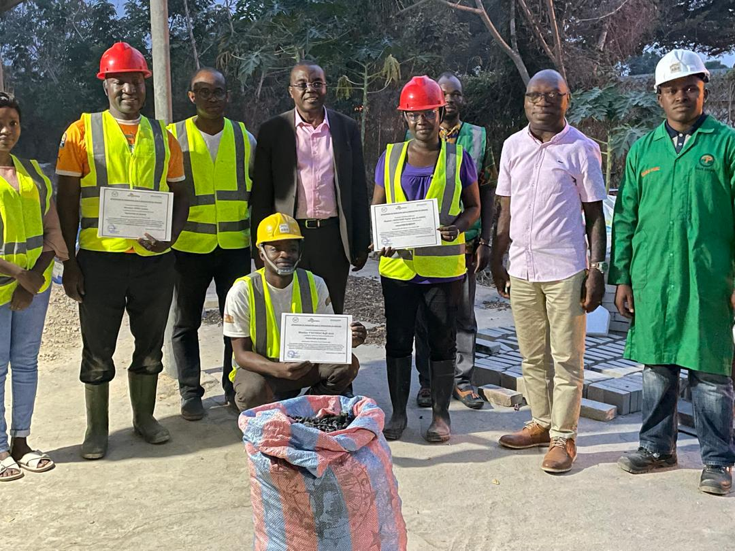
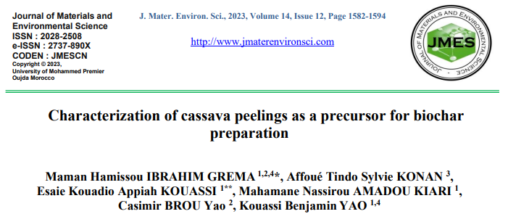
SOIL AMENDMENT
One pyrolysis kiln construction and Field soil amendment trials : to be implemented in cooperative Kapatchiva zone. Contract signed (see photos)

Slide 8
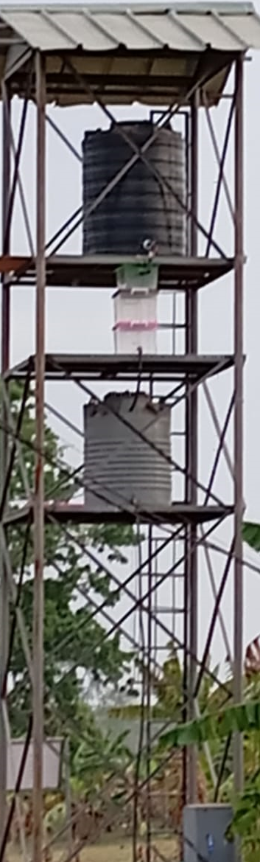


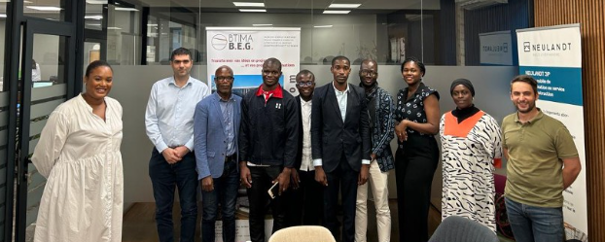



Water filtration

