Slide 1
A participatory exploration of the expected impacts of technological change on small and medium food-processing enterprises in Burkina Faso and Senegal
Bartolomei L., Blundo-Canto G., Diakhate P. B., Girard P. (2024)
BLP 2025 Conference Internationale
January, 29th 2025
Livia Bartolomei

Slide 2
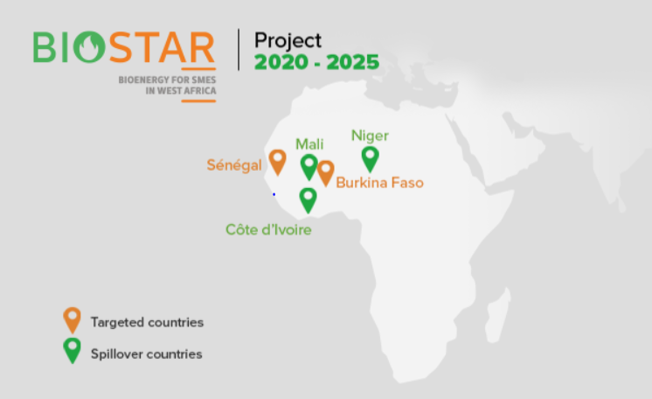
Biostar project
The main goal of Biostar: Investigating on the potential related to biomass conversion in bioenergy within rural areas of Western Africa (pilot sites: Senegal and Burkina Faso), focusing on Small and Medium-sized Enterprises (SMEs) that operate within the agro-processing sector along five food value chains (rice, cashew nut, peanut, mango and shea).
Source: Cirad 2020.
January, 29th 2025 I Livia Bartolomei

Slide 3
I. Research questions
Which will the potential actor reconfiguration be due to the bioenergy innovation(s) at Small and Medium Entreprise (SME) level?
Which are the expected changes in local perspectives related to changes in technology before the implementation?
January, 29th 2025 I Livia Bartolomei

Slide 4
II. Theoretical framework (1)
Innovation means converting an invention into actionable reality (Kashani and Roshani 2019) and consists of a multilevel process that goes through a combination of factors (i.e., its knowledge dissemination, the interdependecies and interactions among the actors, the role played by the institutions, and so forth) (Geels 2005).
process of translation (Callon 1984) where knowledge brokers (Boari and Riboldazzi 2014) play a key role
process of reconfiguration (Geels 2002) of user practices, network, infrastructures, etc.
January, 29th 2025 I Livia Bartolomei

Slide 5
II. Theoretical framework
Access to energy innovation technologies in West Africa is rather challenging because energy supply is expensive, unrealiable and irregular, especially in rural areas.
For food-processing SMEs, the re-introduction of their residues in the production process might spur positive effects such as:
Reducing fossil fuels and wood demand
Avoiding toxicity and pollution due to residues’ management and storage
Optimizing trasformation processes
January, 29th 2025 I Livia Bartolomei

Slide 6
II. Theoretical framework (2)
Localized Agrifood Systems (LAFs)
Multi-actor approach defined as the production and services entities connect to a specific territory by its characteristics (CIRAD-SAR, 1996).
Actor Network Theory (ATN)
Analysis of the set of interactions between actors as a connected network (Callon and Ferrary 2006)
Frequent application of the ANT to ICTs, just few to the enterprise context in Africa (Rhodes 2009)
Aimed at analyzing the spatial dynamics among:
Area (geographical proximity)
Collective action and knowledge exchange represent a necessary condition to move from geographical proximity to organized proximity (Fournier et al. 2018).
Institutions
Relations of trust among actors
Recent contributions about the ATN application to the analysis of food-processing enterprises:
Case study of rural women entrepreneurs in the shea-butter industry in Nigeria (Shitu and Nor 2018)
Case study of agro-processing enterprises in South Africa (Ramoroka 2019)
₊

Slide 7
Case study sites (1)
Agro-processing sector is relatively recent in both countries:
Senegal is experiencing growth in this domain from the adoption of Plan Sénégal Émergent (PSE) in 2014, under which several government policy programmes have been implemented: Projet de Zone de Transformation Agro-industrielle (PZTA) (2021-2025), Programme d’Appui au Programme National d’Investissement Agricole du Sénégal (PAPSEN) (2012-2023), and Programme Agricole Italie- Sénégal (PAIS) (2016-2023).
Burkina Faso has a longer tradition and the recent growth is due to government programmes: Programme Développement de l’Agriculture (PDA) (2022-2025) and Project d’Urgence pour le Renforcement de la Production Agricole au Burkina Faso (PURPA-BF) (2024-tbd).
January, 29th 2025 I Livia Bartolomei

Slide 8
Case study sites (2)
The two countries are simultaneously implementing energy transition programmes, by supporting sustainable and renewable energy generation projects such as the Parc Éolien Taïba Ndiaye (PETN) project, launched in 2020 in Senegal and the Plan d’Action National des Énergies Renouvelables (PANER), launched in 2015 in Burkina Faso.
January, 29th 2025 I Livia Bartolomei

Slide 9
Main characteristics | Senegal | Burkina Faso | Senegal | Burkina Faso
Share of gender of entrepreneurs in % | 69 women, 31 men | 37 women, 63 men | 88 women, 12 men | 26 women, 74 men
Share of SMEs that are members of professional/interprofessional organizations in % | 50 | 95 | 58 | 96
Share of SMEs that have proper access to energy in % | 56 | na (22 any, 17 employ wood) | 82 | na (56 any)
Processed quantity of raw materials in tons per year | 24892 | 23166 | na * | na*
Share of SMEs that commercialize products in % | 92 locally, 39 abroad | 80 abroad | 85 locally | 89 abroad
Quantity of residues released in tons per year | 79 | 811 | na ** | na**
Total of the preselected SMEs | 36 | 18 | 33 | 70
Case study sites (3)
Case study: pilot SMEs on the cashew nut and mango value chains in Senegal and Burkina Faso.
Data: census of pre-selected SMEs conducted in 2021 for cashew nut (Barry et al. 2022; Medah et al. 2022a) and mango (Mané et al 2022; Medah et al. 2022b) value chains.
* Mango fruit typically suffers 30-60% post-harvesting losses.
* * More than 60% if the mango fruit’s initial weight is lost during the drying process

Slide 10
Case study sites (4): The eight pilot SMEs
Name of the SME | Size | Localization | Urban/Peri-urban | Main activity | Type of residues produced | Existing technology | Innovant equipment carried out by Biostar
UTAS | Small | Sokone (Senegal) | Urban | Processing of cashew nut | Cashew and peanut nut shells | Wood-fired boiler aimed at nuts fragilization | Solarium + boiler for cashew and/or peanut nut shells fragilization
Santa Yalla | Medium | Nyassia (Senegal) | Peri-urban | Processing of cashew nut | Cashew nut shells | Steam boiler | Fireplace for cashew nuts shells combustion + steam boiler
Soprial | Medium | Bobo Dioulasso (Burkina Faso) | Urban | Processing of cashew nut | Cashew nut shells | Steam boiler for cashew nut shells combustion +steam dryer | Fireplace for cashew nuts shells combustion + steam boiler
Anasam | Small | Bobo Dioulasso (Burkina Faso) | Urban | Processing of cashew nut | Cashew nut shells | Steam boiler for cashew nut shells combustion | More efficient foyer and boiler
GIE Djiyito di Malanguene | Small | Zinguinchor (Senegal) | Urban | Processing of cashew apple/ fruits and nut | na | 2 ATESTA (Atelier d’Énergie Solaire et de Technologie Approprié) gas dryers | Fireplace for cashew nut shells combustion+ dryers with optimized cabins
Copex-Sud | Medium | Kataba (Senegal) | Peri-urban | Processing of mango fruit | na | 2 ATESTA gas dryers | Fireplace for cashew nut shells combustion
Agroburkina | Medium | Bobo Dioulasso (Burkina Faso) | Urban | Processing of mango fruit | na | 54 ATESTA dryers and 2 tunnel dryers | Fireplace for cashew nut shells combustion + dryers with optimized cabins
Paoline | Small | Bobo Dioulasso (Burkina Faso) | Urban | Processing of mango fruit | na | 8 ATESTA dryers and one tunnel dryer | Fireplace forcashew nut shells combustion + dryers with optimized cabins
Table realized by the author. Source: Barry et al. 2022; Blin 2024; Mané et al 2022; Medah et al. 2022a; Medah et al. 2022b.

Slide 11
III. Methods (1): Data collection
Focus groups were conducted (2022-2023) with each SME to better understand the network of actors with whom they interact for their economic activity and the expected impacts that technological change will generate.
Each focus group was carried out through three structured themes:
I. Mapping of external key actors on five type of linkages:
Raw materials supply
II. Identification of the key relations between the key actors and the SMEs by describing:
The artefacts around which relationships are built
III. Hypothesizing the potential impacts through the wheel of change, an adaptation of futures wheel (Glenn 2009) on three levels
Primary consequences
Funding
Commercial services
Agri-food processing equipment
Advisory, support, and training services
Period and frequency of interaction
Appreciation of the interaction
Reasons why
Members of the SMEs involved in the interaction
Secondary consequences
Tertiary consequences

Slide 12
III. Methods (2): Data analysis
Comparative analysis of the type of external actors who interact with the SMEs by highlighting the most frequent links and their characterization
Identification of the common actors by value chain and by country, by using Gephi 0.9.2 software
In-depth analysis of the relationships between the SMEs and the identified key actors, in terms of frequency, nature and drivers of trust that make a LAF efficient and successful (Fournier et al. 2018)
Identification of the expected consequences of the new technologies
January, 29th 2025 I Livia Bartolomei

Slide 13
IV. Results (1) – 1. Overview of the actor networks
Source: Focus group report for Senegal (Diakhate et al. 2023) and for Burkina Faso (Equipe R4-R2 2023)
Cashew nut value chain
Type of linkages | Senegal (UTAS and Santa Yalla) in % | Burkina Faso (Anasam and Soprial) in %
1. Raw material supply | 30 | 22
2. Agri-food processing equipment and maintenance | 10 | 8
3. Funding | 13 | 13
4. Commercial services | 17 | 35
5. Advisory, support, and training services | 27 | 22
79 actors and 96 linkages
47 actors and 74 linkages

Slide 14
IV. Results (2) – 1. Overview of the actor networks
Source: Focus group report for Senegal (Diakhate et al. 2023) and for Burkina Faso (Equipe R4-R2 2023)
Mango value chain
Type of linkages | Senegal (GIE Djiyito di Malanguene and Copex-Sud) in % | Burkina Faso (Agroburkina and Paoline) in %
1. Raw material supply | 29 | 30
2. Agri-food processing equipment and maintenance | 18 | 9
3. Funding | 5 | 7
4. Commercial services | 21 | 18
5. Advisory, support, and training services | 18 | 29
56 actors and 75 linkages
55 actors and 77 linkages

Slide 15
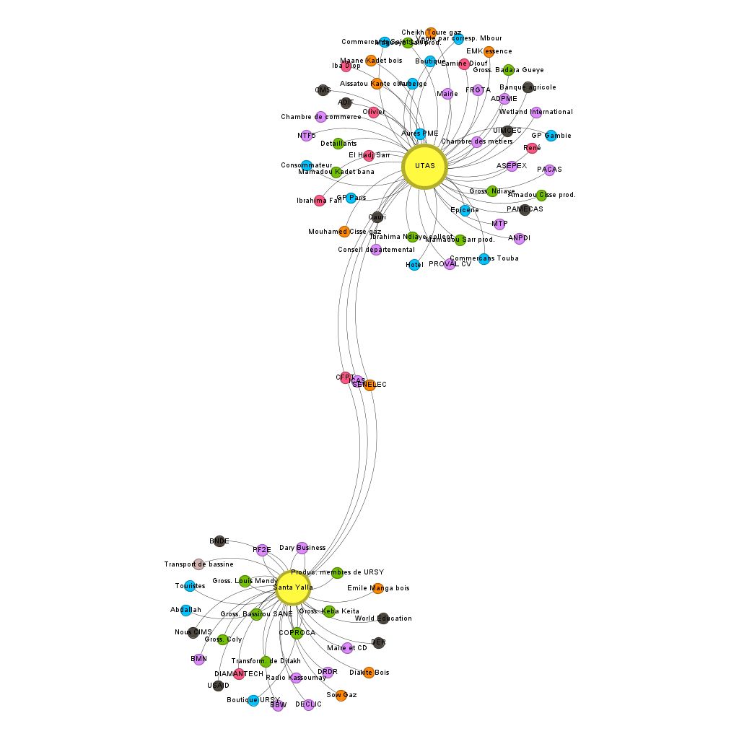
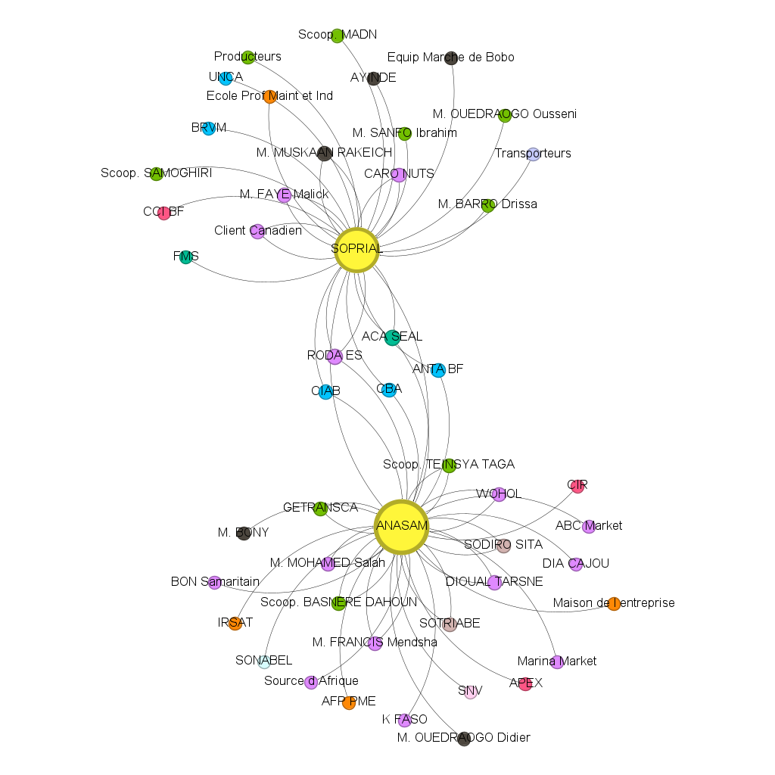
Network of actors in Senegal
Network of actors in Burkina Faso
Source: Networks of actors interacting with the two pilot SMEs within the cashew nut value chain in Senegal (Diakhate et al. 2023) and Burkina Faso (Equipe R4-R2 2023).

Slide 16
IV. Results (3) – 2. Characterization of the relationships with key actors within the network
Considering both value chains, the pilot SMEs identified 68 key actors with whom they built 90 relationships

Slide 17
IV. Results (4) – 3. Expected changes of the intervention through the wheel of changes
The eight pilot SMEs identified 172 expected consequences, of which:
70 are economic (increase in SMEs’ revenues)
61 are technical (increase in production capacity, judgement and/or reduction in utilizing fuel and/or gas, need to recruit and train skilled staff)
28 are social (reduction of occupational hazards, improvement of employees’ health conditions)
11 are environmental (reduced soil and air pollution)
1 is value (improvement of the SME’s image)
1 is political (avoidance of Ministry’s sanctions)
The perceived impacts were grouped to reduce the number of outcomes, allowing us to draw a common wheel of changes for each value chain by employing the wheel of change, an adaptation of futures wheel (Glenn 2009) Hypothesizing the potential both cause-effect and cross-linkages of an innovation allows to stimulate participants to identify and diagnose a group’s collective thinking about the future

Slide 18
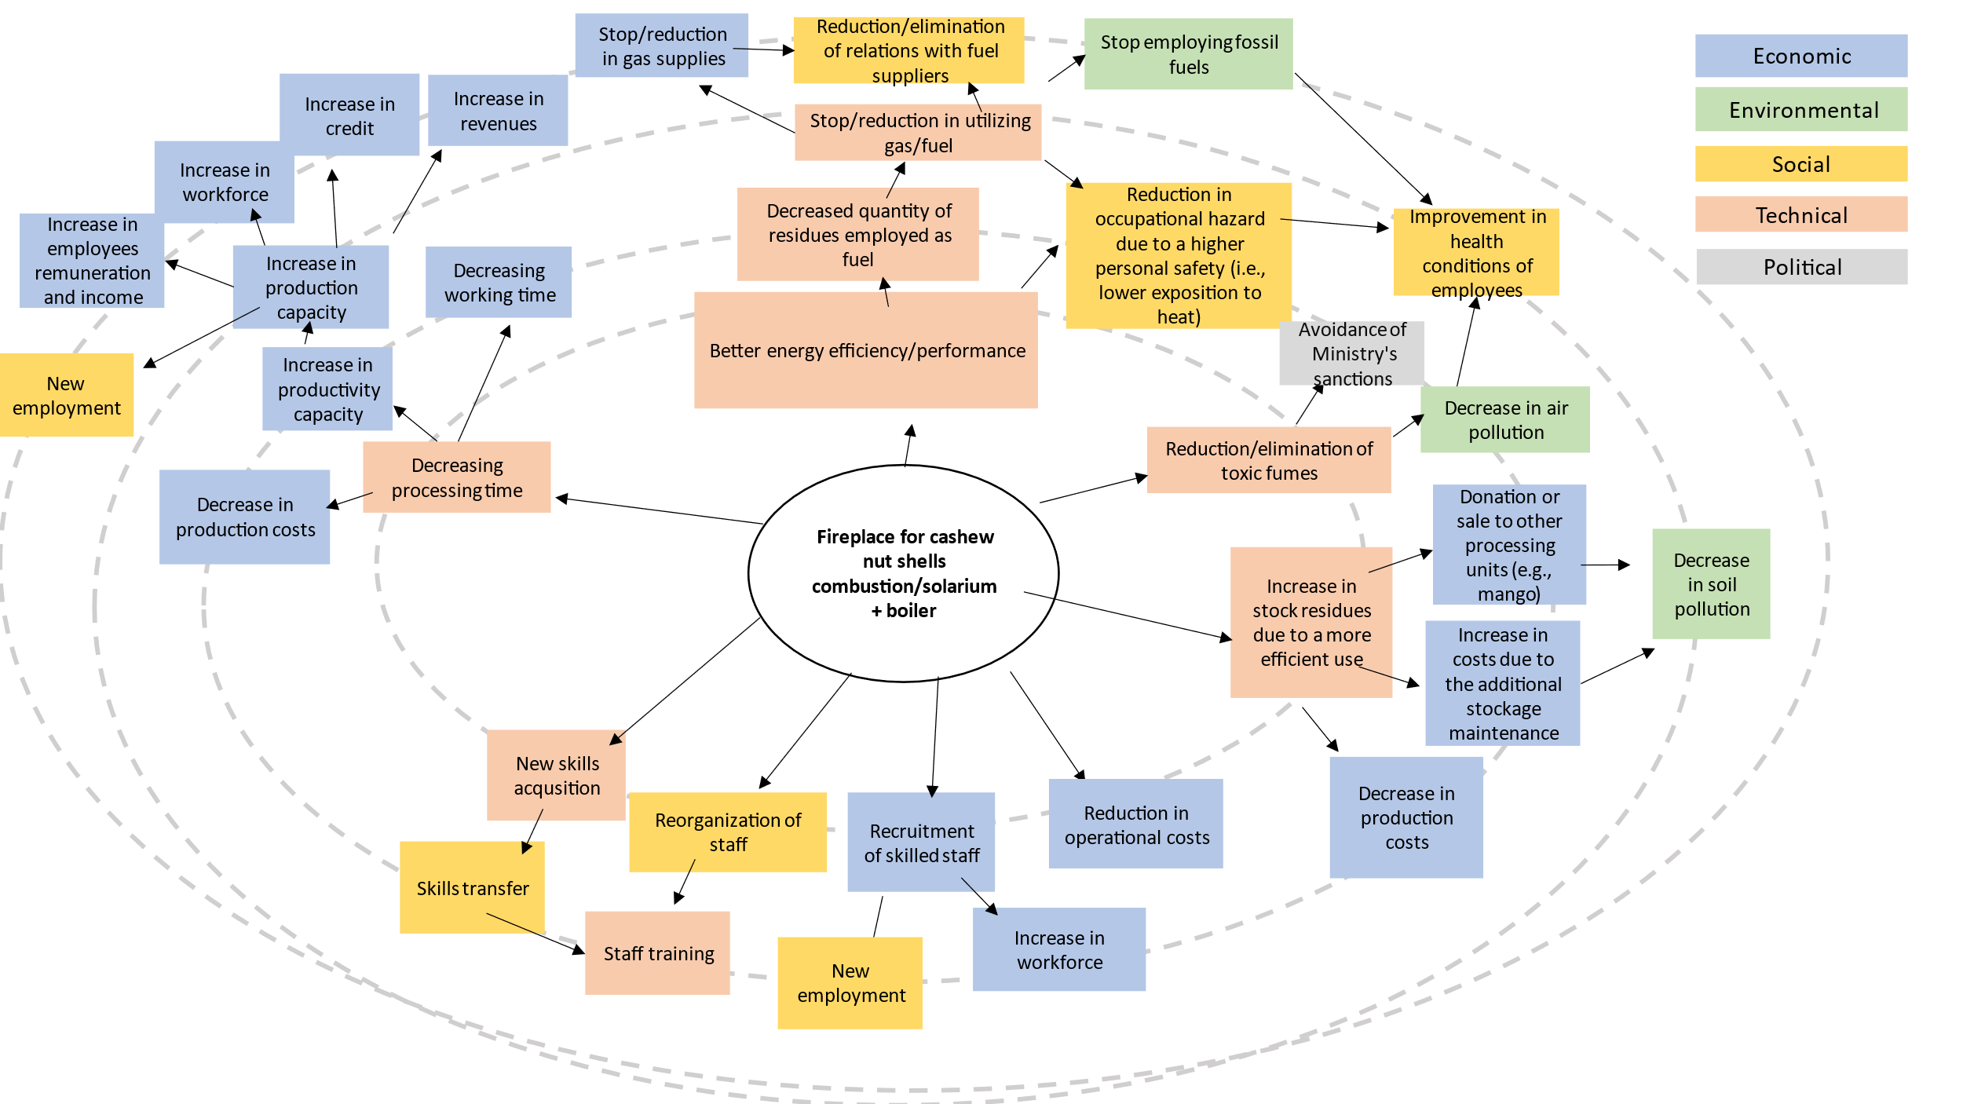
IV. Results (5) – 3. Expected changes of the intervention through the wheel of changes

Slide 19
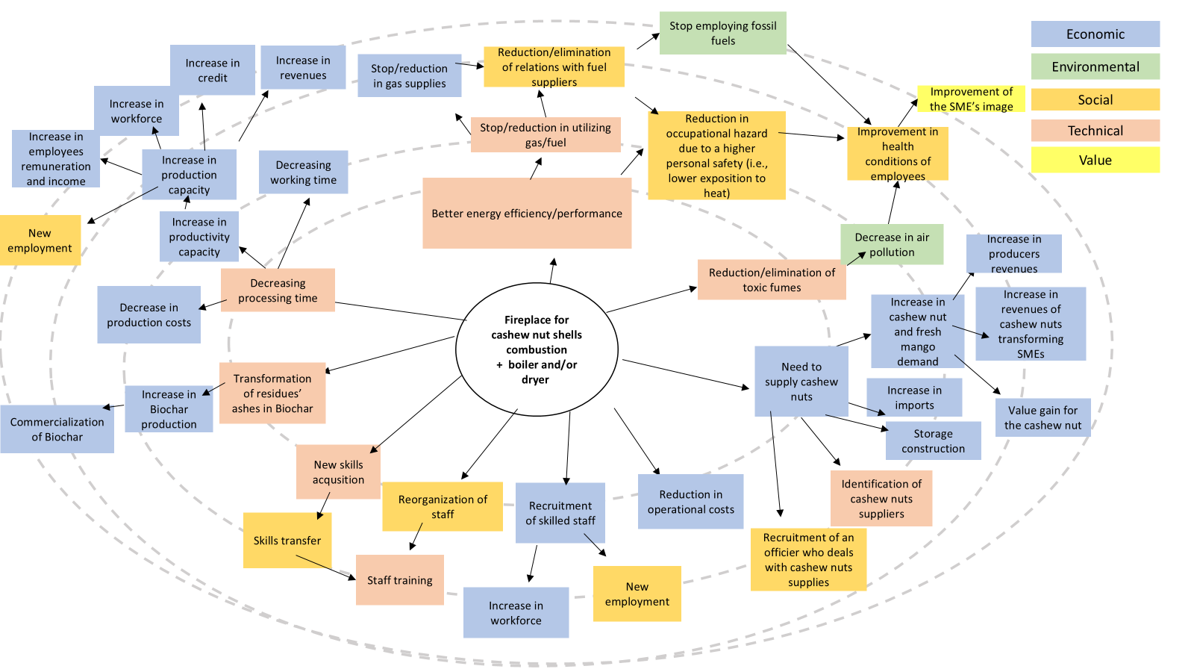
IV. Results (6) – 3. Expected changes of the intervention through the wheel of changes

Slide 20
V. Discussion
Limitations: impacts are not tangible and actor-network reconfiguration might be solely projected at this stage upon the introduction of the new equipment, it is recommended to rearrange focus groups to ascertain whether the actual consequences diverge from the expected outcomes.
ATN is a tool in evaluating networks networks strenght strongly rely on alliances (Rhodes 2009) and social dynamics in regard to the introduction of an innovation, by highlighting the crucial role played by the interactive learning (Ramoroka 2019).
January, 29th 2025 I Livia Bartolomei

Slide 21
VI. Conclusions
The most frequent linkage in both value chains and in both countries is that related to advisory, support, and training services.
The average level of satisfaction of the SMEs towards the relations they build with the identified key actors is satisfying most appreciated features of the interactions: trust and reliability
The expected effects are uniform. The main network reconfiguration is going to affect mostly the raw materials suppliers in mango value chain, the providers of advisory, support, and training services, and those actors who deal with equipment supply and maintenance.
Focus group technique represents an interesting tool for analyzing the state-of-the-art of the socio-organizational environment before an implementation. This tool might help policymakers in developing and enriching their awareness of an intervention setting, making the intervention more targeted and in line with the needs of those who will receive that intervention itself.
January, 29th 2025 I Livia Bartolomei

Slide 22
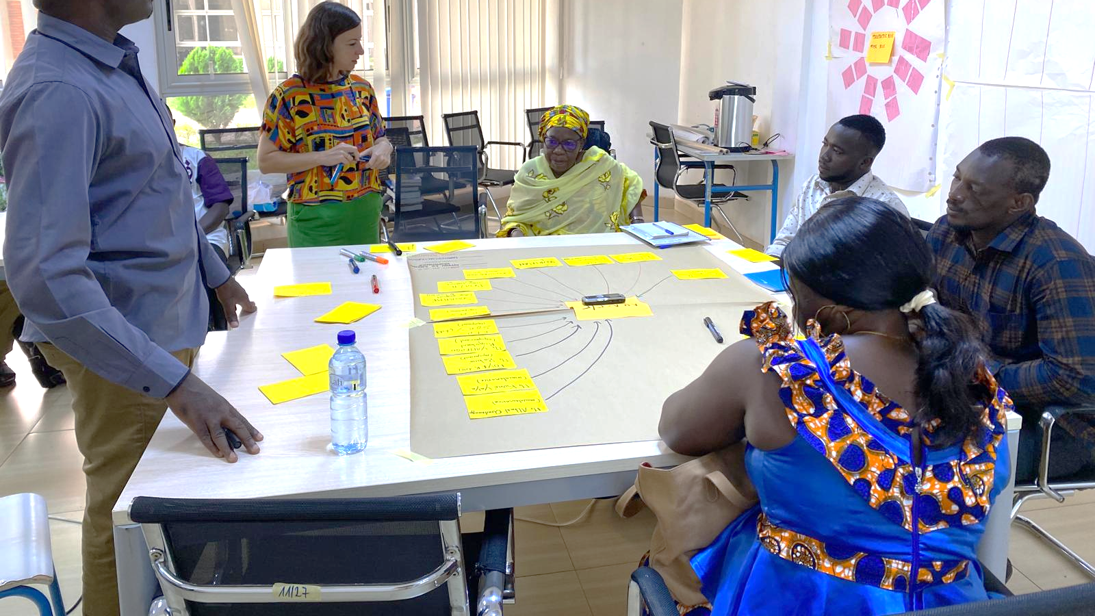
Thank you for your attention!

