Slide 1

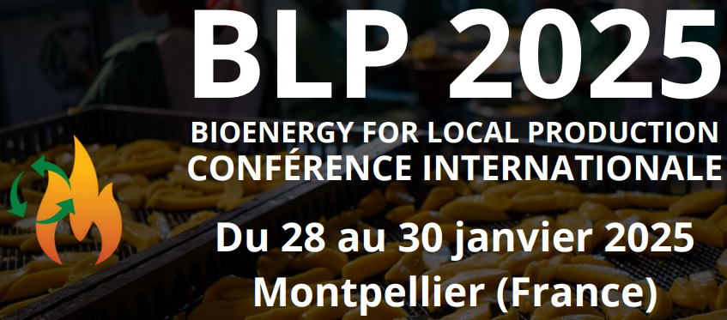
Pyrolyse de résidus agricoles dans un procédé Brésilien
Presenters name(s): P Rousset, L G Ndiaye, M N Tia, B Yao, JM Commandré
Affiliation (s): Cirad, INP-HB, Savanet, UASZ
B4A Final Conference/BLP 2025,
28-30 January, Montpellier

Slide 2
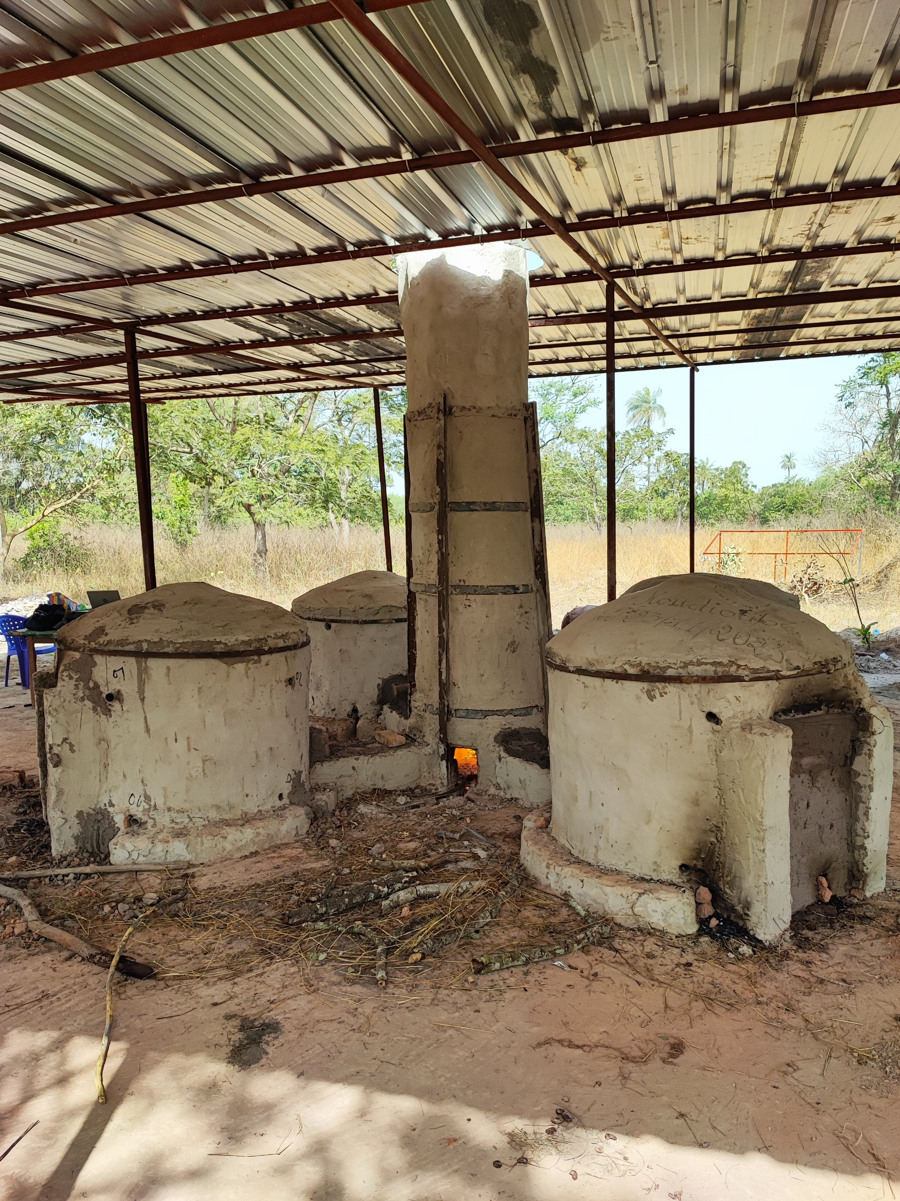
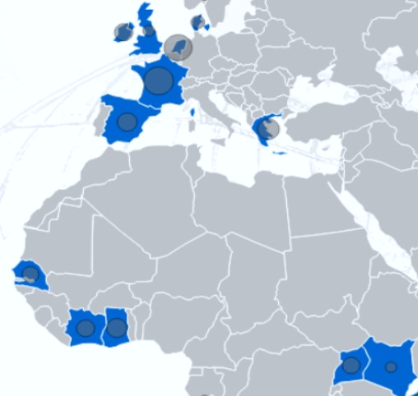
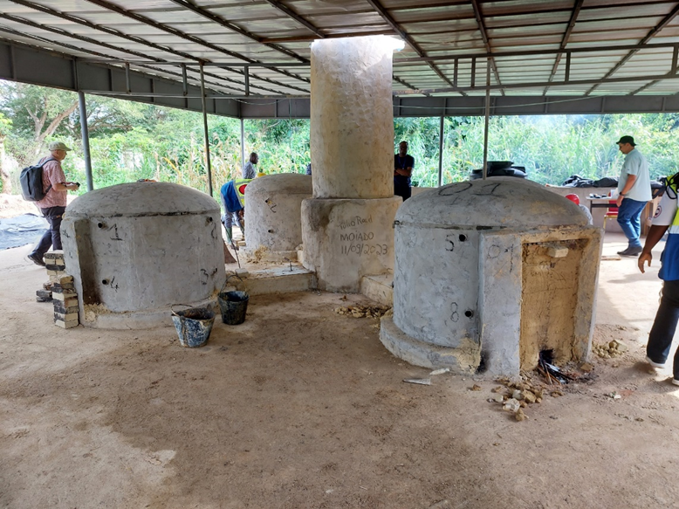
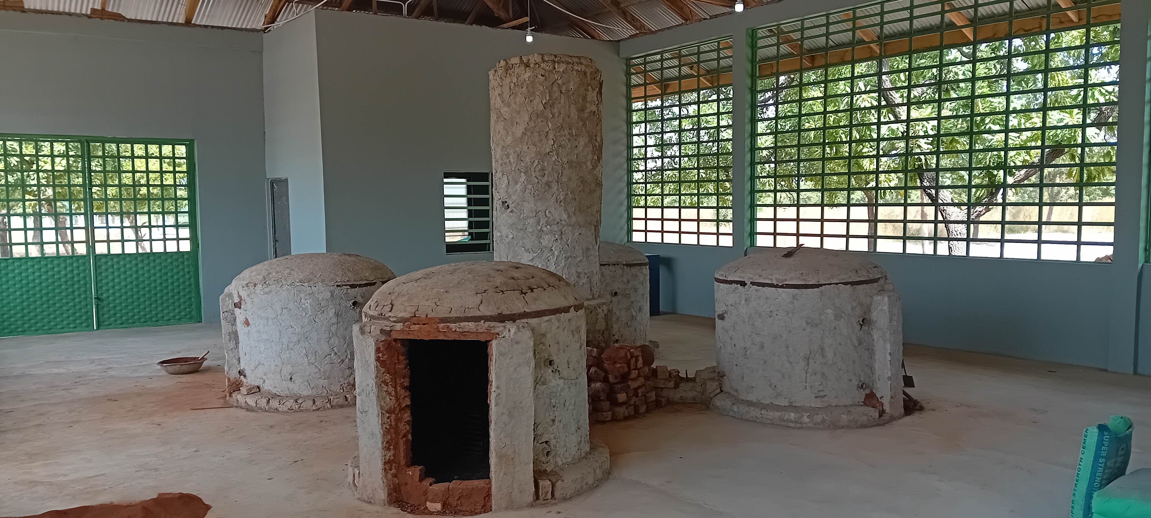
Brazilian kilns : set up at a glance
UASZ (Sénégal)
INP-HB (Côte d’Ivoire)
SAVANET (Ghana)

Slide 3


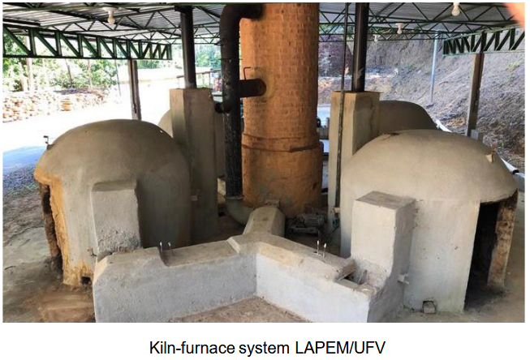


Why the Brazilian kilns selected in B4A?
LAPEM develops research, and extension activities in the areas of Bioenergy
Engineering Services
The Sustainable Steel Industry Project was created to:
encourage the reduction of greenhouse gas emissions in the Brazilian steel industry.
developp cleaner and more efficient production technologies
offer a technology to small and medium-sized rural producers

Slide 4
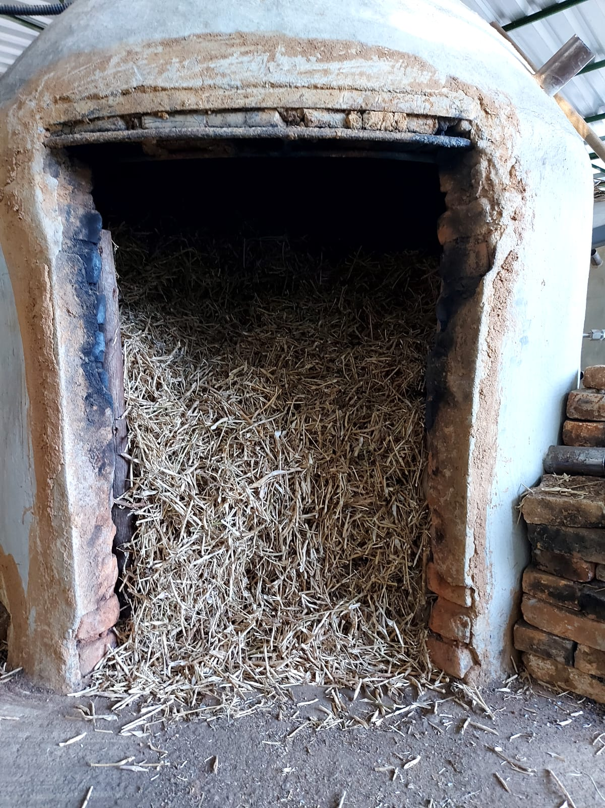
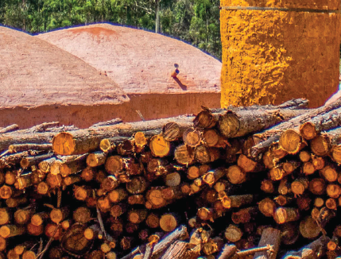
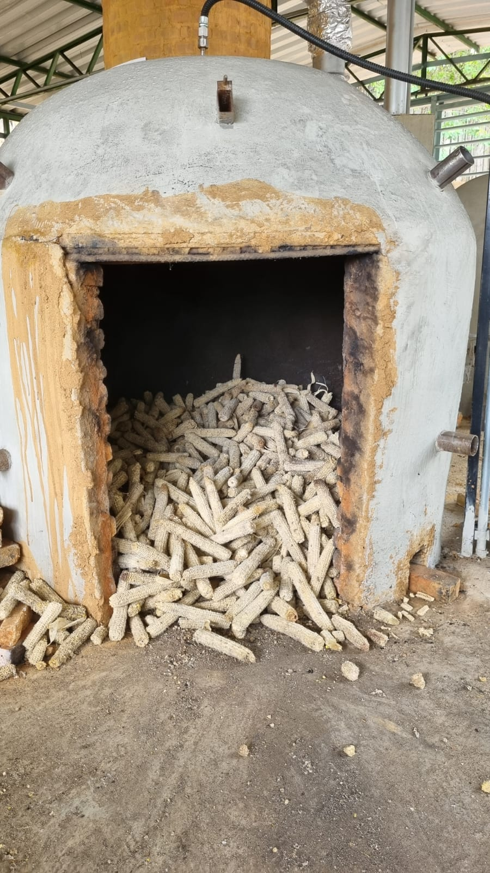
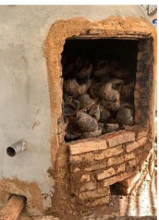
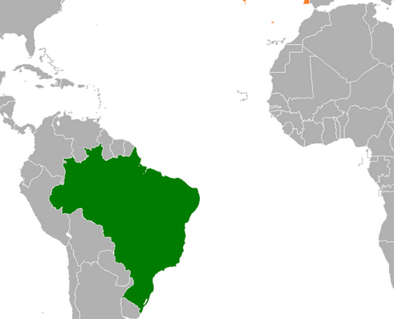
Brazilian kilns: Challenges for B4A
Straw
Replace wood with agricultural residues that have very different physicochemical properties.
Transfer the technology with the support of Brazilian universities.
To size the furnaces according to local contexts.
Find the necessary materials for furnace construction in each concerned country.
Create infrastructure
Train operators.
Ensure remote maintenance.
Duplicate and disseminate the technology at low cost.
Peanuts
Rice husks
Ground nut husk
Cashew nuts
…
Corn
Coconuts
Wood

Slide 5
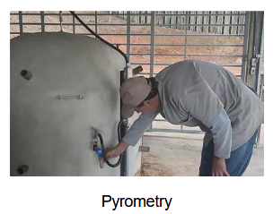
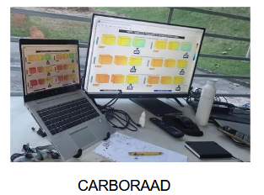
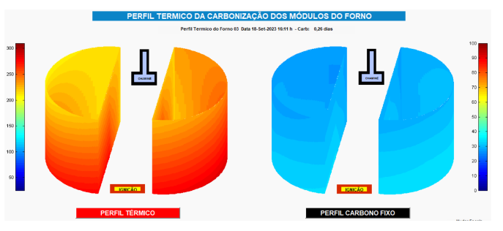
Brazilian kilns : Transfer method adopted in B4A
Contact with Labem and explanation of the B4A project.
Sharing data on the biomass selected in B4A.
Carbonization test at Labem using similar biomasses.
Definition and optimization of pyrolysis operating conditions (biomass size, temperature, duration, etc.)
Characterization of the produced biochars (proximate analysis).
Calculation of mass yields.
Transfer of data to partners.
Acceptance by African partners.
Preparation for technology transfer.

Slide 6
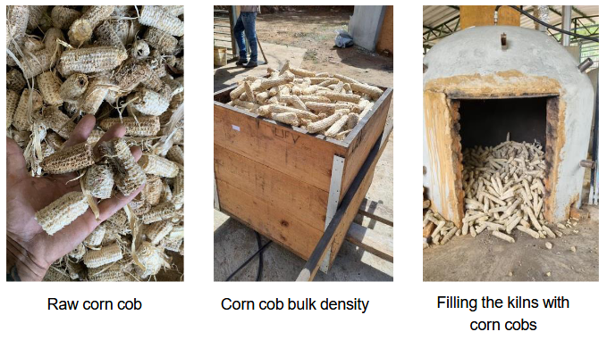
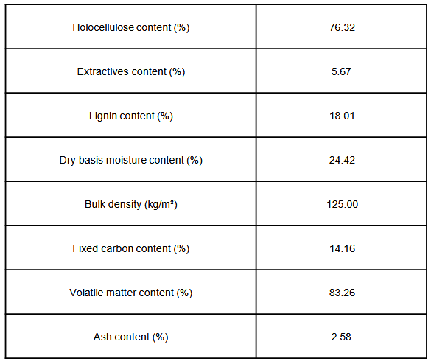
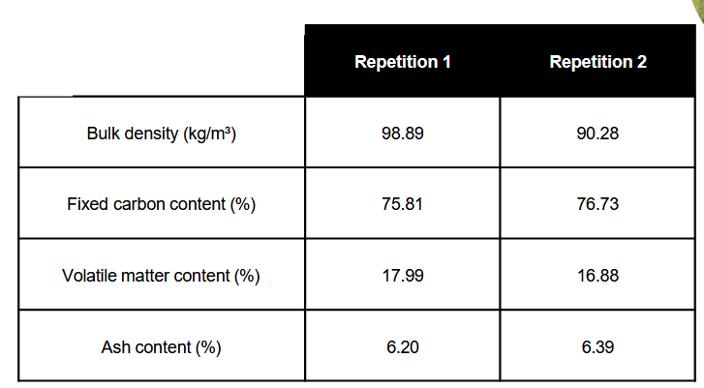
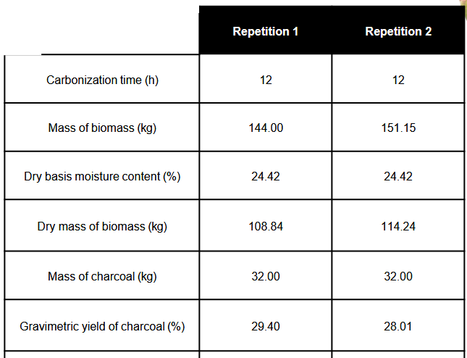
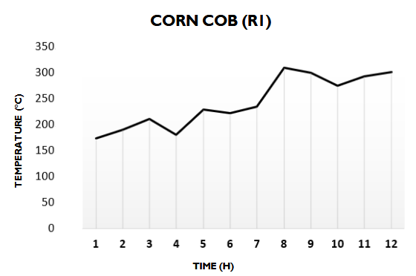
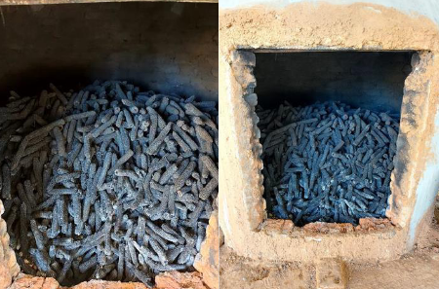
Brazilian kilns: Exemple of trial done at UFV by Nascente
Raw biomass characterization
Biochar
characterization
Carbonization

Slide 7
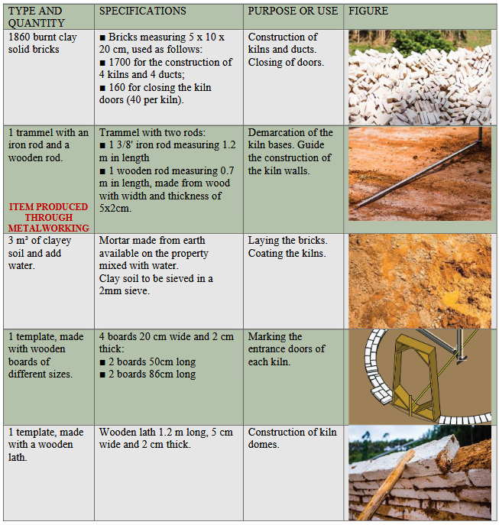
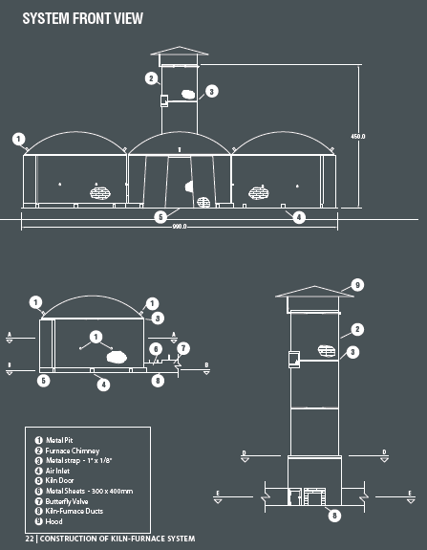
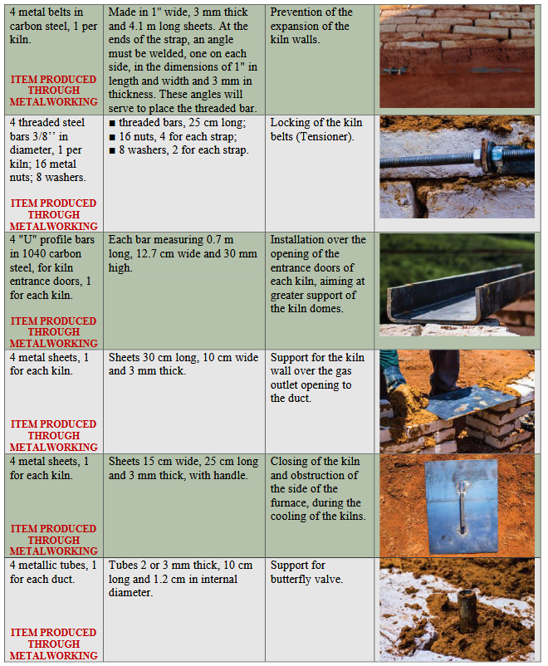
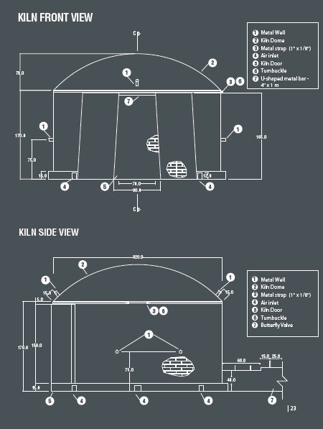
Brazilian kilns: the construction in each study case (1)
Plans sent to the partners
Collaboration between Nascente/UFV and the partners to prepare the materials.

Slide 8
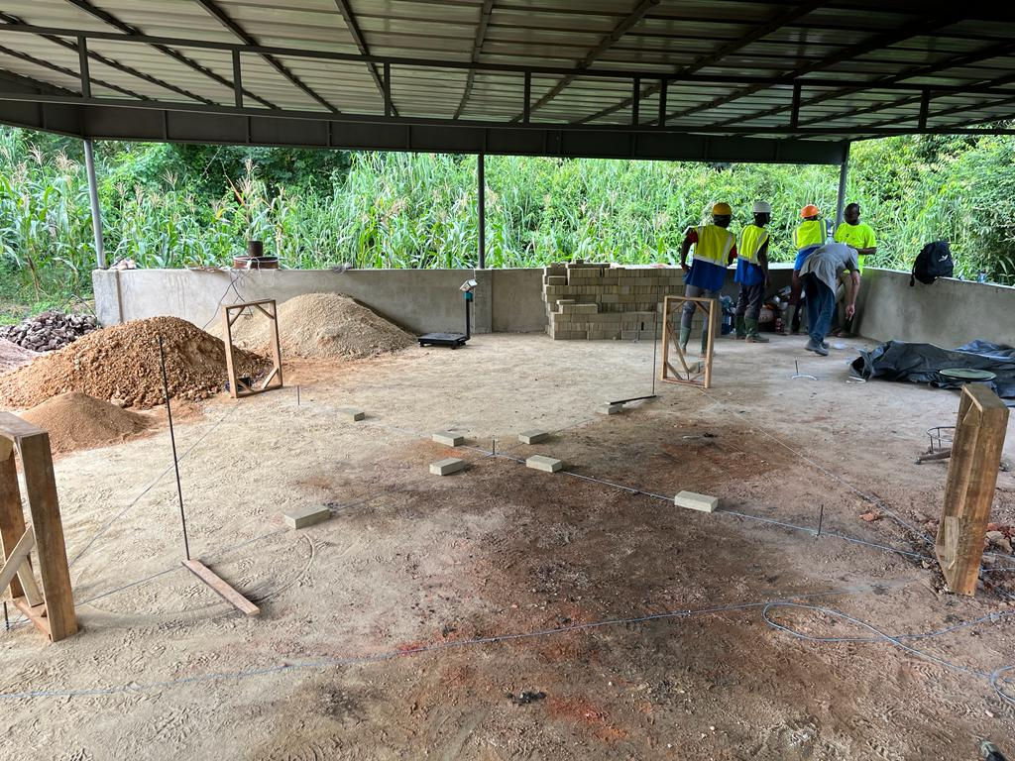
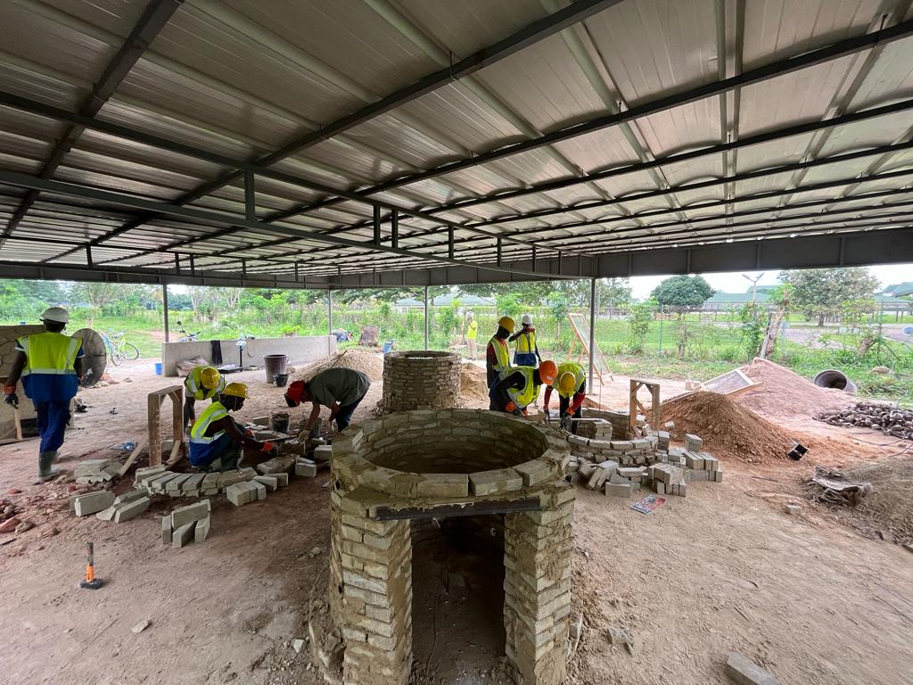
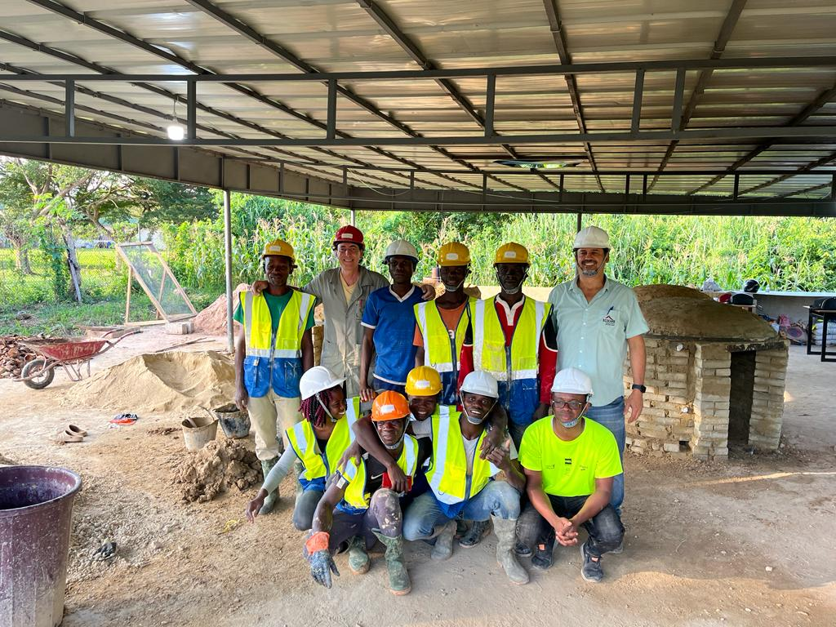
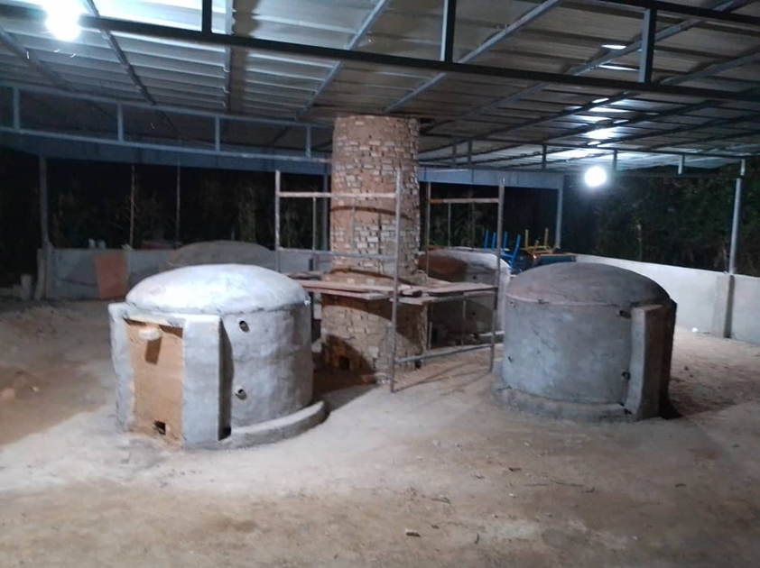
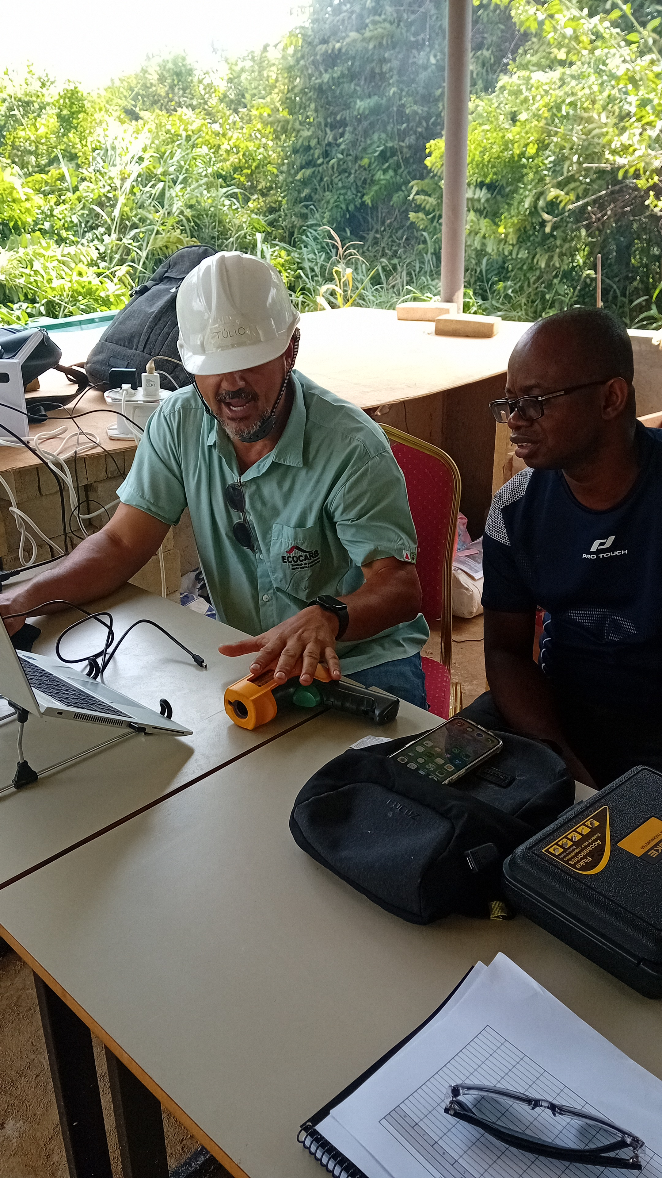
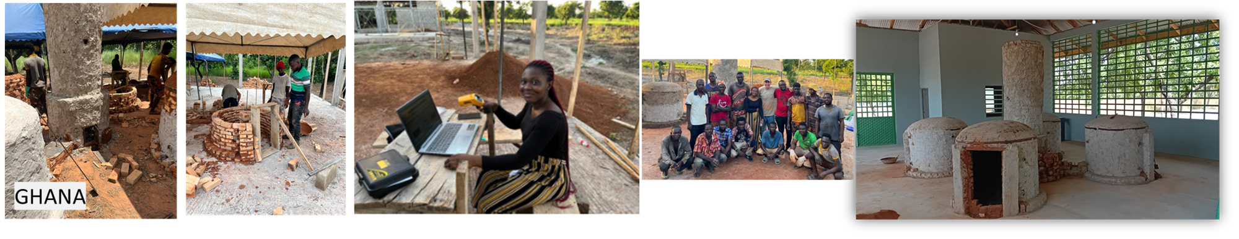
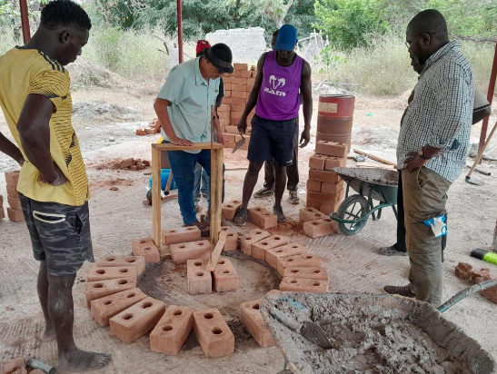
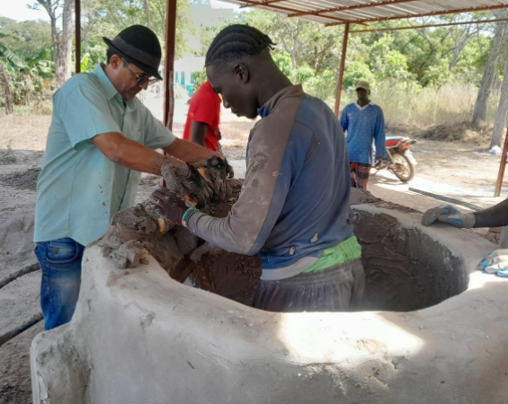
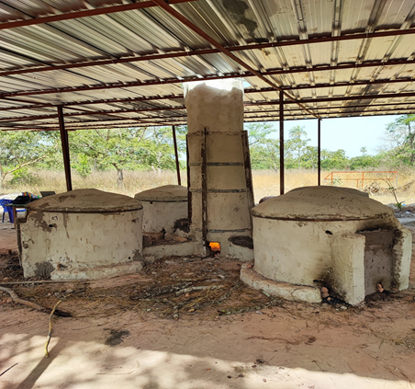
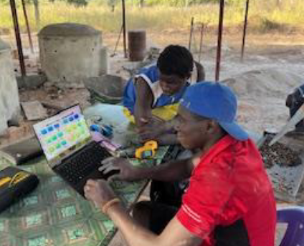
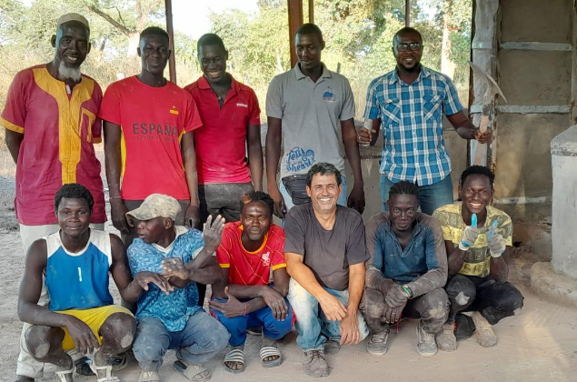
Brazilian kilns: the construction in each study case (2)
COTE D’IVOIRE
SENEGAL

Slide 9
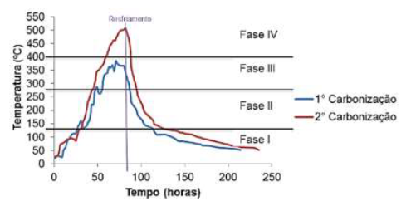
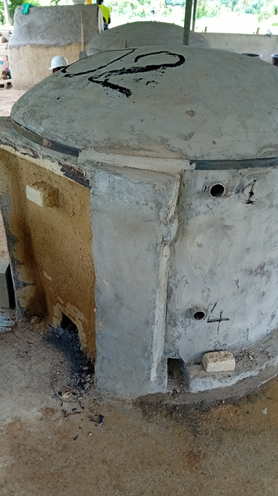
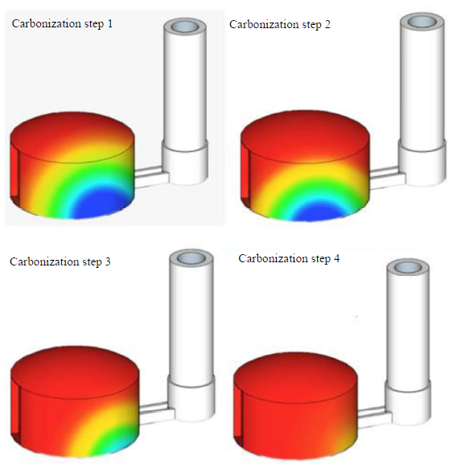
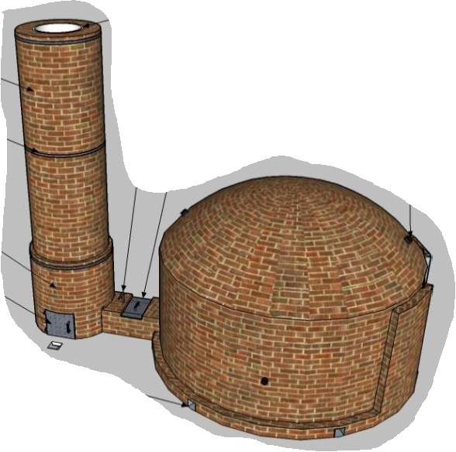
Brazilian kilns: Operation
The furnace-kiln system is composed:
4 circular surface kilns (1m3)
1 combustion chamber
Temperature control : air controllers (6 per kiln) / 8 metal tubes (pyrometer)
Furnace/cheminey
metal tubes
Primary air
kiln
air controllers
Danilo Donato, UFV, 2017

Slide 10
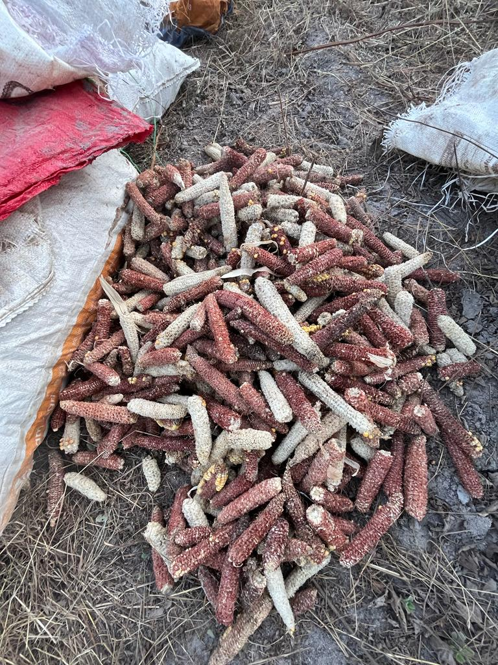
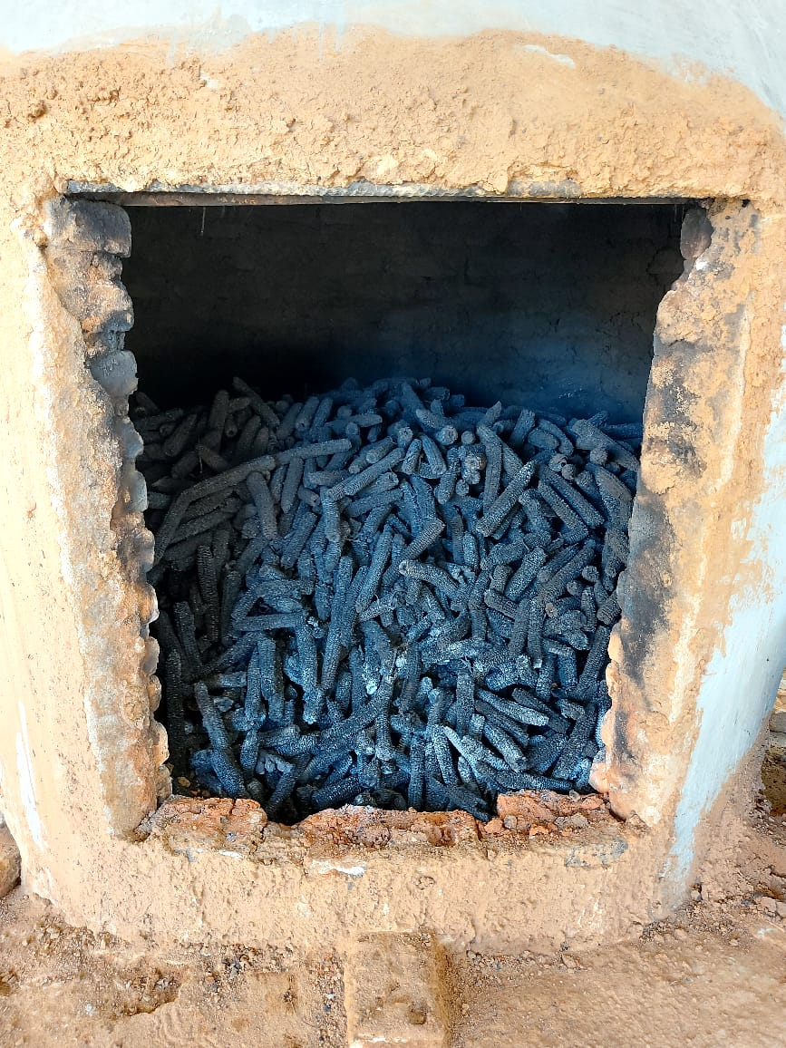
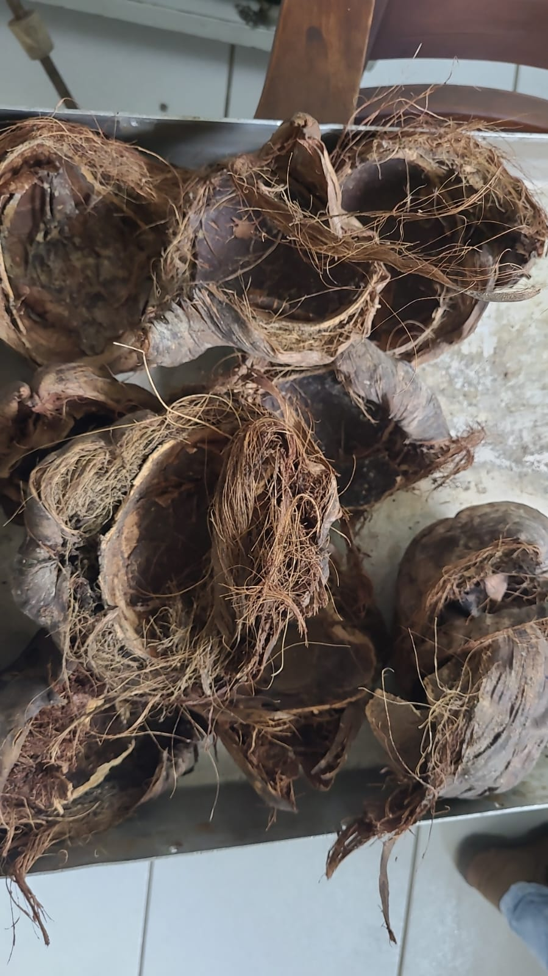
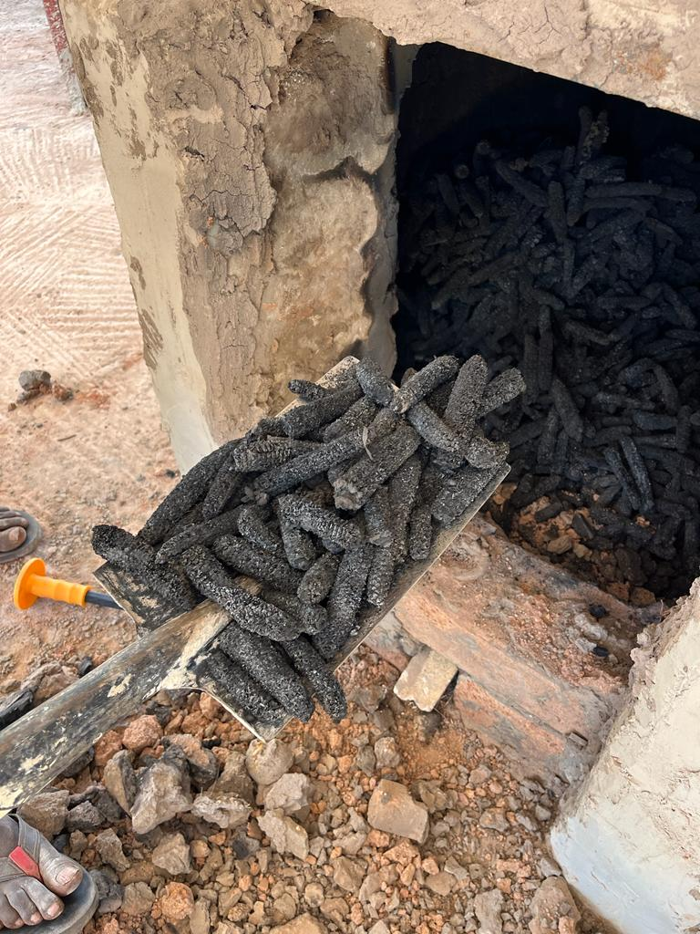
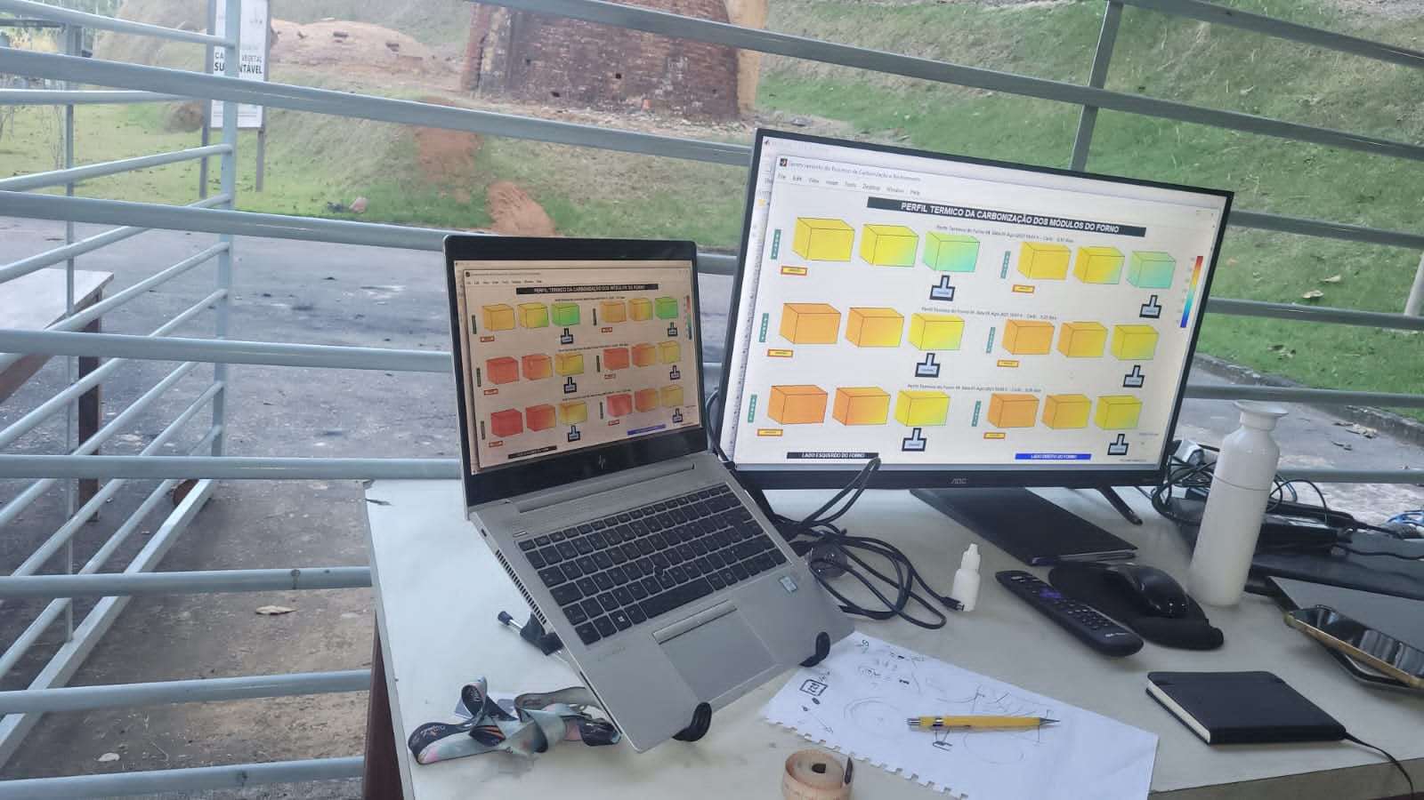
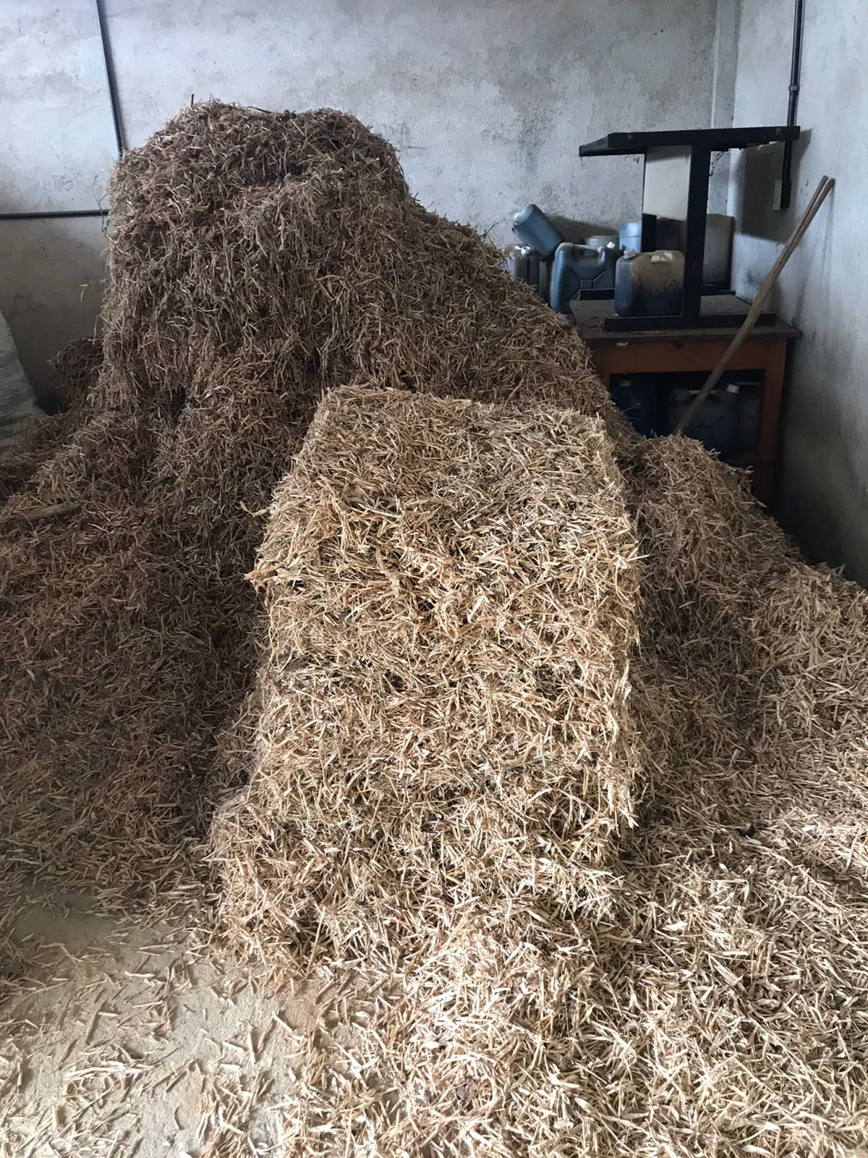
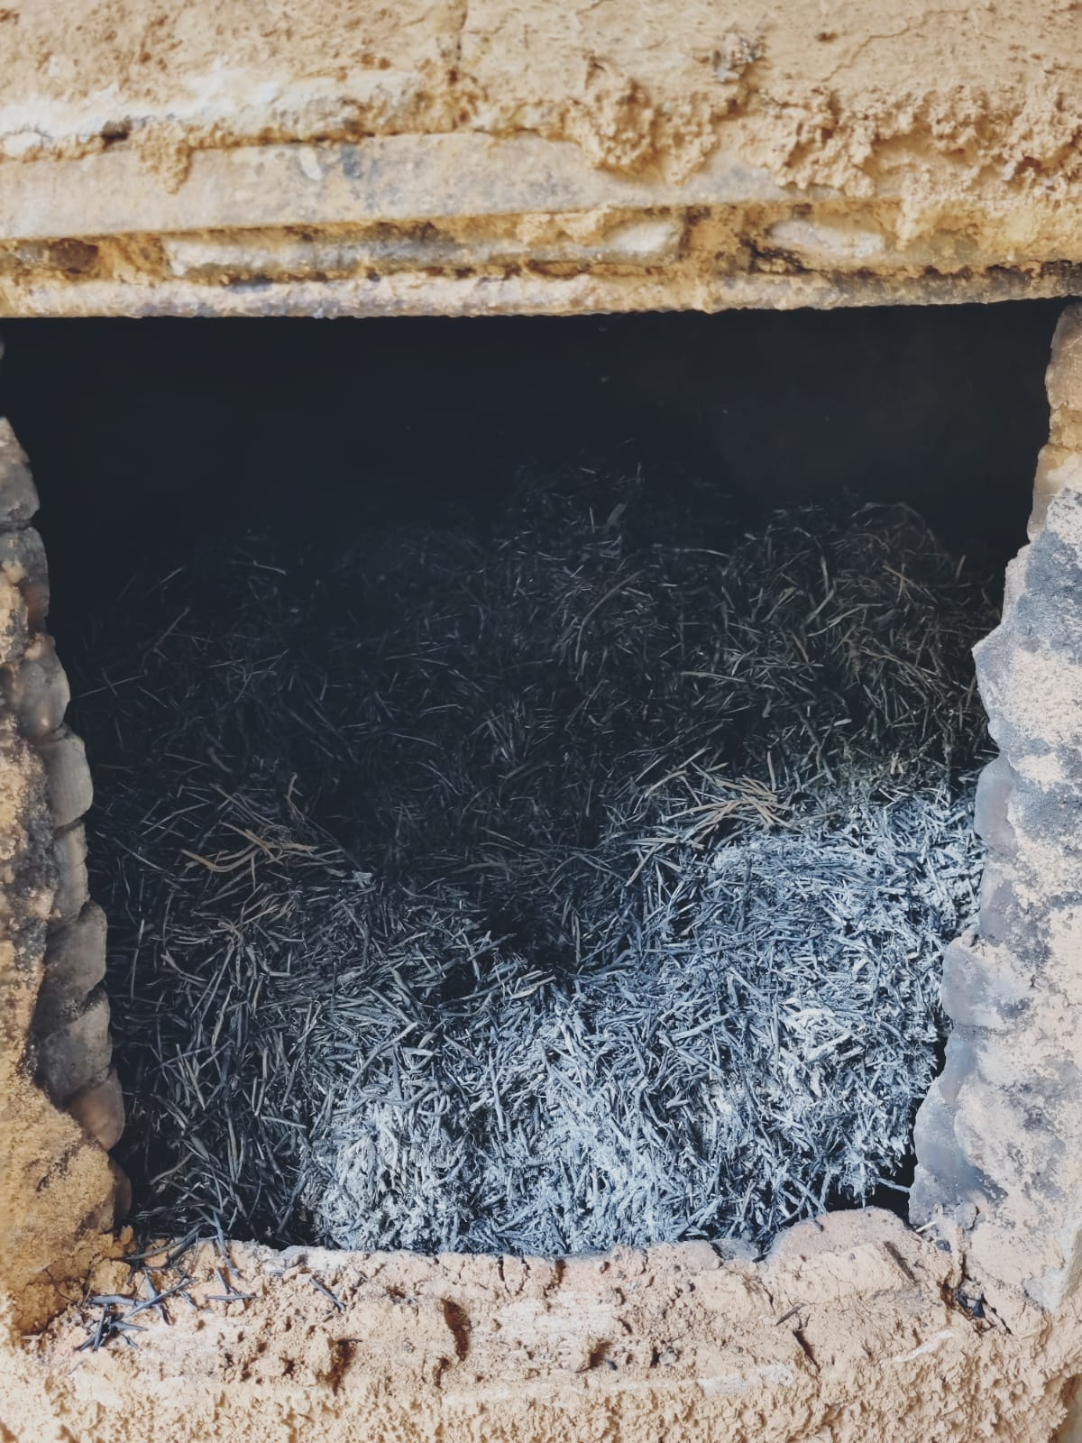
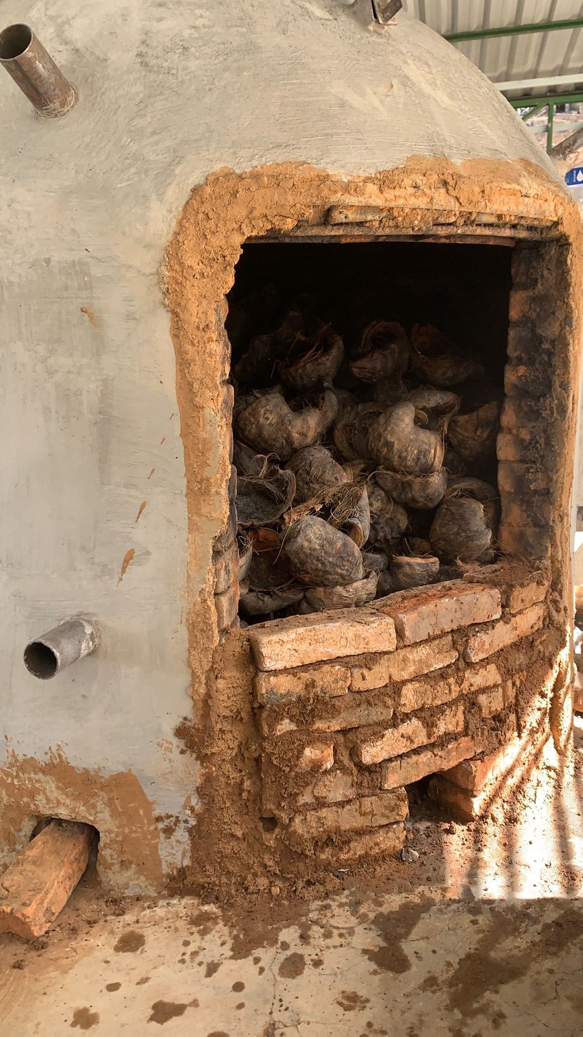
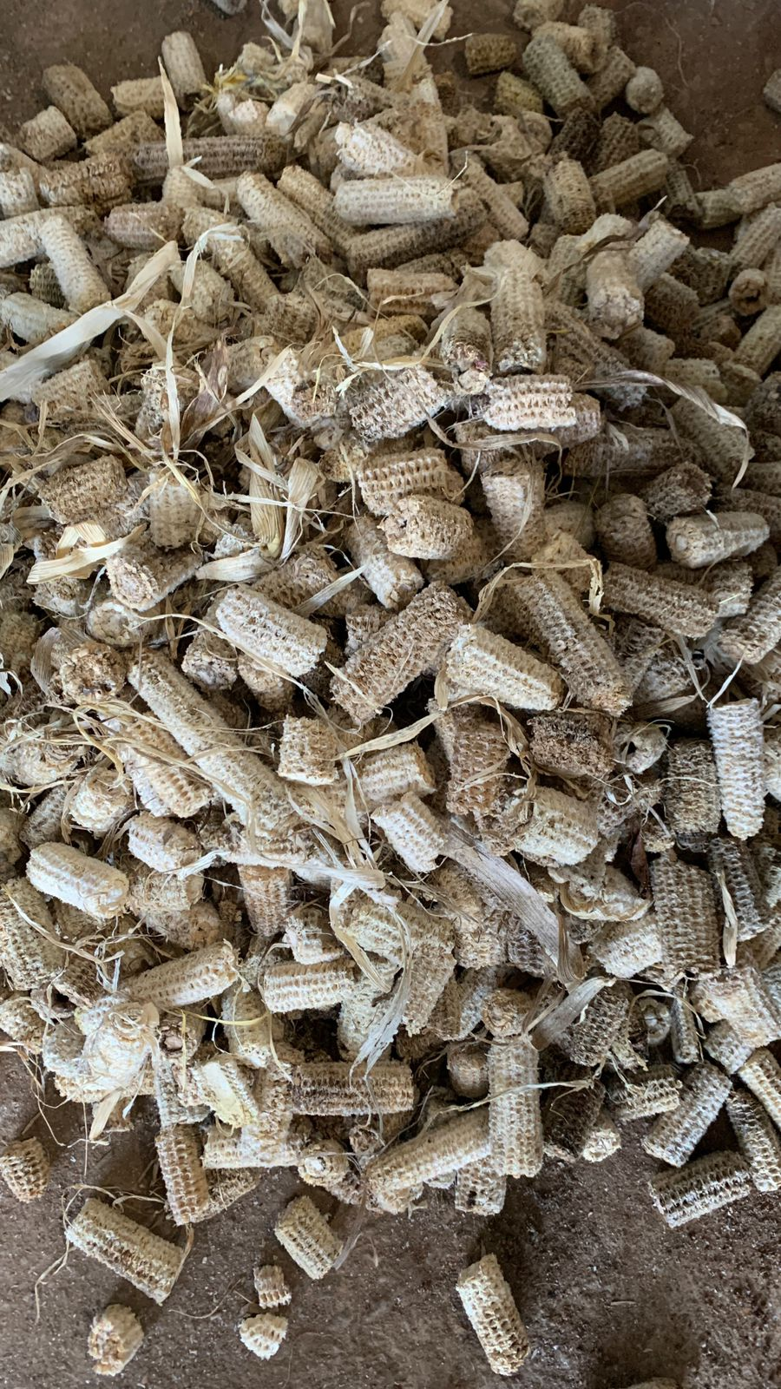
Brazilian kilns: Operation
Corn cob
Coconuts
Biochar
Kiln unloading
Straw
Temperature measurement
Ground nut husk
Raw materials drying
Kiln loading

Slide 11
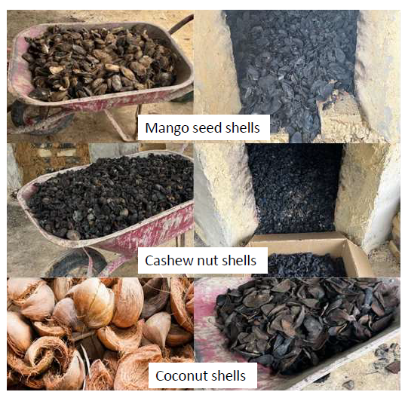
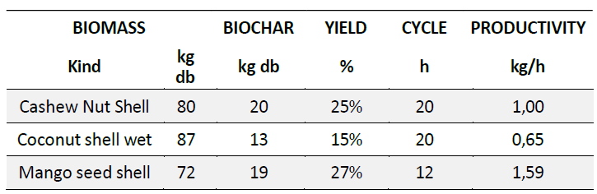



Brazilian kilns : 1st Results at INP-HB (Cote d ‘Ivoire)
Biochar production yield
Biochars produced with the Brazilian kilns (INP-HB, Yamoussoukro, Côte D’ Ivoire)

Slide 12


Brazilian kilns : 1st Results at SAVANET (Ghana)
Biochar production parameters
Corn cob
Biochar proximate analysis with Brazilian kilns pyrolysis technology

Slide 13


Brazilian kilns : 1st Results at UASZ (Senegal)
Corn cobs
Temperature profile kiln 1
Profile of temperature powered by Carboraad software

Slide 14


Brazilian kilns : Next step/Drying
Drying
Pyrolysev
Pyrolysev
Pyrolyse
Drying
Drying
Hot gas
Drying
Pyrolyse
Hot gas
HUMBERTO SIQUEIRA, UFV 2021
The hot gases come either from the furnaces or from the chimney.

