Slide 1
Characterisation of West-African agricultural waste as feedstock for biochar production in a circular economy context
Dupont, C., Sharma, N., Bedzo, O., Ndyaye L., Himbane, PB., Radbeau, B., Nganwani, M., Yao, B., Campargue, M., Commandre, JM.
IHE Delft
B4A Final Conference/BLP 2025,
28-30 January, Montpellier

Slide 2
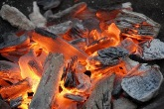
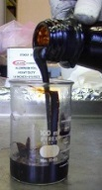
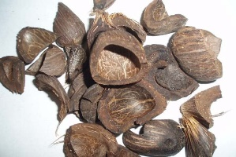
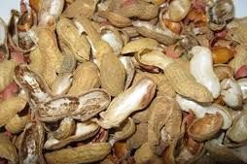
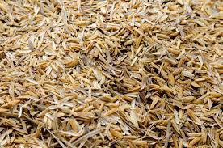
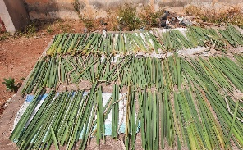
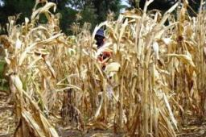
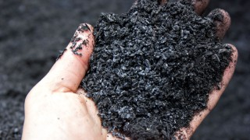
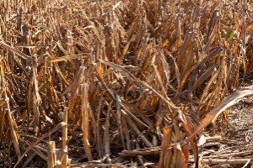
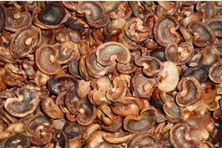
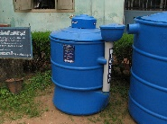
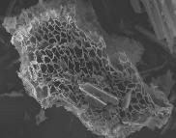
Biochar value chain from “dry” biomass
Biochar upgrading
Fuel
300-700 ° C
Heating rate: 1-10 ° C.min⁻¹
Absence of O₂
Atmospheric pressure
Volatile matter
Gas (CO, CO₂, CH₄…)
Condensates (water, tars)
Soil improving material
Pyrolysis
Dry
resource
Biochar
Grinding
Water/gas
filtration
Carbon-rich
Porous
Anaerobic digestion
2

Slide 3
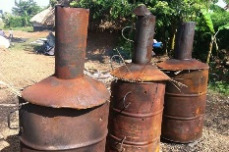
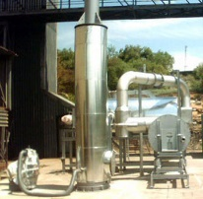
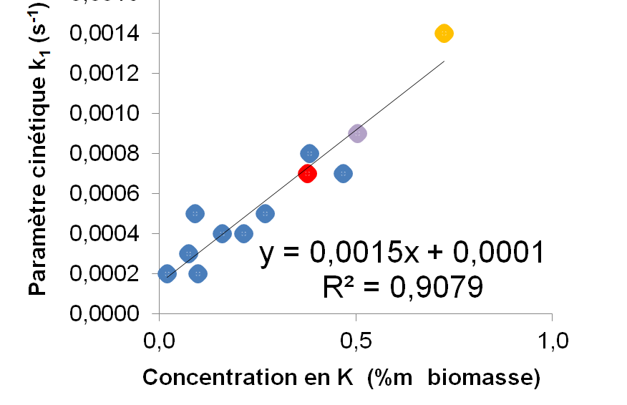
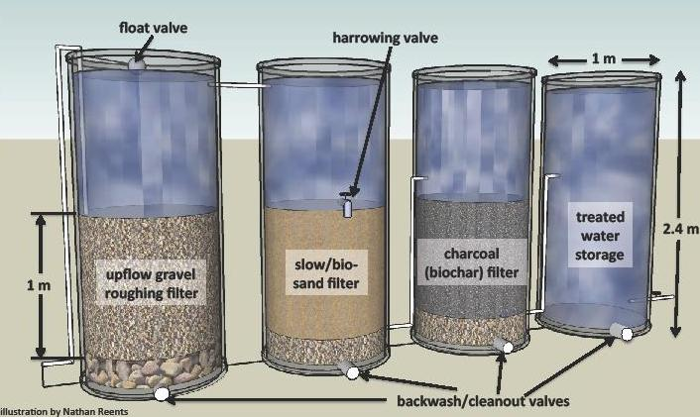
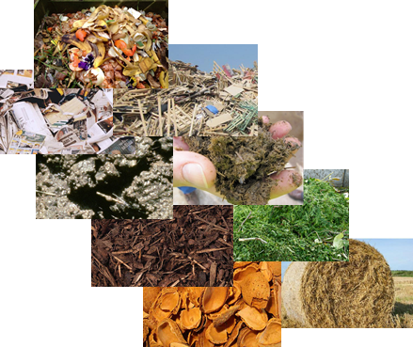
Technical challenges towards biochar value chain implementation
Design efficient & robust & cheap technologies
Recover byproducts
Understand the link resource/process/product
Lack of
systematic studies!
Product properties
Performances
ε = f(T, Ca, C-H…)
Resource
properties
Process conditions

Slide 4
Technical challenges towards biochar value chain implementation
Design efficient & robust & cheap technologies
Recover byproducts
Understand the link resource/process/product
Lack of
systematic studies
…especially for African feedstock
Product properties
Performances
ε = f(T, Ca, C-H…)
Resource
properties
Process conditions

Slide 5
Objectives of the study
Provide an extensive physico-chemical characterization of lignocellulosic biomass with high potential in Western Africa as feedstock for biochar production
Sample selection and collection
Sample physicochemical characterization
Assessment of biomass suitability with biochar production

Slide 6
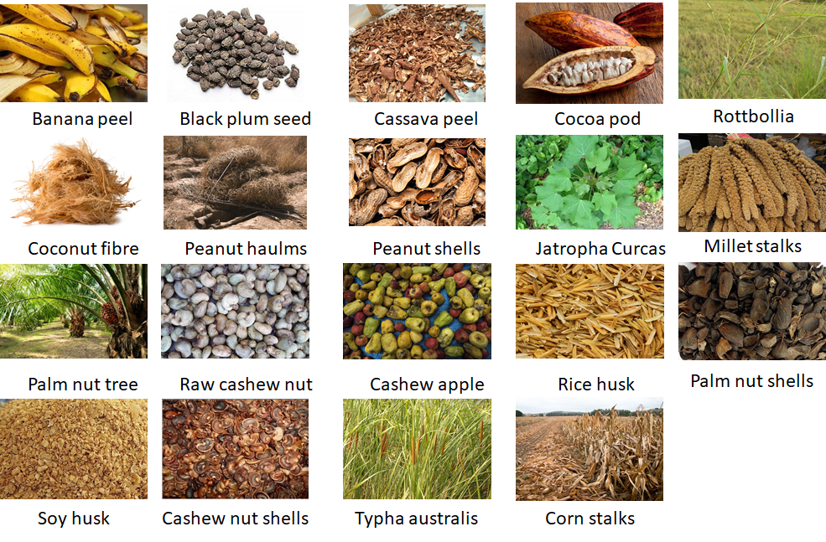
Methodology
28 samples selected based on a database of potential availability of biomass in:
Senegal (UASZ)
Côte d’Ivoire (INP-HB)
Ghana (Savanet)
Collection of samples
Characterization according to EU standards on solid biofuels (CELIGNIS laboratory) → more than 20 physico-chemical properties/sample
Includes samples of the same biomass from different countries/collection points

Slide 7
Proximate analysis
SD < 1 %DM
Trends as expected for lignocellulosic biomass
Ash content from 1 to more than 20%DM (rice husk)
Slight differences due to country origin/collection point
Feedstock with the highest fixed carbon, the most suited: coconut fiber, palm nut shells, peanut shells

Slide 8
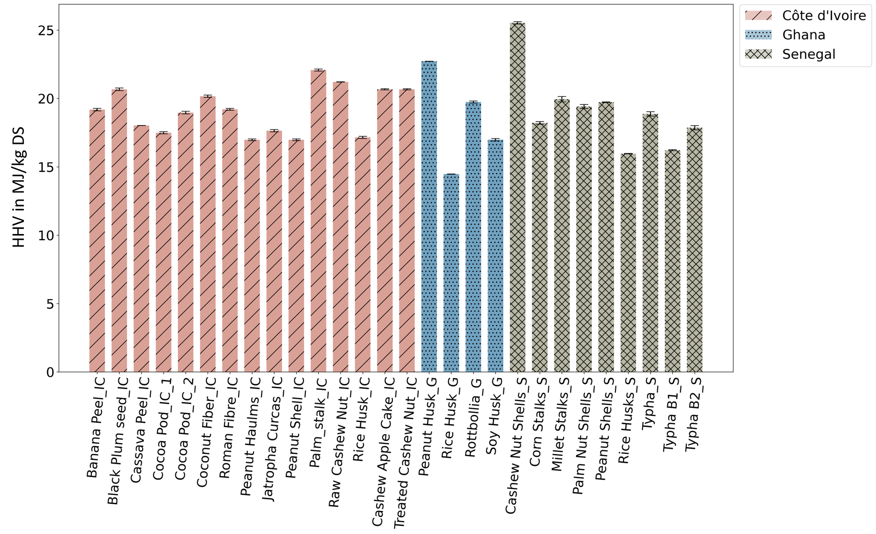
Higher Heating Value
Expected range for lignocellulosic biomass: 15-25 MJ/kg DS
Differences due to ash content (rice husk) and extractive content (cashew nut shell)
Slight differences due to country origin/collection point
If used as solid fuel (directly), most suited biomass: black plum seed, palm stalk, peanut husk

Slide 9
Elemental composition CHNS
Expected ranges
A few outliers regarding N
S very low
No differences due to country origin/collection point
Impact of high N when biochar used as soil amendment

Slide 10
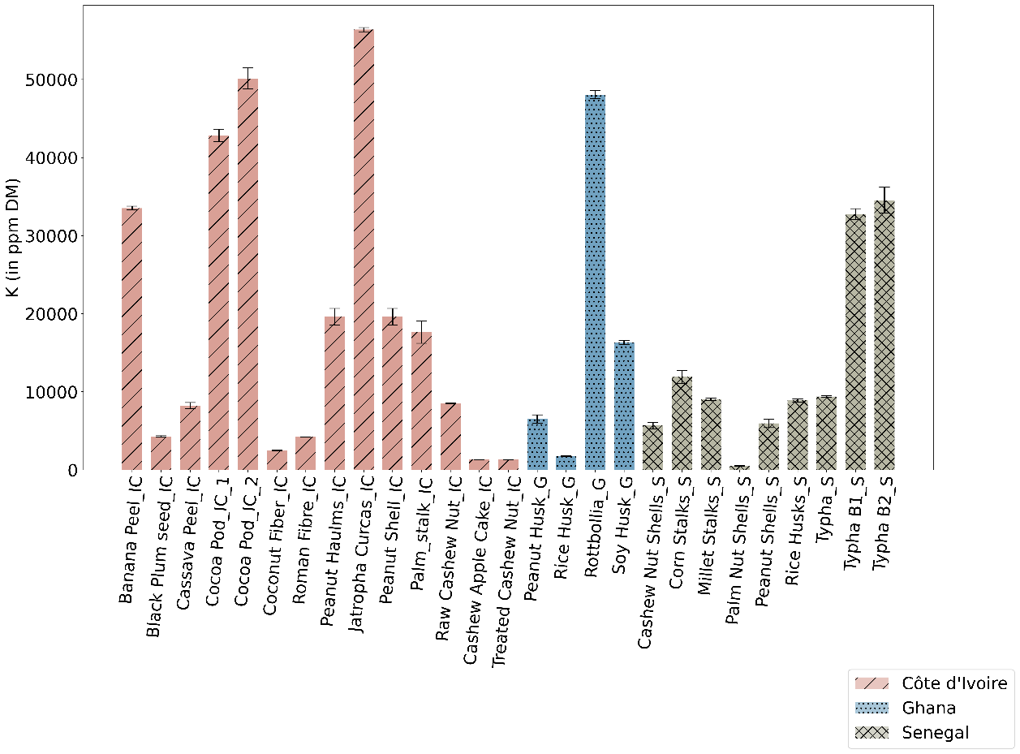
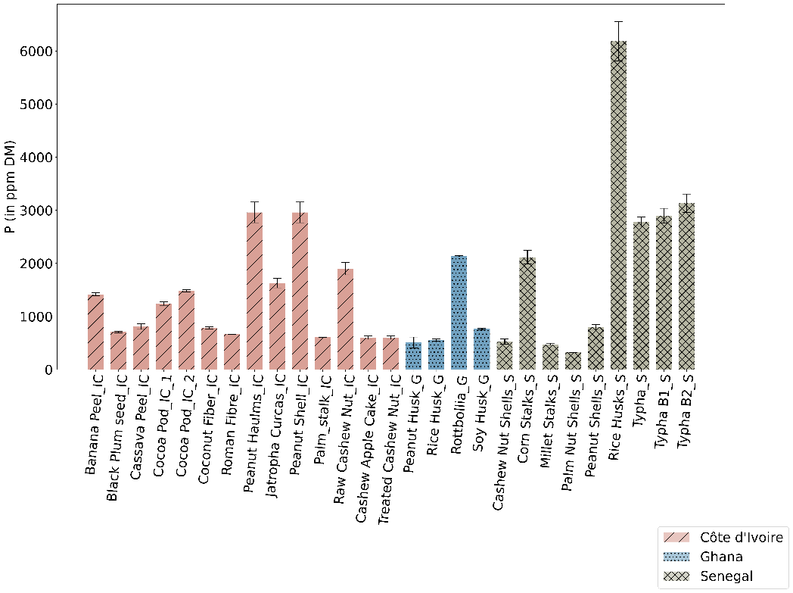
K and P concentrations
Expected range for lignocellulosic biomass
Large variations due to biomass type and origin (rice husk)
Important to consider for use of biochar as soil amendment

Slide 11
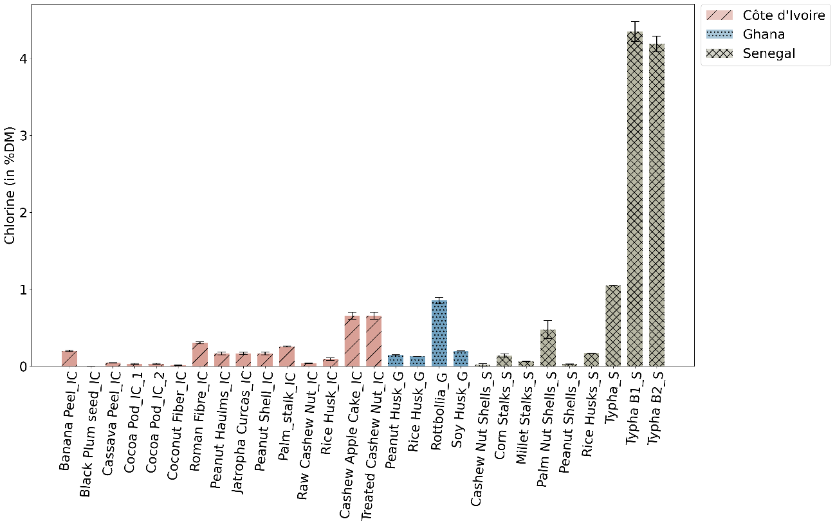
Cl concentration
Expected range for most biomass <1%DM
Much higher amounts in typha (wetlands) with differences due to collection point
If used as solid fuel, typha can be problematic

Slide 12
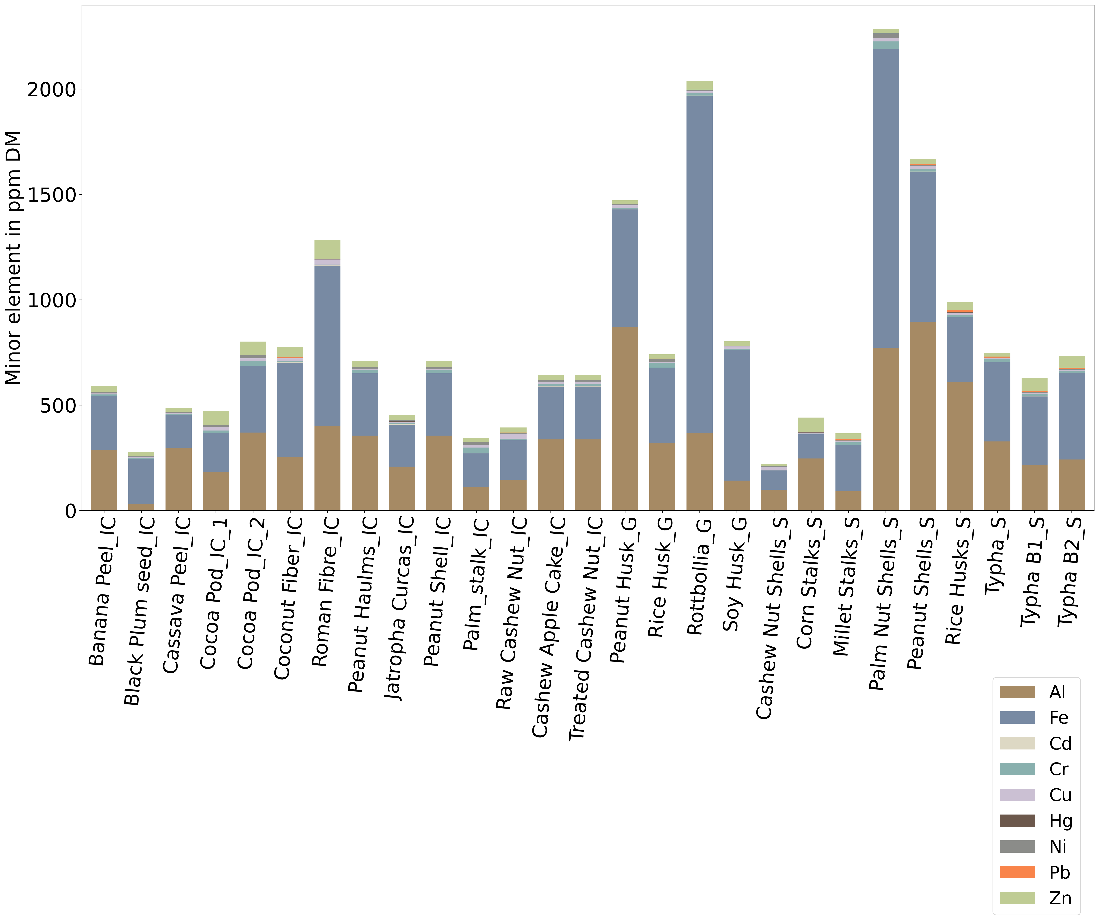
Minor element concentration
Generally relatively low <1000 ppmDM, with mostly Fe and Al
Some outliers: romana fibre, peanut husk, rottbollia, palm nut shells, peanut shells
Presence of harmful elements as traces
Slight differences due to country origin/collection point
Outliers should be avoided especially as solid fuel or soil amendment

Slide 13
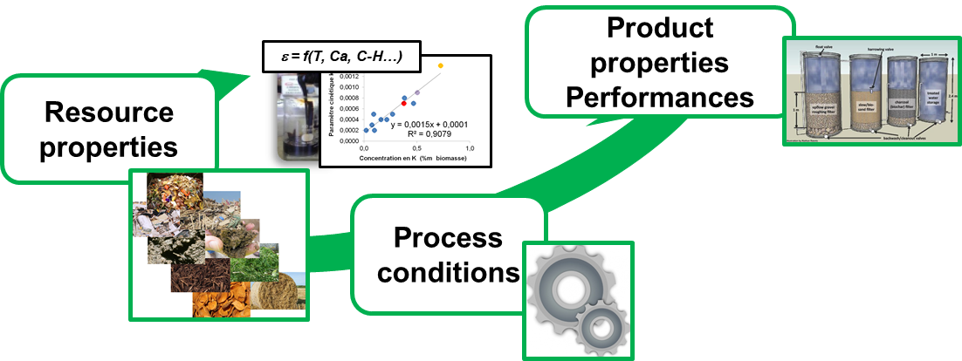
Conclusions and next steps
Open database of Western-Africa biomass physicochemical characteristics →will be made available to the community at the end of the project
Most biomass samples can be used as feedstock for biochar production
Significant influence of the country of origin/collection point on inorganic elements
Processing of the samples
to confirm suitability with process

Slide 15
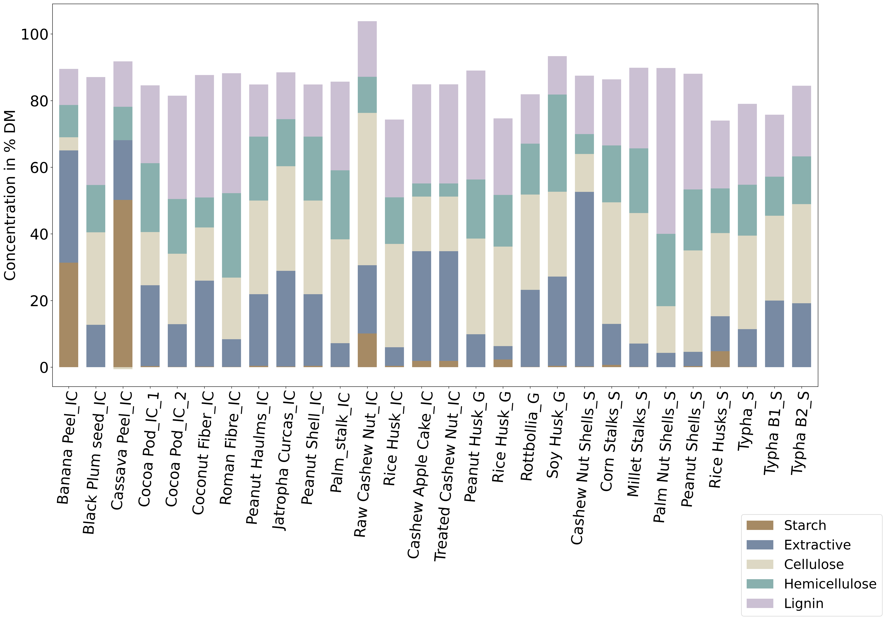
Figure 2 Macromolecular composition in biomass in %DM with SD < 1%

Slide 16
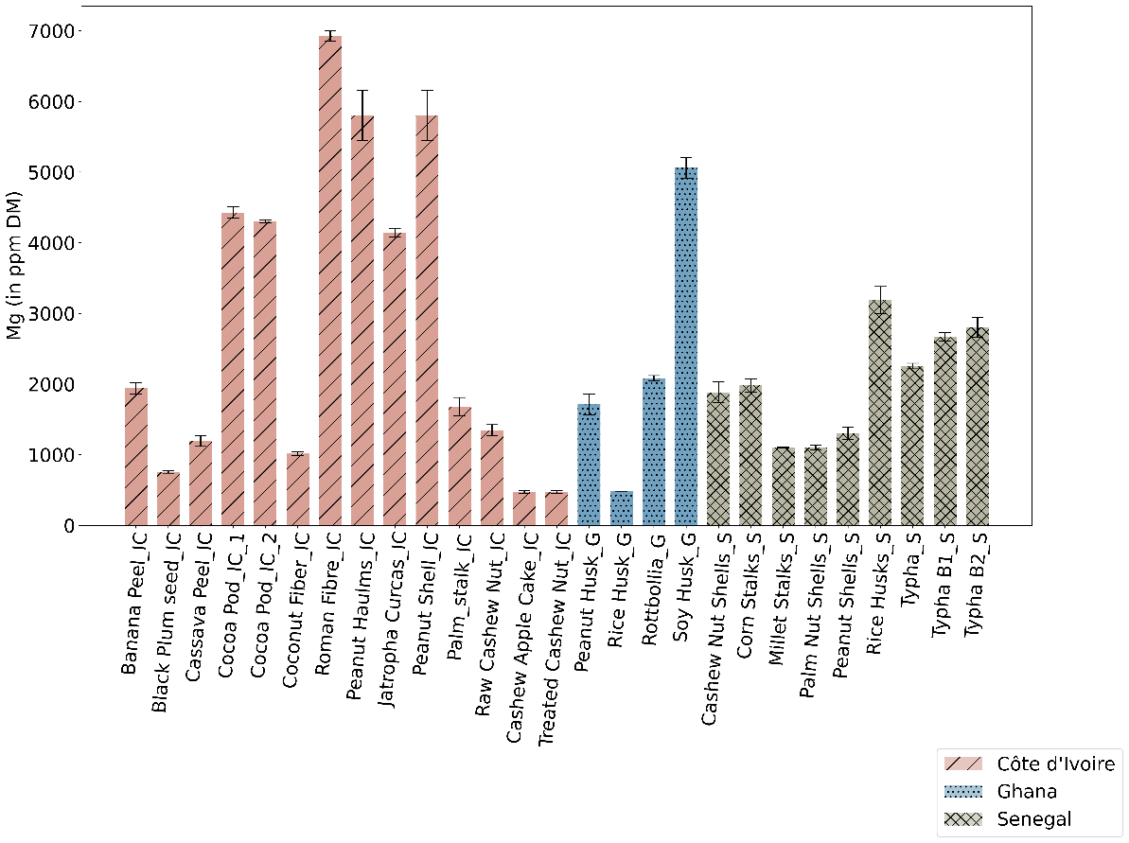
Figure 8 Mg concentration in biomass sample in ppm DM

Slide 17
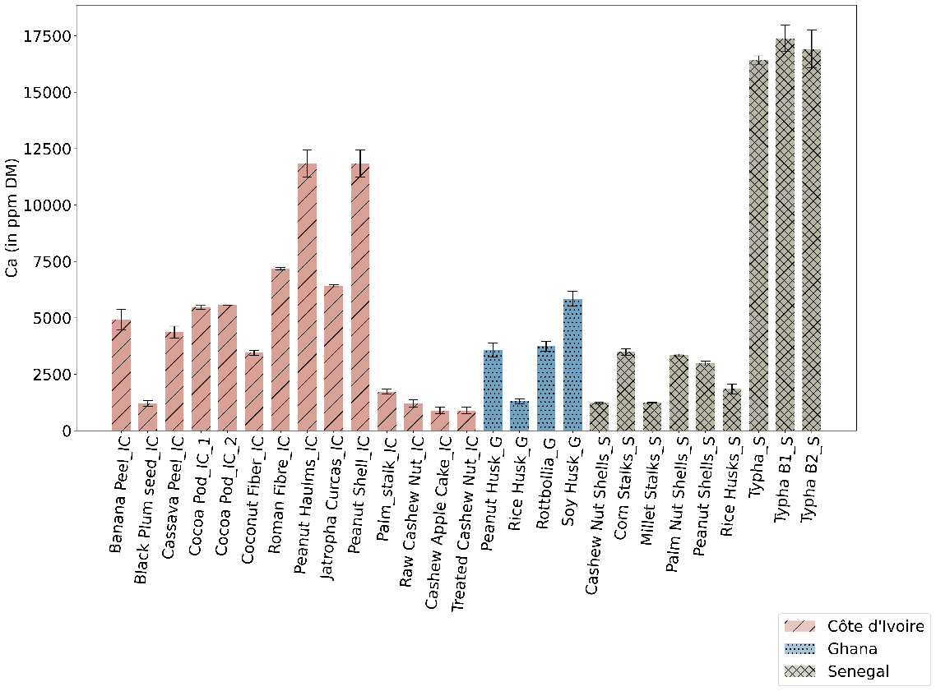
Ca concentration

