Slide 1
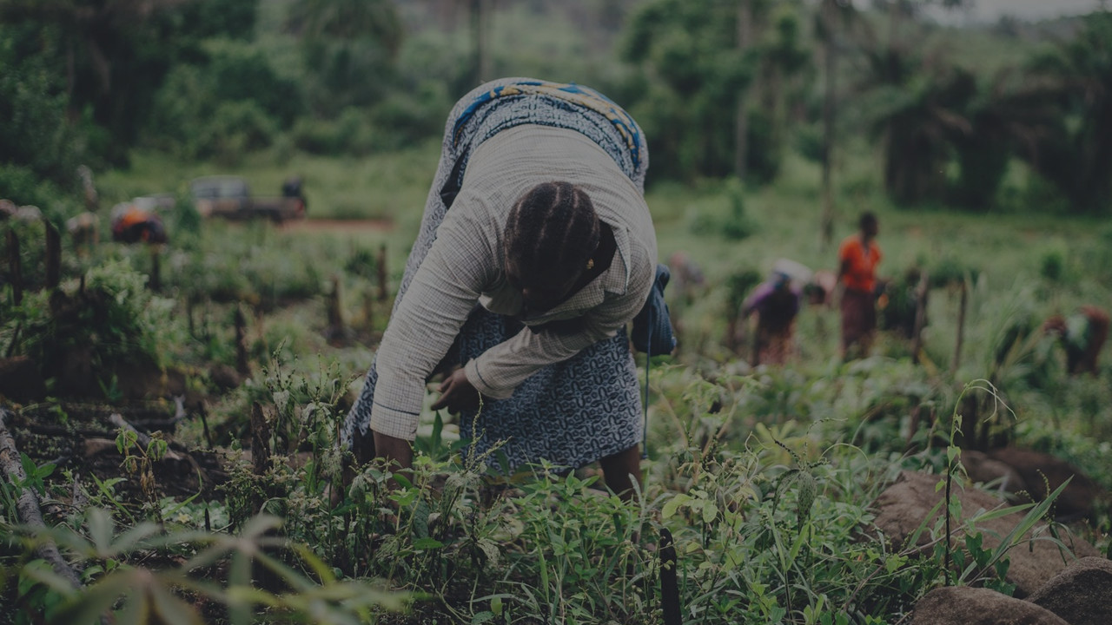
Diversifying revenue in rural Africa through circular, sustainable and replicable biobased solutions and business models
Jean- Michel Commandre
jean-michel.commandre@cirad.fr
CIRAD
This project has received funding from the European Union’s Horizon 2020 Framework Programme for Research and Innovation under Grant Agreeement no 101000762

Slide 2
Project identity
Work Programme | CE-SFS-36-2020 “Diversifying revenue in Africa through bio-based solutions”
Type | Research and Innovation Action (RIA)
Duration | 48 months (1 Jun 2021 - 31 May 2025)
Funding Authority | European Research Executive Agency
Budget / EC contribution | ≈ 9 M€
Coordinator | CENTRE DE COOPERATION INTERNATIONALE EN RECHERCHE AGRONOMIQUE POUR LE DEVELOPPEMENT - C.I.R.A.D.
Partners | 25 partners (12 different countries)

Slide 3
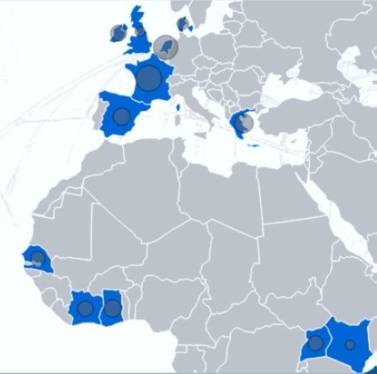
Consortium & Countries
Netherlands
Denmark
Ireland
United Kingdom
France
Greece
Spain
Senegal
Côte d’Ivoire
Kenya
25 partners
12 countries (5 from Africa, 7 from Europe)
Ghana
Uganda

Slide 4
Context and rationale
African agri-food systems can contribute towards Africa’s food and nutritional security, by combating poverty and enhancing food security, while driving inclusive and sustainable rural development.
Current Status:
Africa will need to feed 1.2 billion people by 2030 and over 2 billion by 2050
Undernourishment is still on the rise, affecting almost 20% of Africa’s population.
Problems faced:
African agri-food systems need to become:
more resilient to economic and environmental risks,
more sustainable to conserve, restore and enhance the biodiversity and natural resources that constitute an essential heritage for the rural communities that live off them.

Slide 5
Main Aim
Bio4Africa supports the deployment of the bioeconomy in rural Africa by developing bio-based solutions and value chains with a circular approach to drive the cascading use of local resources and diversify the income of farmers
Bio4Africa aims to:
Transfer simple, small-scale and robust bio-based technologies adapted to local biomass, needs and contexts
Empower farmers to sustainably produce a variety of higher value bio-based products and energy
Set up 4 pilot cases with over 8 testing sites in Uganda, Ghana, Senegal and Ivory Coast
Offer to farmers and farmer groups the opportunity to test them in real productive conditions.

Slide 6
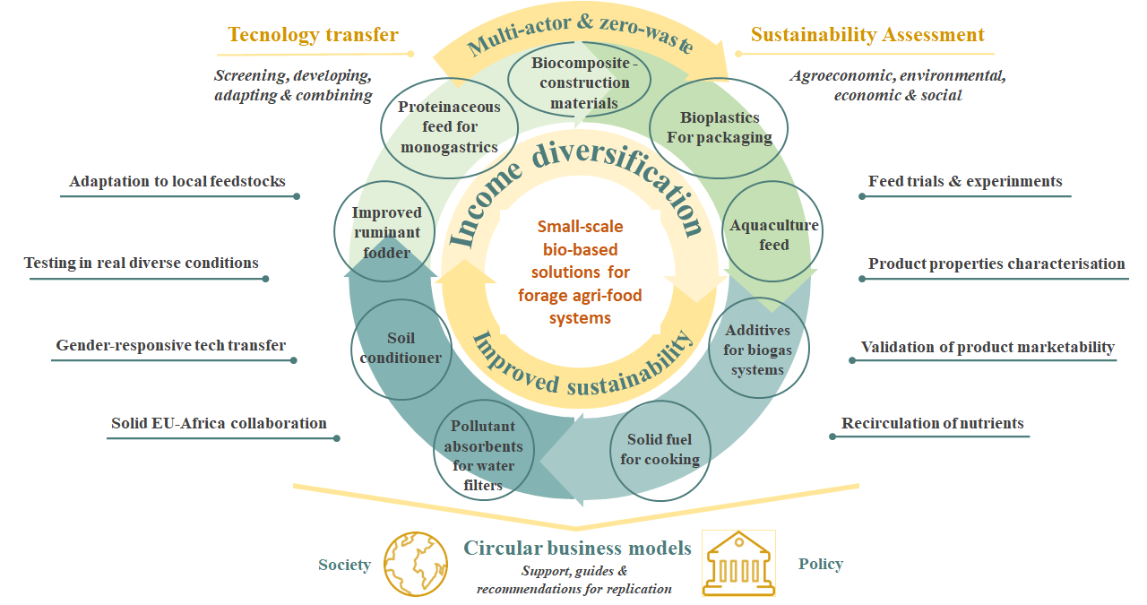
Overall concept
Processing local fresh green biomass to improve feed products and soil fertility
Valorising agricultural waste via biochar, bio-composites and bioplastics with value-added applications
A multi-actor approach by solid international collaboration
Testing and validation of bio-based solutions in representative real productive conditions
Assess the potential of our solutions via circular and inclusive business models
Notes:
The concept of the Bio4Africa project is based on :
Processing local fresh biomass to improve… The target of this part are a press cake and a liquid fraction for aquaculture feed, proteinaceous feed for monogastrics and improved ruminant fodder.
Is based also Valorisation of agricultural waste via biochar for soil conditioner, water treatment, additives for biogas process or as solid fuel , and as bio-composites and bioplastics
Testing and validation of bio-based solutions in representative real productive conditions
Assess the potential of our solutions via circular and inclusive business models
And last but not least, this project is based on a solid multi-actor and international collaboration.

Slide 7
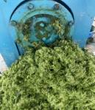
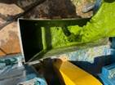
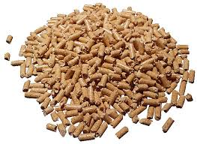
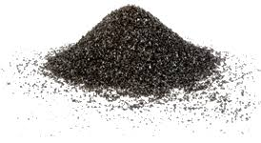
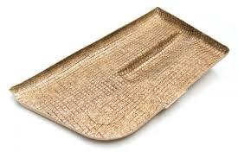
The Bio4Africa pilot cases
Uganda
Small-scale green biorefinery
Proteins for feed animals
HTC
Biochar for soil amendment
Briquetting
Briquettes for solid fuel
Ghana
Small-scale green biorefinery
Proteins for feed animals
Pyrolysis
Biochar for soil amendment
Pelletizing
Pellets for feed animals
Côte d’Ivoire
Pyrolysis
Biochar + Adsorbent
Biocomposites production
Pelletizing
Pellets for animals feed
Senegal
Pyrolysis
Biochar for soil amendment + solid fuel + additive for biogaz
HTC
Biochar for soil amendment
Briquetting (raw and biochar)
Biocomposites production
Kenya
Analyze the needs and local contexts
Screening of technologies to be transferred
Replication potential

Slide 8
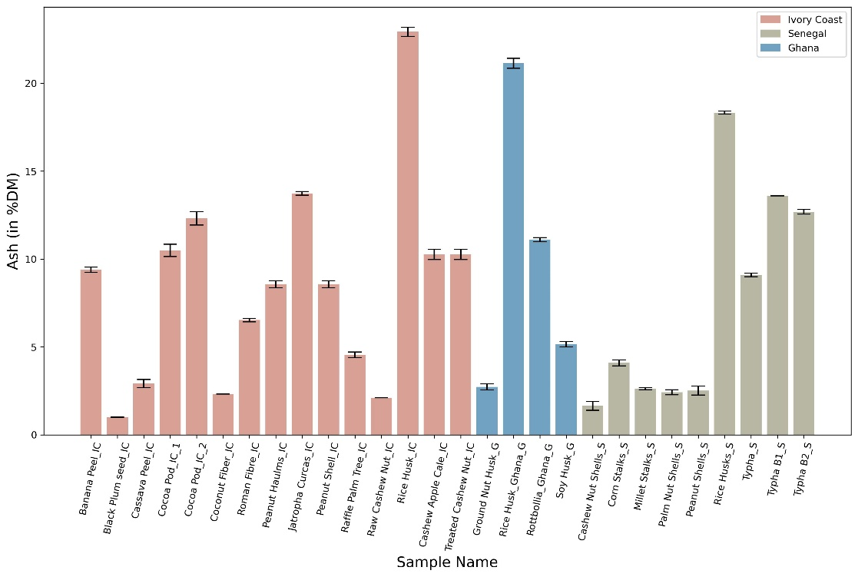
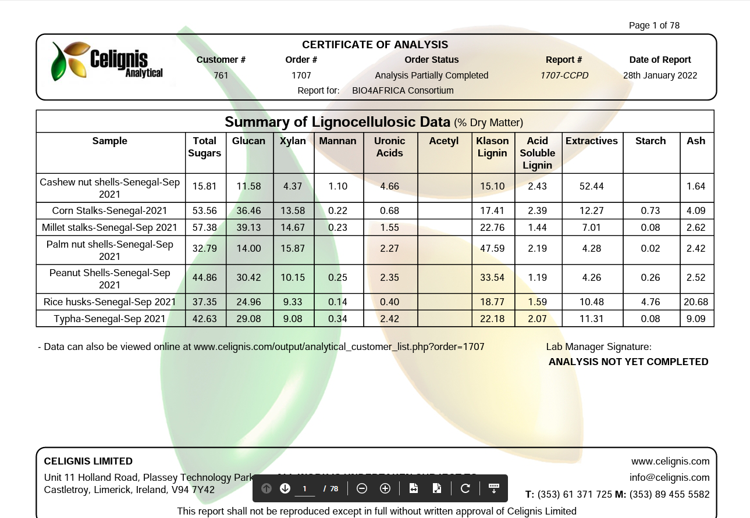
Biomass selection and characterization
Characterize the locally available feedstock in terms of physico-chemical properties relevant for the technologies
Around 30 samples characterized (30 physico-chemical properties each)

Slide 9
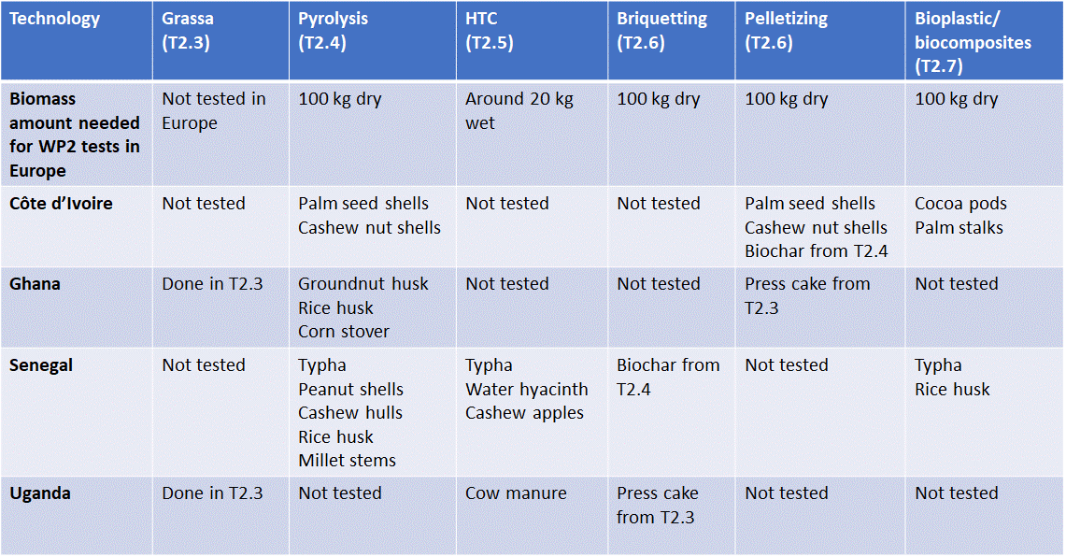
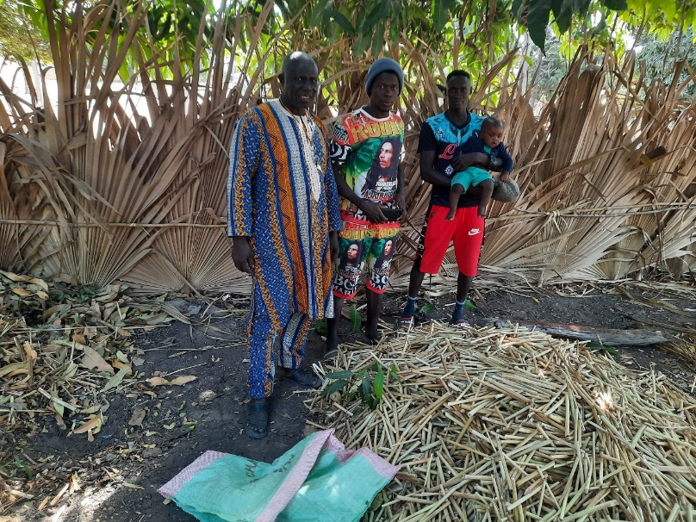
Biomass selection and characterization
Select, collect and supply the most promising samples for tests in the different technologies in lab/pilot units in Europe
9 biomass samples selected, collected and delivered to Europe
Biomass samples dried and ground to be ready for conversion tests

Slide 10
Technologies & Products introduced by BIO4AFRICA - SO WHAT ? -
This project has received funding from the European Union’s Horizon 2020 Framework Programme for Research and Innovation under Grant Agreeement no 101000762

Slide 11
The technologies
Slow pyrolysis
Briquetting
Small-scale green biorefinery
Hydrothermal carbonization (HTC)
Pelletizing
Bio-composites & bioplastics production

Slide 12
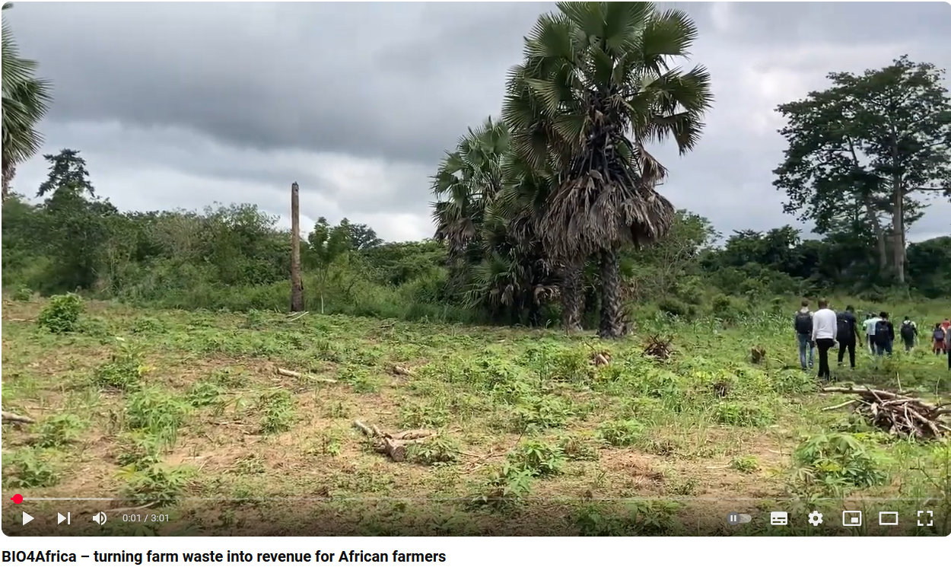
https://www.youtube.com/watch?v=t9QA-GHmQmo&t=140s

Slide 13
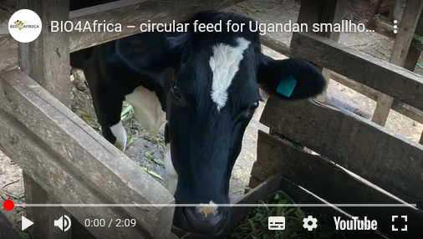
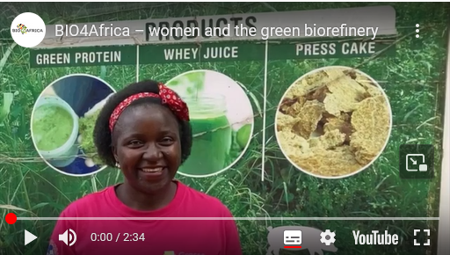
https://www.youtube.com/watch?v=W4ecSFjpc8s
https://www.youtube.com/watch?v=vYbmTFwkPXE

Slide 14
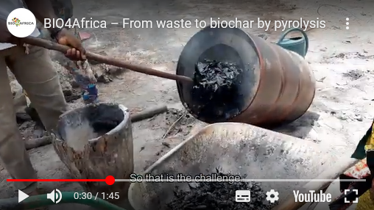
https://www.youtube.com/watch?v=wTWe1YXJt3w
https://www.youtube.com/watch?v=YC_bLLt40Bo

Slide 15
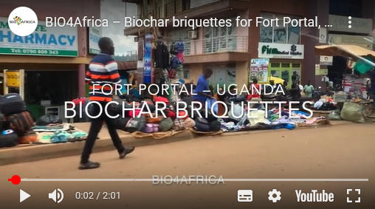
https://www.youtube.com/watch?v=jgmjCptf3wo
https://www.youtube.com/watch?v=Oo_3WcJ95SE

