Slide 1
Novel application of green biorefinery whey
Aleksandra Augustyniak
Munster Technological University, Ireland
B4A Final Conference/BLP 2025,
28-30 January, Montpellier

Slide 2
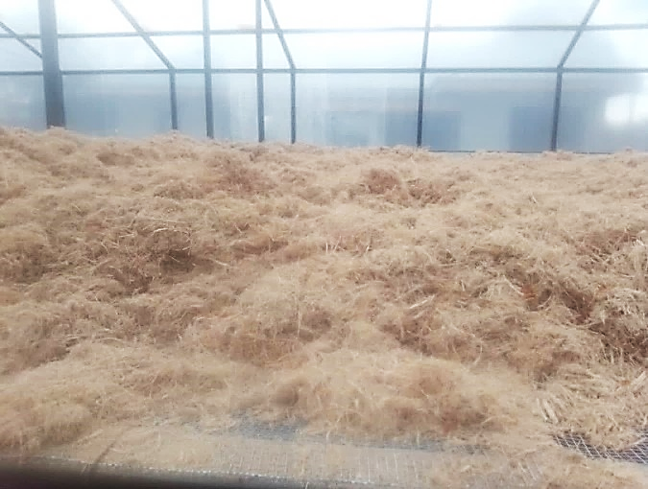
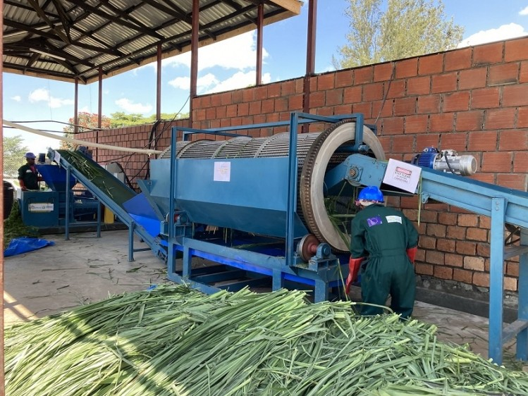
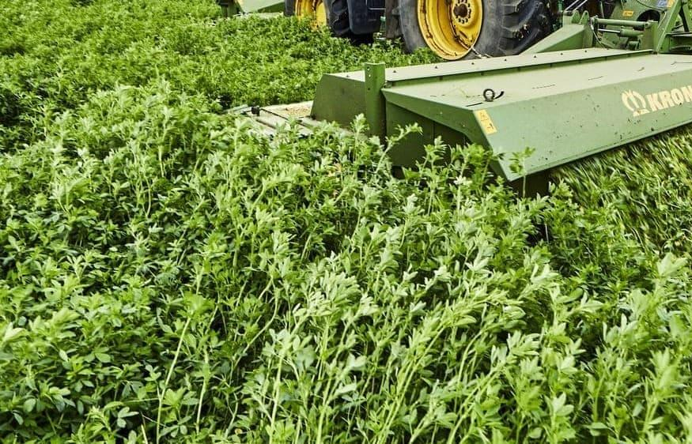
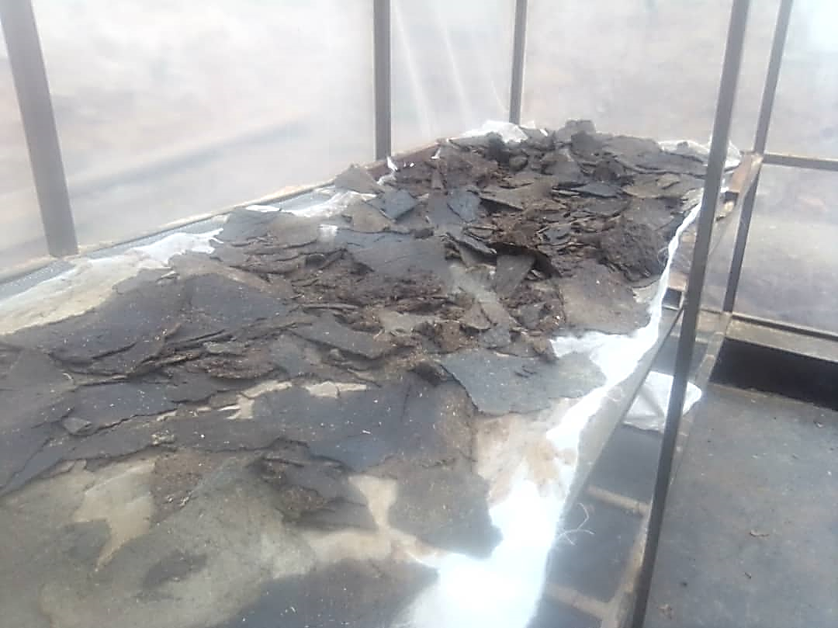
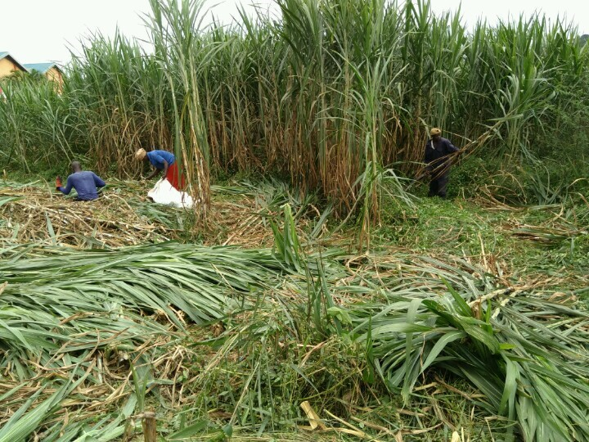
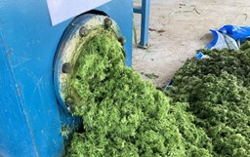
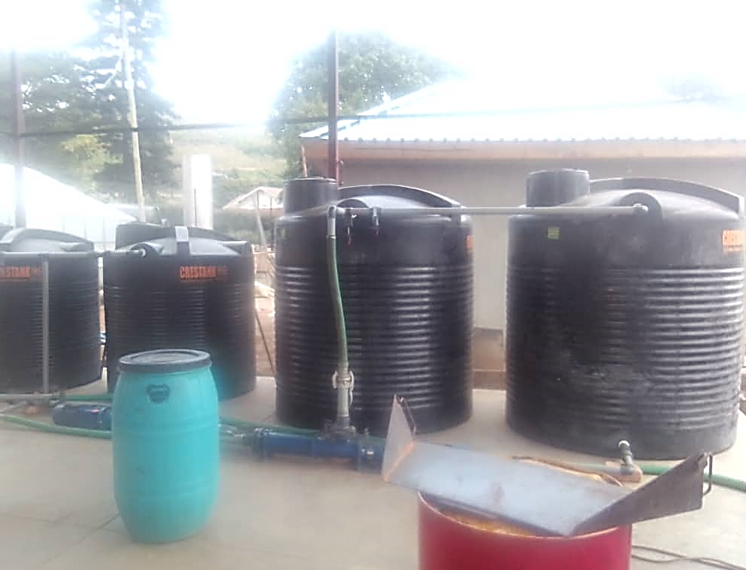
Green biorefinery
Presscake
Alfalfa
Collection of raw biomass
Plant residues processing
Protein concentrate
Pakchong
Green juice
Whey (brown juice)

Slide 3
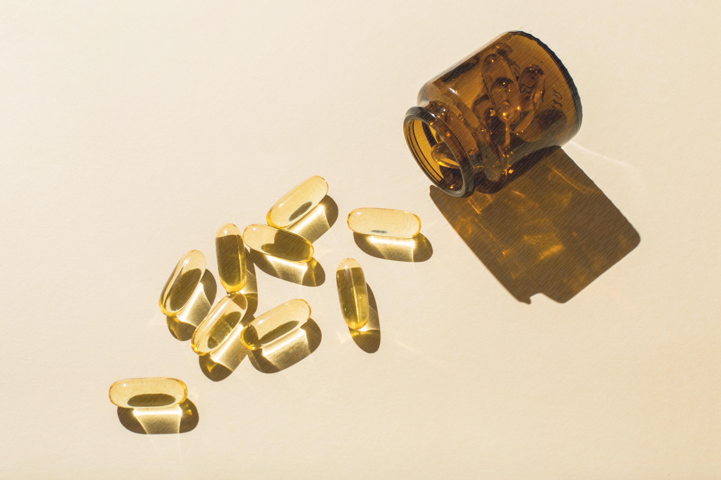
Assessment of the high-value bioactive ingredients in the biorefinery whey
High-value ingredients
Whey (brown juice)
Residual stream derived from the green biorefinery process
Cosmetics/cosmeceuticals
Pharmaceuticals

Slide 4
Assessment of the high-value bioactive ingredients in the biorefinery whey
Residual green biorefinery whey samples were generated in Uganda in January and May 2024.
The biomass used for the biorefinery process is derived from:
Alfalfa (Medicago sativa)
Pakchong (Pennisetum purpureum)
Biochemical assays
Cellular assays
Skin cells

Slide 5
Human skin structure
EPIDERMIS
DERMIS
HYPODERMIS

Slide 6
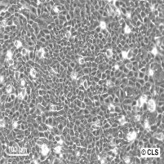
Human skin structure
EPIDERMIS
keratinocytes
DERMIS
HYPODERMIS

Slide 7
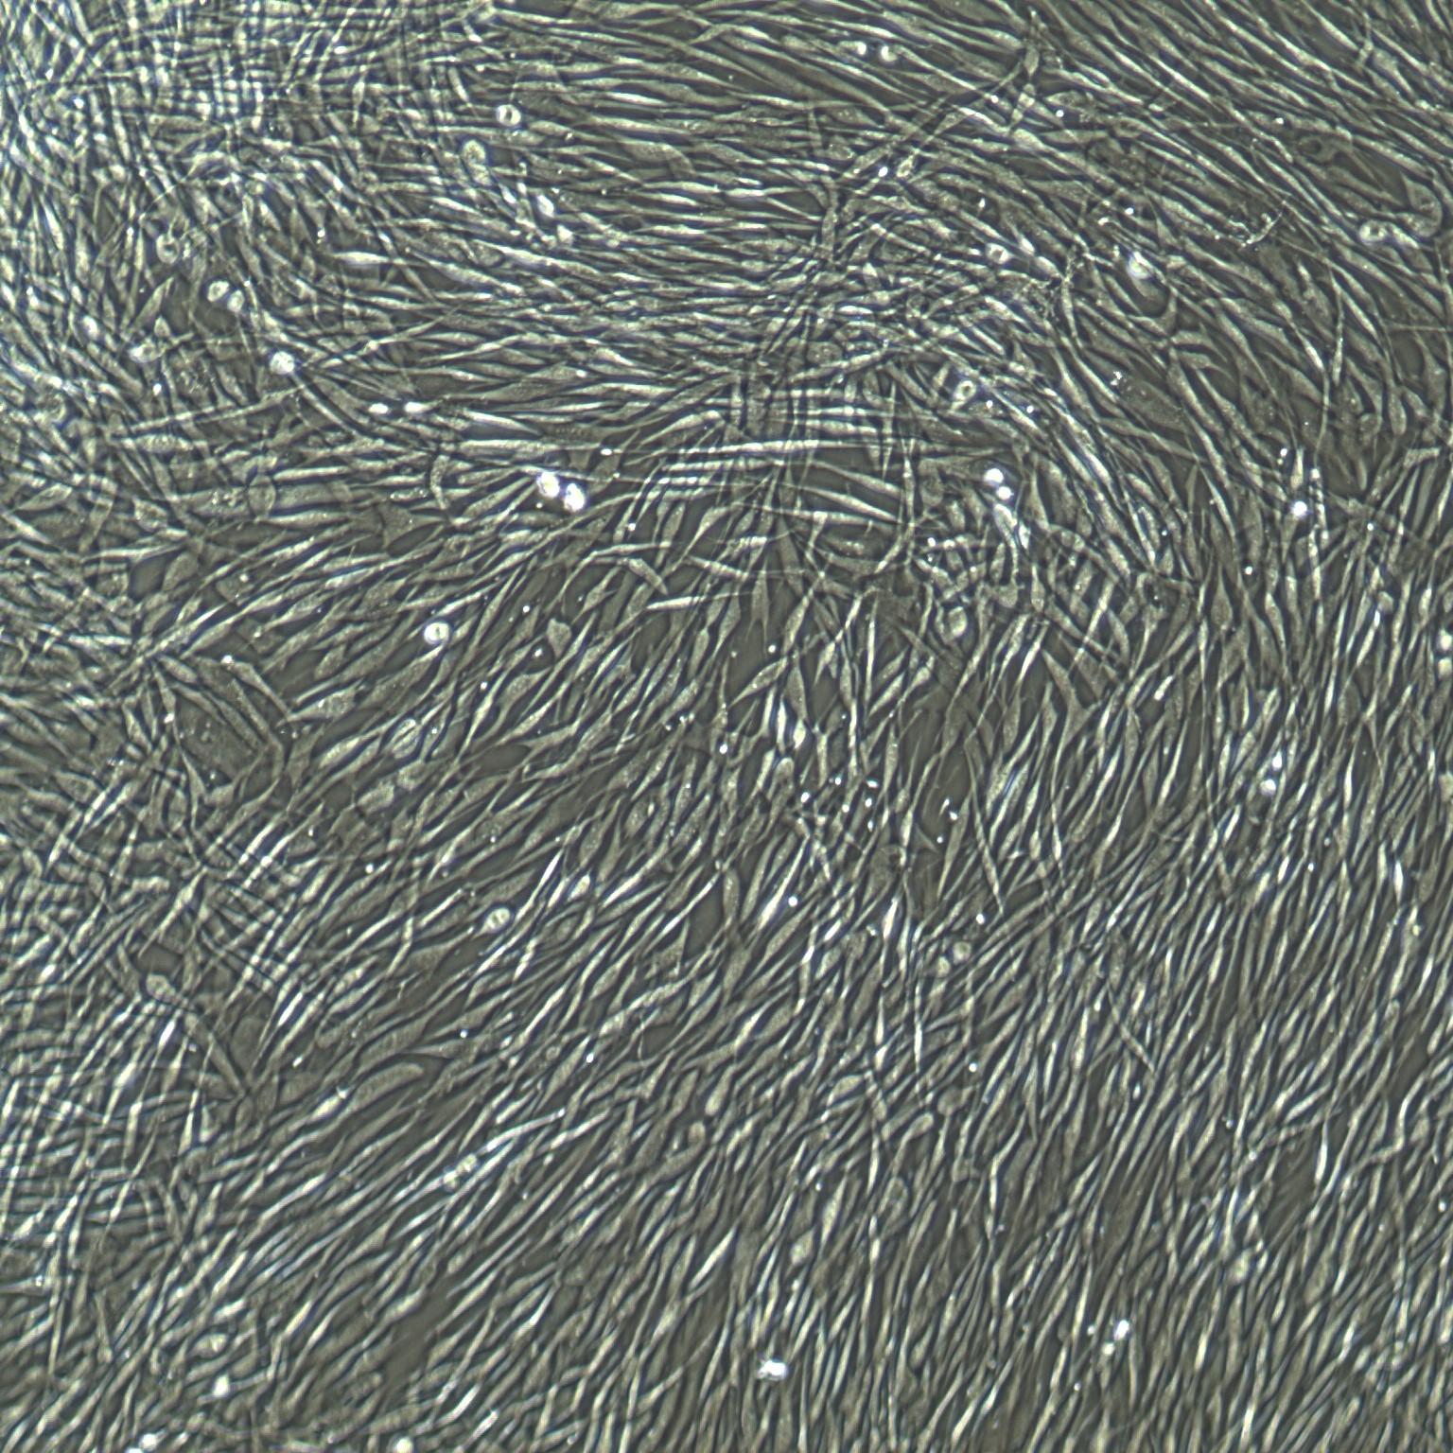
Human skin structure
EPIDERMIS
DERMIS
fibroblasts
HYPODERMIS

Slide 8
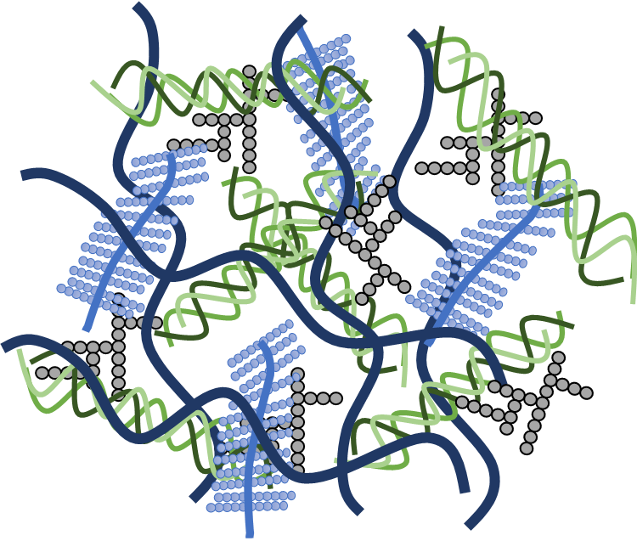
Human skin structure
EPIDERMIS
DERMIS
fibroblasts
HYPODERMIS
Skin extracellular matrix (ECM)

Slide 9
Skin extracellular matrix (ECM)
glycoproteins
glycosaminoglycans
(GAGs)
collagen
elastin
the largest component of normal skin
composed of a variety of molecules which give the skin strength, and elasticity
occupies the space between cells
serves as a sort of intranet which connects all the components of the skin

Slide 10
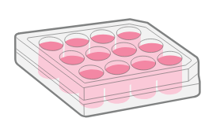
Experimental design
Non-cellular assays
Cellular assays
Protein content
(BCA assay)
Sugar content (Dubois assay)
Total polyphenolic content
(F-C assay)
Total flavonoid content (aluminium chloride assay)
Antioxidant assay (DPPH)
ECM degradation (enzyme inhibition)
Skin pigmentation (tyrosinase inhibition)
Cytotoxicity
ECM production (Col I, Eln and GAGs synthesis)
Anti-inflammatory assay (IL-6 production)
biorefinery whey
biorefinery whey
Human Dermal Fibroblasts (HDFa)

Slide 11
Proximate composition of the green biorefinery whey
Sample | Protein [mg/ml] | SEM | Sugar [μg/ml] | SEM | TPC [mg GAE/g] | SEM | TFC [mg QE/g] | SEM
Alfalfa | 0.66 | 0.05 | 17.36 | 1.61 | 20.1 | 0.64 | 13.06 | 0.77
Pakchong | 0.4 | 0.06 | 31.04 | 1.99 | 33.26 | 1.1 | 18.97 | 2.19
Phenolic compounds are well-known for their antioxidant properties, and a higher TPC typically correlates with greater potential health benefits.

Slide 12
Antioxidant potential of biorefinery whey
DPPH radical scavenging potential of whey samples and positive control (ascorbic acid).
Values correspond to mean ± SEM of three independent experiments.

Slide 13
Skin health-related anti-enzymatic activity
Effect of biorefinery whey on tyrosinase, elastase and collagenase activity.
 |  | Tyrosinase inhibition [%] | SEM | Elastase inhibition [%] | SEM | Collagenase inhibition [%] | SEM
positive control |  | 91.46**** | 0.41 | 26.86**** | 3.90 | 75.6**** | 1.48
Alfalfa [mg/ml] | 10 | 7.40 | 2.14 | 2.21 | 1.44 | 35.27**** | 0.97
 | 1 | 17.90** | 4.97 | 5.42 | 1.07 | 25.402**** | 1.06
 | 0.1 | 26.15**** | 4.33 | 5.10 | 1.50 | 22.08*** | 4.47
 | 0.01 | 22.94**** | 3.13 | 5.27 | 1.29 | 13.75*** | 0.73
Pakchong [mg/ml] | 10 | 6.62 | 2.78 | 25.90**** | 1.15 | 79.44**** | 2.37
 | 1 | 19.53** | 2.72 | 4.60 | 2.03 | 70.38**** | 1.88
 | 0.1 | 19.19** | 2.00 | 6.74 | 1.87 | 47.07**** | 3.92
 | 0.01 | 13.42 | 5.74 | 5.07 | 2.60 | 21.32**** | 0.81
Results are presented as a percentage of the enzyme activity. 10 mg/ml kojic acid, 1 mM MeOSuc-Ala-Ala-Pro-Val-CMK and 0.5 mM phenantroline were used as positive controls (tyrosinase, elastase and collagenase inhibitor, respectively). Bars correspond to mean ± SEM of three independent experiments. * p<0.05; ** p<0.01; *** p<0.001; **** p < 0.0001 vs. negative control (enzyme activity; 100%).

Slide 14
Cytotoxicity assessment
Effect of the brown juice on the human dermal fibroblasts (HDFa) viability after 24 h incubation.
The data are presented as the mean ± SEM from three independent experiments. Statistical significance in comparison to the negative control (100%) was assessed using one‐way ANOVA followed by Dunnett’s multiple comparison test; * p<0.05; **p < 0.01. The black line indicates the cytotoxicity limit according to ISO 10993–5 (70%).

Slide 15
Extracellular matrix (ECM) molecules production
Effect of biorefinery whey on collagen I (Col I), elastin (Eln) and glycosaminoglycans (GAGs) production.
 |  | Col I production [%] | SEM | Eln production [%] | SEM | GAGs production [%] | SEM
cells only |  | 100.00 | 0.00 | 100.00 | 0.00 | 100.00 | 0.00
positive control |  | 174.11**** | 3.58 | 123.04*** | 4.32 | 151.48*** | 4.82
Alfalfa [µg/ml] | 200 | 92.49 | 3.73 | 110.19* | 3.94 | 161.99**** | 20.28
 | 100 | 95.47 | 5.04 | 110.14* | 2.92 | 156.27**** | 2.93
 | 50 | 97.46 | 2.59 | 106.63* | 2.65 | 144.77** | 6.60
Pakchong [µg/ml] | 200 | 76.44 | 2.53 | 110.28* | 1.67 | 136.20* | 6.21
 | 100 | 84.46 | 2.90 | 108.90* | 3.20 | 149.76*** | 4.07
 | 50 | 90.45 | 3.11 | 104.89 | 1.32 | 150.97*** | 7.73
Results are presented as a percentage of the untreated cells. Bars correspond to mean ± SEM of three independent experiments. * p<0.05; ** p<0.01; *** p<0.001; **** p < 0.0001 vs. negative control (cells only; 100%).

Slide 16
Anti-inflammatory activity of biorefinery whey
Interleukin 6 production in PMA-activated skin cells
The data are presented as the mean ± SEM. Statistical significance in comparison to the activated cells was assessed using one‐way ANOVA followed by Dunnett’s multiple comparison test; ****p < 0.0001.

Slide 17
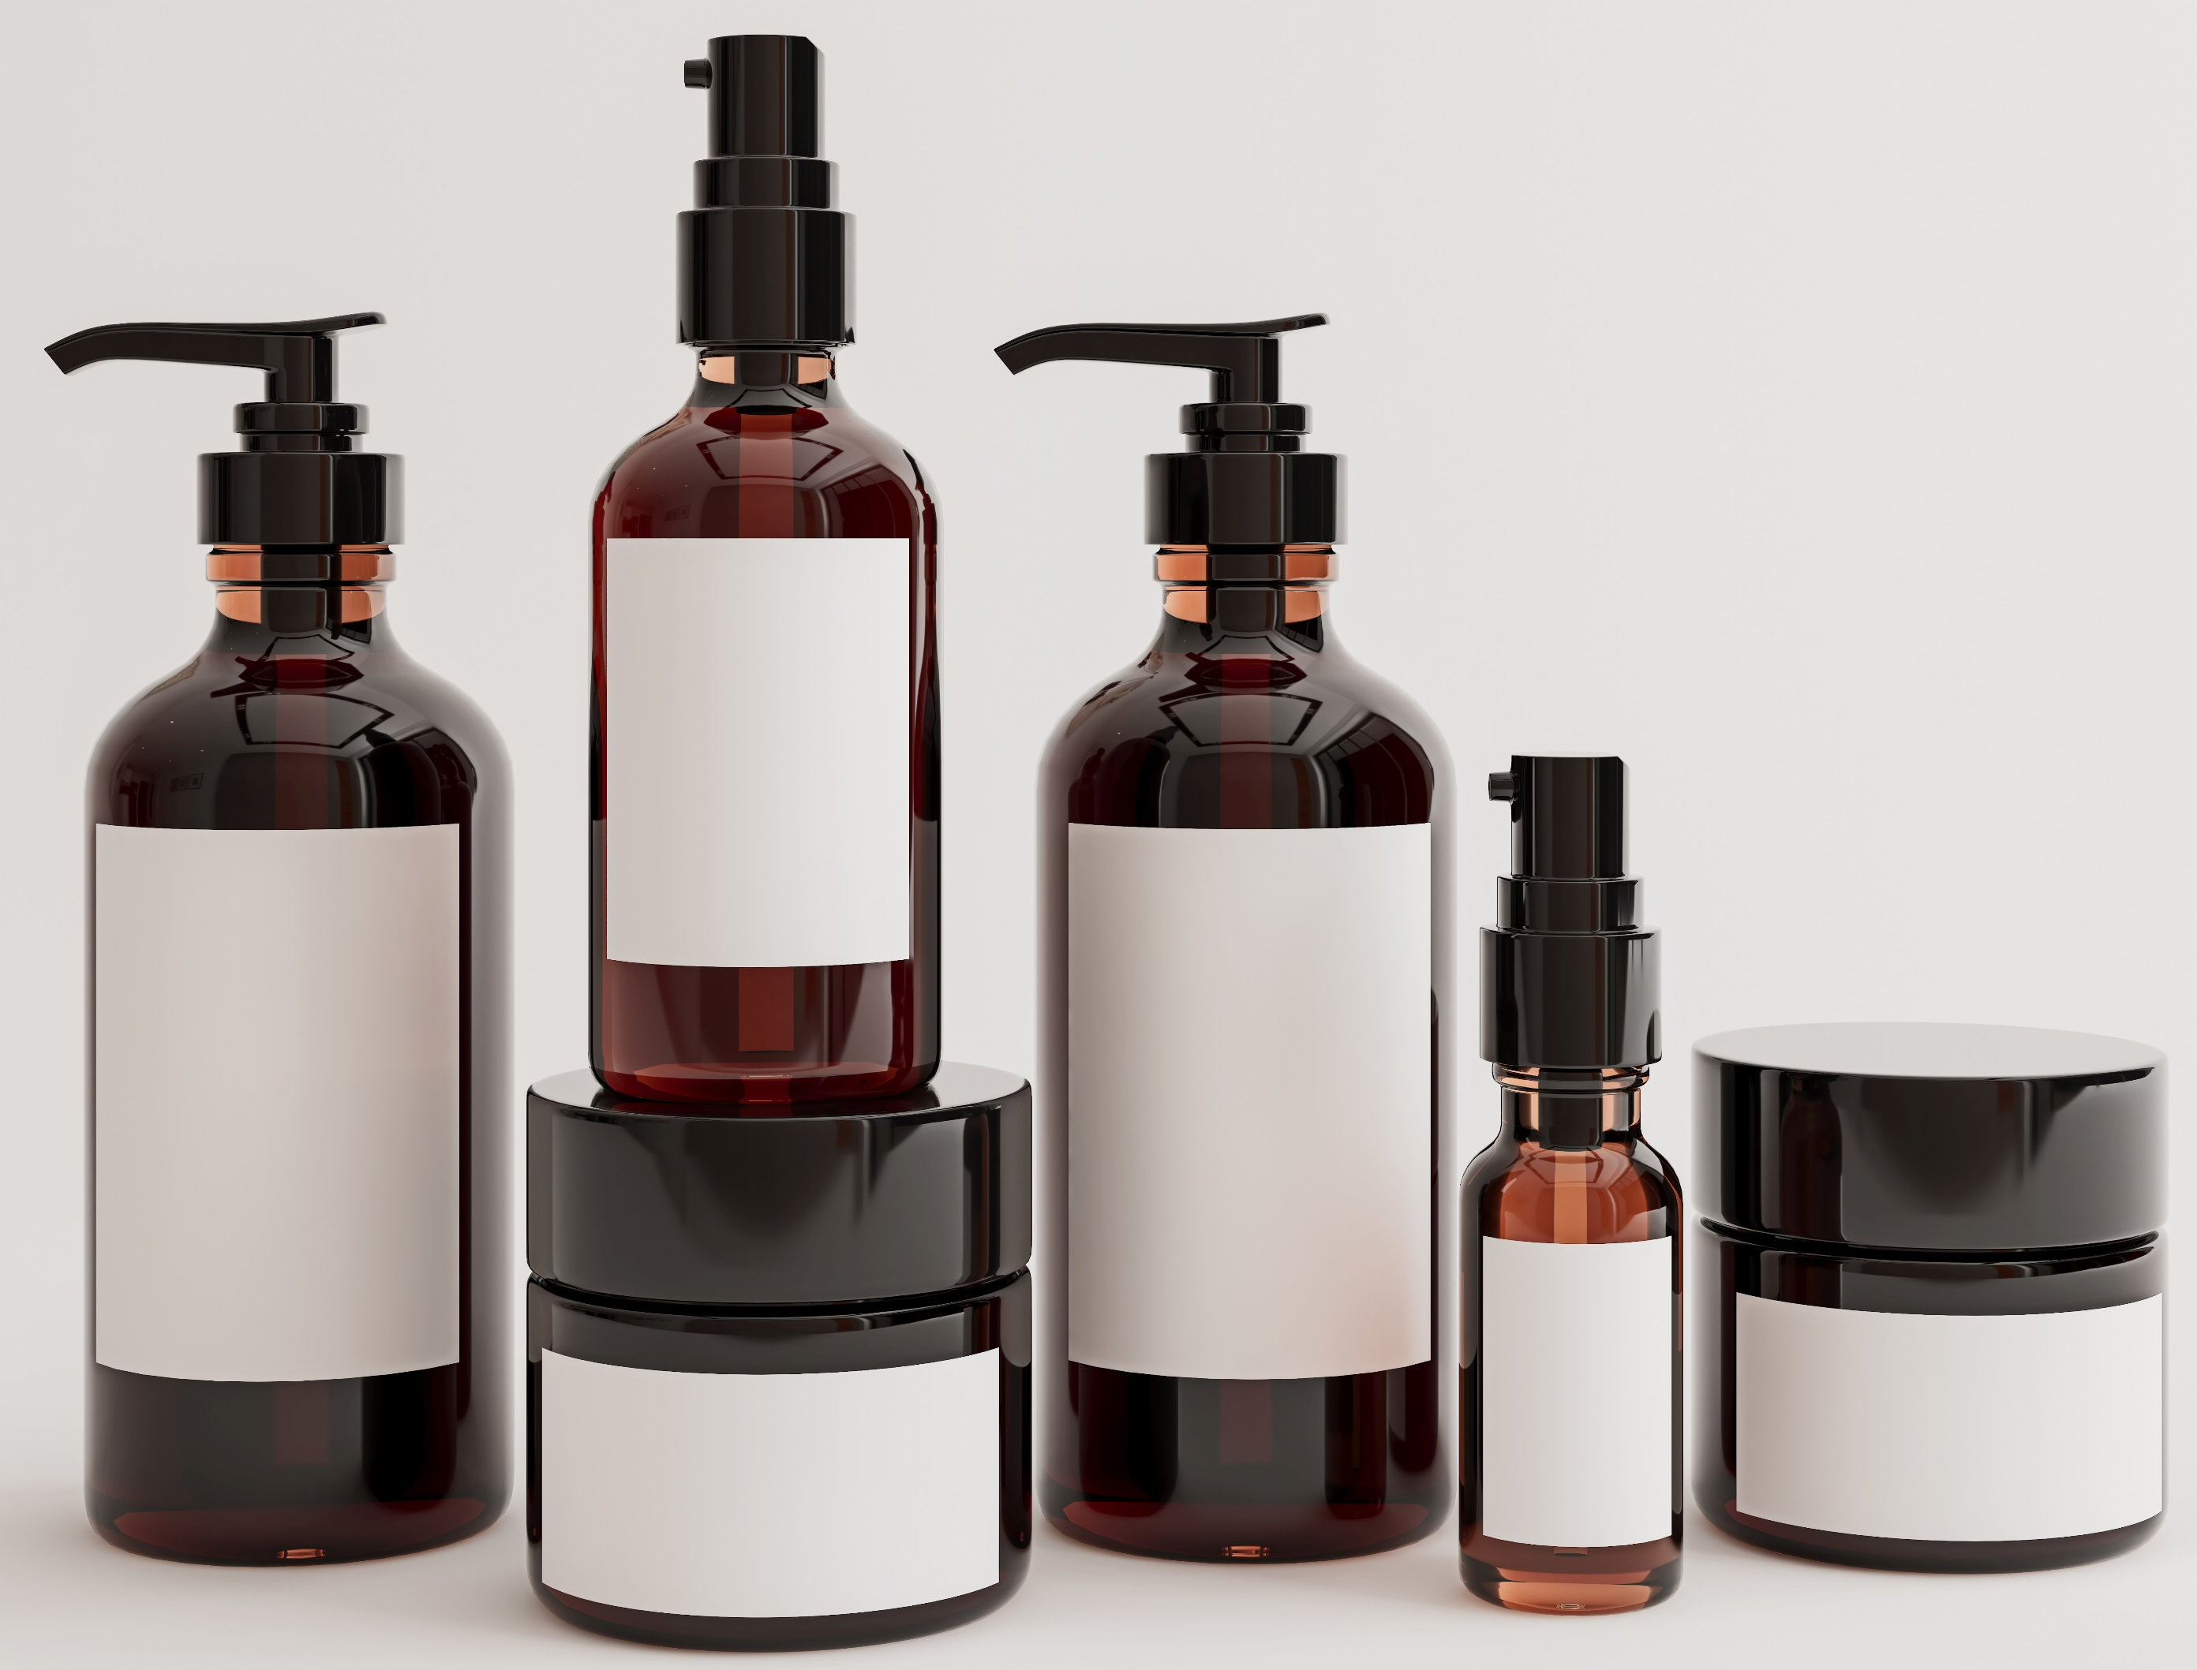
Potential application of biorefinery whey
 | Alfalfa | Pakchong
Antioxidant assay | √ | √√
Anti-elastase assay | √ | √
Anti-collagenase assay | √ | √√
Anti-tyrosinase assay | √ | √
Viability assay | √√ | √
Elastin production | √ | √
Collagen production
Glycosaminoglycans production | √√ | √
Anti-inflammatory assay | √√ | √
Assay
Sample
antioxidant nutraceuticals; anti-ageing, anti-wrinkle cosmetic products
anti-ageing/anti-wrinkle cosmetic/cosmeceutical products
anti-ageing/anti-wrinkle cosmetic/cosmeceutical products
cosmetic/cosmeceutical products (skin hyperpigmentation treatment)
anti-ageing/anti-wrinkle cosmetic/cosmeceutical products
cosmetic/cosmeceutical products (anti-ageing, anti-wrinkle, stretch marks treatment)
cosmetic/cosmeceutical products (anti-ageing, anti-wrinkle, moisturisers)
cosmetic/cosmeceutical products (treatment of skin conditions related to inflammation, e.g. atopic dermatitis)

Slide 18
Conclusions
Biorefinery whey (brown juice), the by-product of the green biorefinery was investigated for its potential use by the cosmetic/nutraceutical/pharmaceutical industry.
The obtained results show that:
tested whey is not cytotoxic against used skin cell culture models, human dermal fibroblasts
tested samples have antioxidant activity
whey increases the expression of extracellular matrix molecules, such as elastin and glycosaminoglycans
tested whey has the ability to inhibit elastase, collagenase and tyrosinase activity
residual biorefinery whey has anti-inflammatory activity in skin cells
The obtained results indicate that whey offers promising potential as a cosmetic/cosmeceutical/pharmaceutical ingredient, because of its lack of toxicity, antioxidant, anti-hyperpigmentation, anti-wrinkle and anti-inflammatory properties.

