Slide 1


Up-grading agro-wastes from western Africa in biocomposites applications
Souha MANSOUR, Amandine VIRETTO, Marie-France THEVENON & Loïc BRANCHERIAU
CIRAD
B4A Final Conference/BLP 2025,
28-30 January, Montpellier

Slide 2
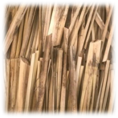
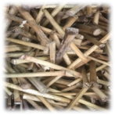
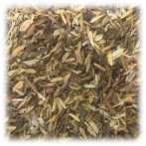
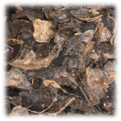
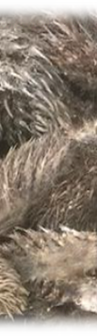
GENERAL OVERVIEW
TYPHA
300,000 to 500,000 tons
MILLET STALKS
26.31 million tons
QUANTITIES PRODUCED IN AFRICA IN 2020
RICE HUSK
8.71 million tons
COCOA PODS
1.33 million tons
OIL PALM EMPTY FRUIT BUNCH
23.6 million tons
Notes:
TPY extracted from Senegal’s river

Slide 3





GENERAL OVERVIEW

Slide 4

MATERIALS AND PARAMETERS
BIOMASS
PANELS
TYPHA
RICE HUSK
COCOA PODS
MILLET STALKS
OIL PALM EMPTY FRUIT BUNCH (OPEFB)
Application in the housing sector
Non-load-bearing applications
Resistant to the tropical climate
PARAMETERS
BIOMASS
FIBER/BINDER RATIO
GRANULOMETRY
BINDER
Melamine-Urea-Formaldehyde (MUF)

Slide 5
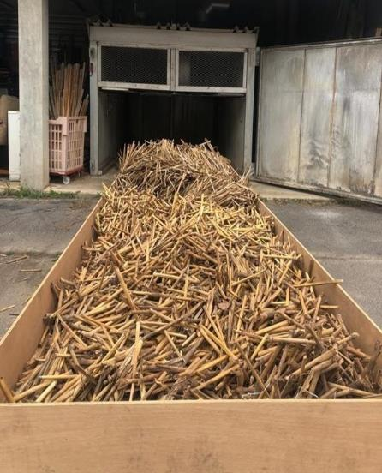
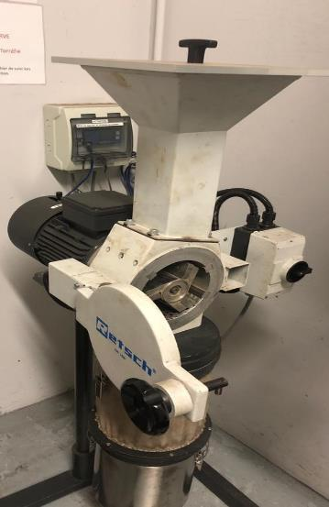
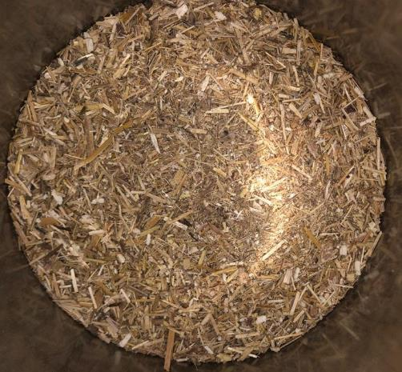
FIBERS PREPARATION
Biomass dried at 80 °C for 24h
Grinding with a sieve of 6 mm
Lignocellulosic fibers
5

Slide 6
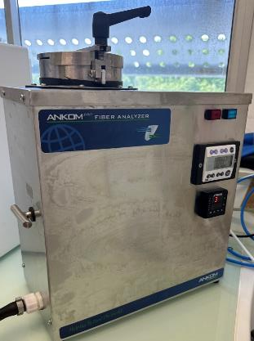
FIBERS CHARACTERIZATION
1
CHEMICAL COMPOSITION
6
Notes:
The biomasses all present similar quantities of the main constituents, except for the cocoa pods which have more lignin than all the others.
Rice husk is also special among the rest of the biomasses due to its high ash quantity which is caused by the presence of Silica

Slide 7
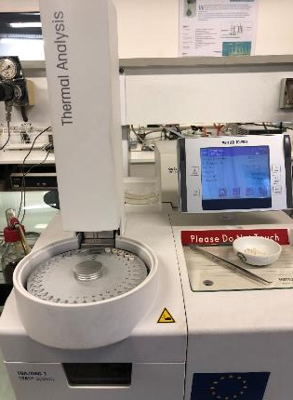
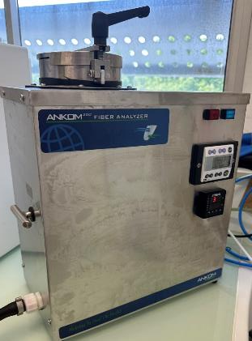
FIBERS CHARACTERIZATION
30 °C to 800 °C
10 °C.min⁻¹
Nitrogen atmosphere
1
THERMAL STABILITY
CHEMICAL COMPOSITION
2
BIOMASS | RESIDUE (%) | DEGRADATION TEMPERATURE (°C)
Cocoa | 32.4 ± 1.1 | 317.2 ± 3.5
Millet | 25.9 ± 1.0 | 316.7 ± 4.1
OPEFB | 25.9 ± 1.0 | 317.7 ± 4.7
Rice | 34.0 ± 1.4 | 347.9 ± 1.5
Typha | 23.8 ± 1.8 | 333.1 ± 4.1
7
Notes:
Rice is the most stable with the highest residue % and that is predicted due to its high Silica content.

Slide 8
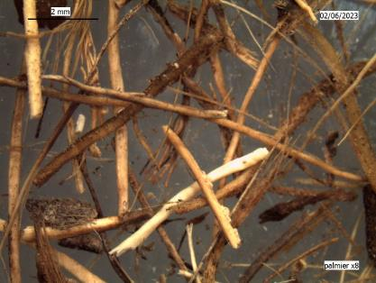
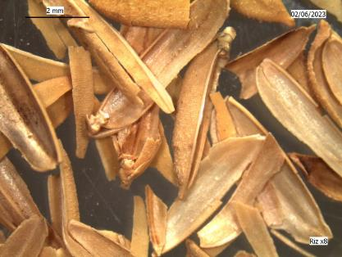
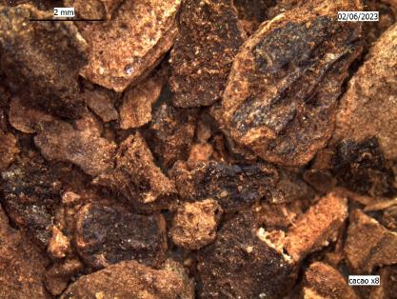
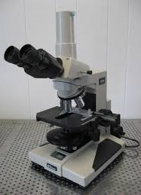
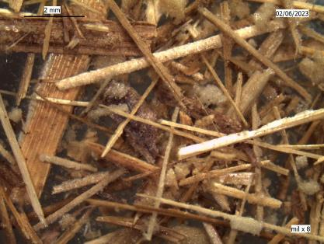
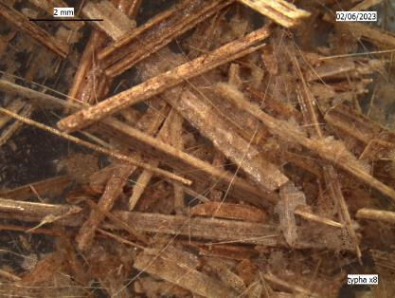
FIBERS CHARACTERIZATION
Optical microscope (x8)
1
SHAPE AND SIZE
OPEFB
RICE HUSK
COCOA PODS
THERMAL STABILITY
CHEMICAL COMPOSITION
2
3
MILLET STALKS
TYPHA
8
Notes:
An optical microscope was used to obtain an image of each biomass to understand more the structure of these materials.
OPEFB, Typha, and millet stalks all have an elongated fiber shape, unlike the cocoa pods that is more spherical.
As for the rice, its structure wasn’t affected by the grinding.

Slide 9
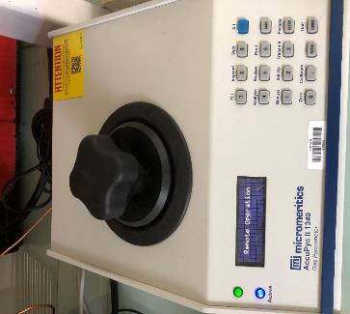
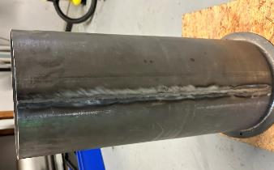
FIBERS CHARACTERIZATION
1
SHAPE AND SIZE
DENSITY
THERMAL STABILITY
CHEMICAL COMPOSITION
Biomass | Apparent Density (kg/m³) | Real Density (kg/m³) | Porosity (%)
Cocoa | 484.7 | 1401.2 ± 8 | 65.4
Millet | 93.6 | 1229.8 ± 4.5 | 92.4
OPEFB | 157.1 | 1282.9 ± 3.0 | 87.8
Rice | 150.7 | 1482.9 ± 5.6 | 89.8
Typha | 65.9 | 1325.9 ± 1.3 | 95.0
2
3
4
9
Notes:
Two tests were realized to measure the density.
At first a compaction test to measure the apparent density, then there’s the pycnometer to measure the real density.
Cocoa pods are the most dense. With high values of porosity for typha and millet stalks which previews an isolation behavior of the panels prepared with these two fibers.
Compaction has no std deviation

Slide 10
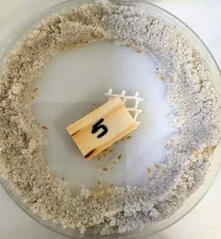
FIBERS CHARACTERIZATION
Reticulitermes flavipes
27°C, RH > 75%
5 Weeks
1
SHAPE AND SIZE
Biomass | Termites activity
Rice | Activity decreases over time, no visible activity after 28 days
OPEFB | 3/5 no activity after 28 days 2/5 active termites
Millet | Termites actives
Typha | 2/5 activity decreases after 20 days 3/5 no activity after 20 days
Cocoa | 2/5 active termites 2/5 reduced activity after 28 days 1/5 no activity after 28 days
Pine Sapwood Control | The termites were very active during the test period Survival rate > 50%, The screening test is validated
DENSITY
THERMAL STABILITY
DURABILITY
TOWARDS
TERMITES
CHEMICAL COMPOSITION
2
3
4
5
10
Notes:
The durability against termites was tested. The screening test was validated by the pine sapwood control.
Termites are most active with millet stalks due to the high cellulose/hemicellulose contents which constitutes a main food source for termites.
On the other hand, rice husk is the most resilient due to its silica content which is not a food source for termites

Slide 11
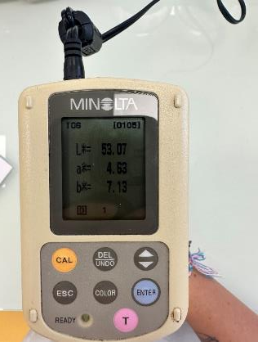
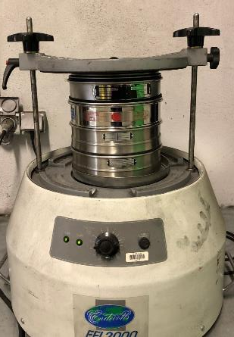
FIBERS CHARACTERIZATION
1
SHAPE AND SIZE
TYPHA
DENSITY
THERMAL STABILITY
COLOR
CHEMICAL COMPOSITION
2
GRANULOMETRY
3
4
5
6
11
Notes:
Finally, the granulometry distribution was measured.
Cocoa pods are centered around 2.5 mm and the rest is at 1.6 mm
The sieve used for the grinding process is 6 mm which is higher than the rice husk’s original size, therefore it is not very affected.

Slide 12
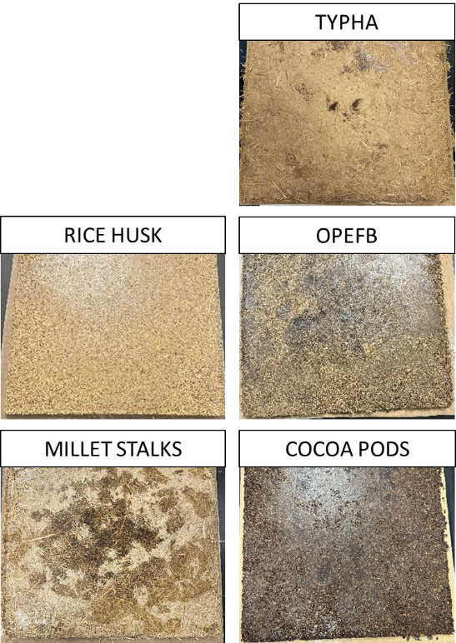
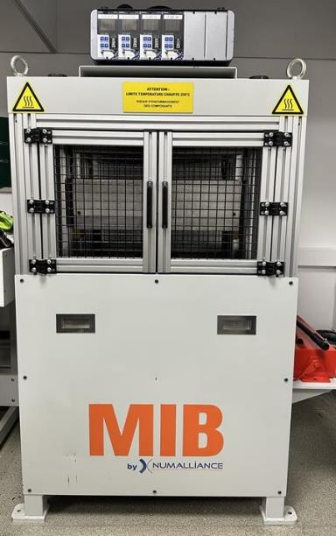



PANELS PRODUCTION
120 °C
10 minutes
Melamine urea formaldehyde
Biomass
Cooling and demolding
1.76
kg
12
Notes:
A mix of 1.76 kg total of biomass and binder was prepared then placed in a mold that was then pressed in a thermal press for 10 mins at 120 °C. and after cooling and demolding we obtained the different panels obtained as the photo shows
These panels will be compared to commercial particle boards

Slide 13
PANELS FABRICATED
In Total:
25 panels with 3x5 replicates for rice
Fiber/Binder Ratio | BIOMASS
 | COCOA | RICE | OPEFB | MILLET | TYPHA
50/50 | Not tested | Not tested | The glue is difficult to dispense | Not tested | Too much powder surrounding the glue
60/40 | Easy mixing between components Glue is well distributed | Easy mixing between components Glue is well distributed | Difficulty dispensing glue Poor glue absorption | Too much powder surrounding the glue | Too bulky with little glue
70/30 | Easy mixing between components Glue is well distributed | Easy mixing between components Glue is well distributed | Too little glue, mixing was too difficult | Too bulky with little glue | Not tested
80/20 | Mixing more difficult due to the quantity of glue | No glue at the edge Difficult to distribute the glue | Not tested | Not tested | Not tested
13
Notes:
One panel was fabricated for each fiber/binder ratio except for rice where five replicas were made for each.
The fiber/binder ratios were chosen depending on the biomass and the compatibility between the biomass and the binder.
The hardest mix was that of OPEFB, millet, and typha where the binder wasn’t easily distributed and it coagulated causing non-homogeneous distribution of the binder

Slide 14


PANEL CHARACTERIZATION
1
APPARENT
DENSITY
Apparent Density (kg/m3)
RICE
TYPHA
OPEFB
MILLET
COCOA
REF
14
Notes:
The apparent density was measured showing that C60/40 are the most dense
With higher fiber content the density decreases
*MUF density 1300 kg per cubic meter

Slide 15
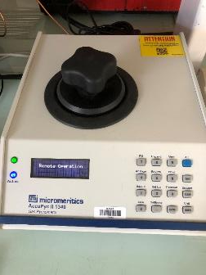
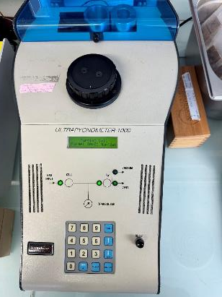
PANEL CHARACTERIZATION
1
REAL DENSITY
2
REAL
DENSITY
15
Notes:
Using a pycnometer we measured the real density in order to calculate the porosity

Slide 16

PANEL CHARACTERIZATION
1
POROSITY
REAL DENSITY
2
REAL
DENSITY
3
16
Notes:
The higher the fiber content the higher the porosity

Slide 17

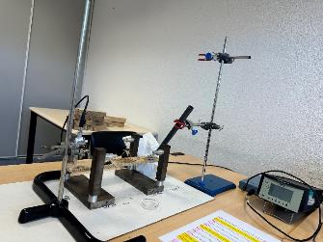
PANEL CHARACTERIZATION
1
POROSITY
REAL DENSITY
YOUNG’S
MODULUS
2
REAL
DENSITY
3
4
176
Notes:
Using BING method we measured the young’s modulus
Millet showed higher values even higher than the reference panel
At 20% binder content the panels showed very low values of young’s modulus

Slide 18
PANEL CHARACTERIZATION
1
POROSITY
REAL DENSITY
2
REAL
DENSITY
ACOUSTIC
ISOLATION
3
4
5
18
Notes:
Absorption is not really affected by the fiber content (going from 60 to 80 didn’t change it much)
Cocoa has highest absorption
Millet, Typha, and OPEFB are the most soundproofing panels
Rice and cocoa with higher filler loading had lower values of transmission loss meaning the panels are less insulating

Slide 19
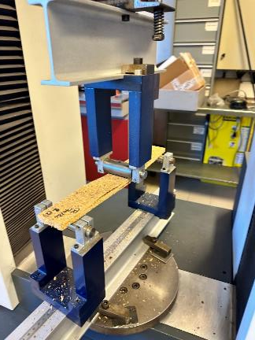
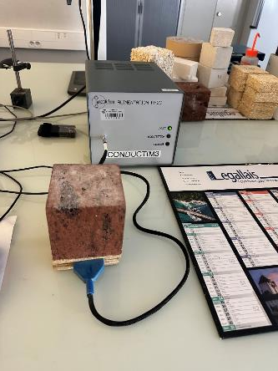
PANEL CHARACTERIZATION
1
POROSITY
ACOUSTIC
ISOLATION
REAL DENSITY
YOUNG’S
MODULUS
2
REAL
DENSITY
0.2
THERMAL
CONDUCTIVITY
3
4
5
6
19
Notes:
All panels are thermal insulators except OPEFB 50/50 AND M 60/40

Slide 20
CONCLUSIONS
The five biomasses can be used
as reinforcing fibers in biocomposite panels
In terms of acoustic isolation
In terms of density
Higher fiber loading had no significant effect on absorbance
C 60/40 panels are the most dense
T 60/40 panels are the least dense
Cocoa has the highest absorption → Good for limiting echo and reverberation
In terms of porosity
Typha, Millet, and OPEFB have high transmission loss →Good for soundproofing
R 80/20, T 60/40, and M 70/30 panels are the most porous
Higher filler loading lowered the transmission loss values of rice and cocoa panels
C 60/40 and OPEFB 60/40 panels are the least porous
In terms of thermal isolation
In terms of Young’s Modulus
R 80/20 and T 60/40 panels provide the best thermal insulation
M 60/40 panels have the highest Young’s Modulus
M 60/40 and OPEFB 50/50 panels are not thermal insulators
C 80/20 and R 80/20 panels have the lowest Young’s Modulus
20

