Slide 1



Enabling Environment for Enhanced Bioeconomy : Policy recommendations from Bio4Africa Project
Dr. Daniel Kyalo Willy
African Agricultural Technology Foundation (AATF)
B4A Final Conference/BLP 2025,
28-30 January, Montpellier

Slide 2
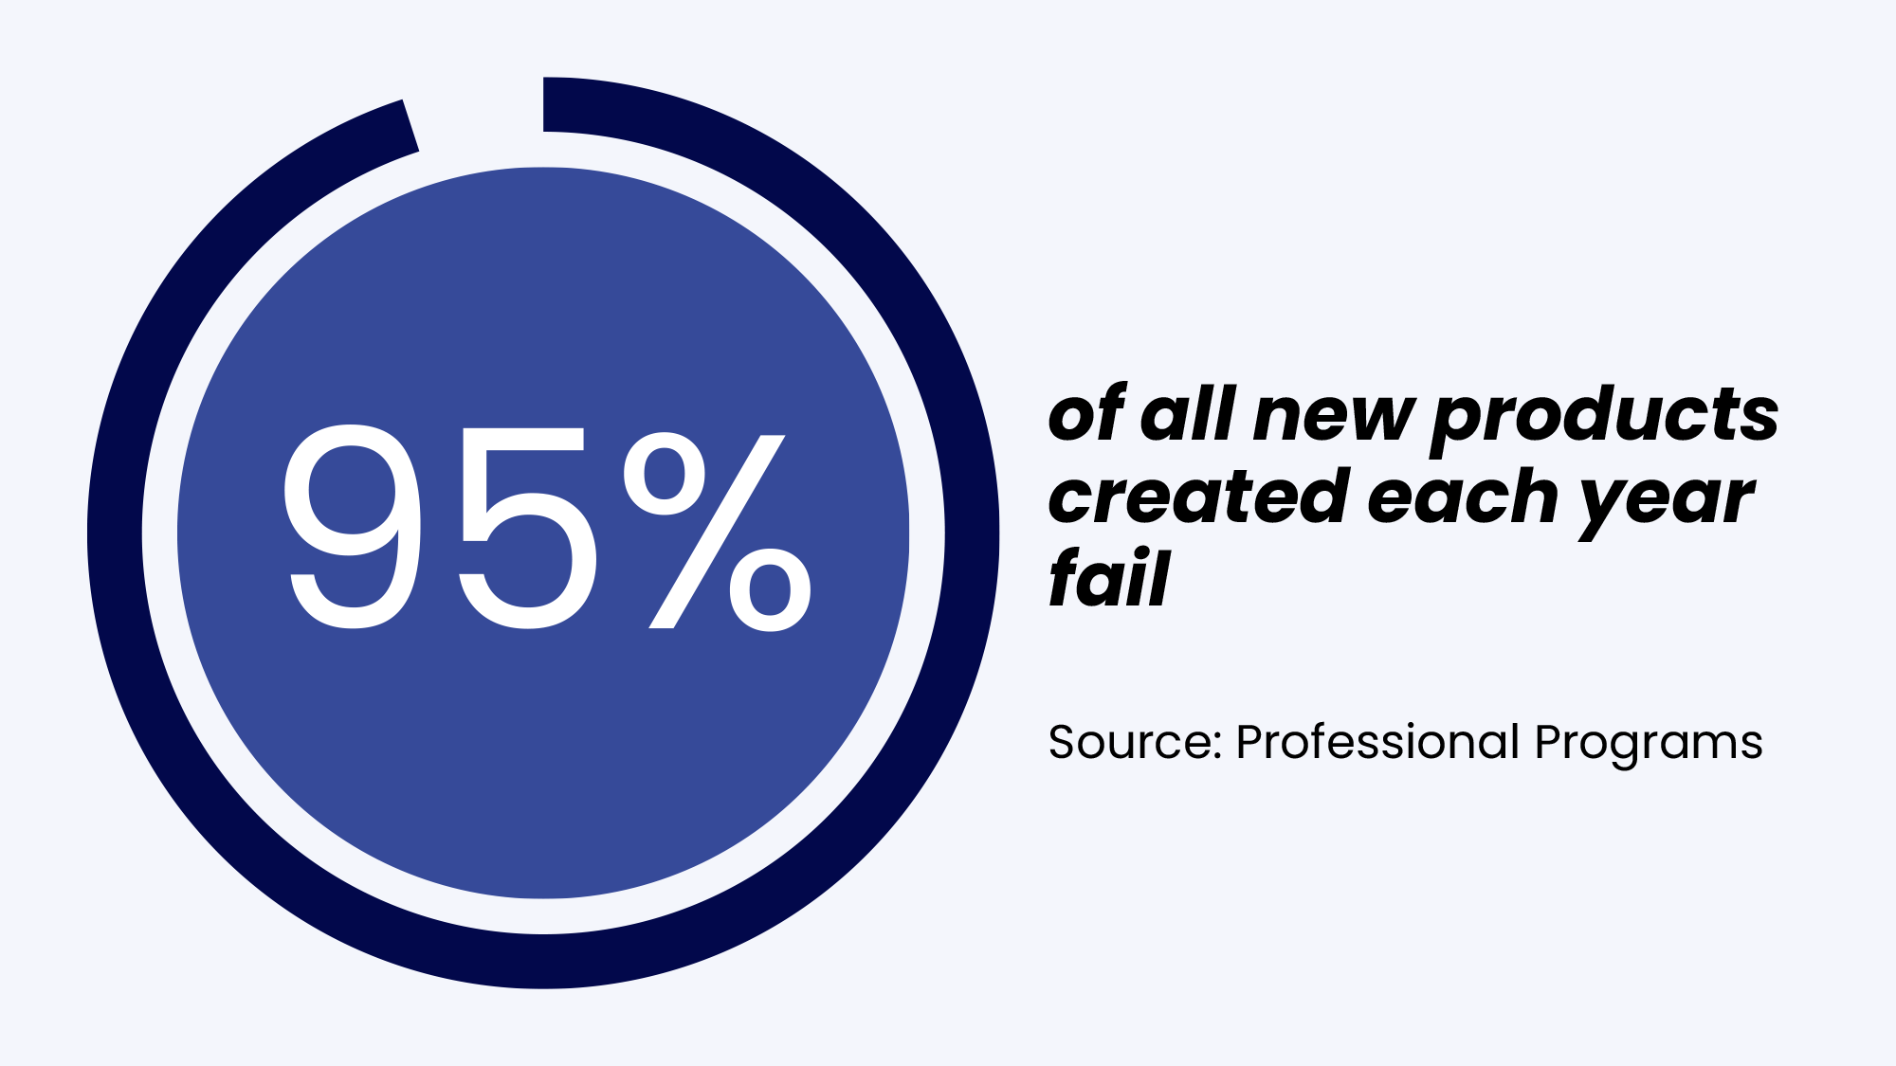
Did you know?
“Nearly 30,000 new products are introduced each year, and 95% of them fail. No business is immune to this harrowing statistic, which includes misfires from companies like Google, Coca-Cola, and Colgate. The tech giant’s Google Glass project received millions in investment but quickly disappeared from view”. Clayton Christensen, Professor at Harvard Business School
95%
Part of this failure can be attributed to lack of an enabling policy and regulatory Environment

Slide 3







Why Creating an enabling environment for the Deployment, Commercialization and Adoption of Bio-based Technologies and products is important to avert failures….
Sustainable supply : (Markets, Value chain Dvt, Standards
Sustainable production
(Feed stock production; Opportunity Cost)
Research and Development
(Adaptation, Local maintenance)
Funding
(Private sector promotion, FDI, Credit access)
Access
(Cost, Import tariffs)

Slide 4

3
Important Questions
Outline
What cost effective and comprehensive strategies can we apply to identify policy challenges?
What are the key policy challenges limiting the development and deployment of Biobased solutions in target countries in Africa?
What are the recommendations to address these challenges and how do we catalyze actions on these?
5
Notes:
TO DO THIS, I will first
Provide a contextual background by very briefly giving you the Outlook of African Agriculture (AGRICULTURAL OUTLOOK and seek to put this in the CONTEXT of the TAAT program
…. highlight OBJECTIVES that underpin TAAT Policy work,
then spend the some time highlighting progress in 2018/19
And conclude

Slide 5
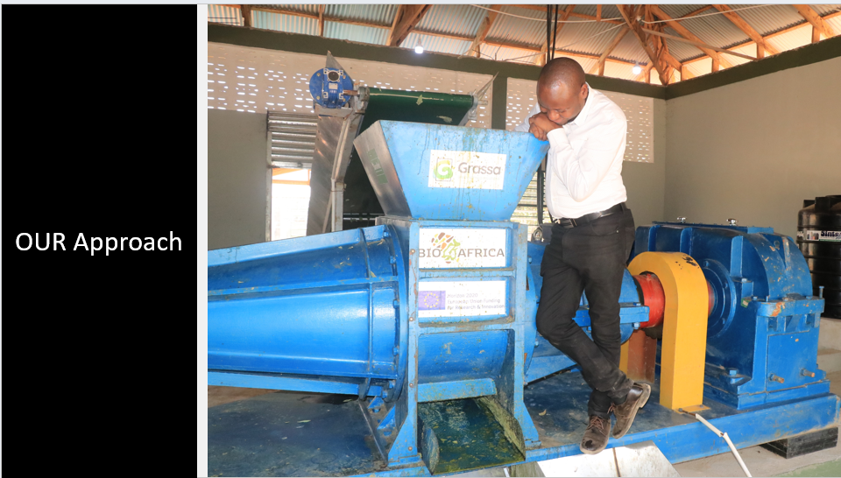

Slide 6


Critical steps in facilitating an enabling environment
Identify existing Policies/ Regulations/Guidelines
Document current status
Identify gaps
Advocacy to Engage Policy Makers at all Levels towards facilitating implementation of policy actions
Engage stakeholders to validate and prioritize gaps
Package and develop Policy Briefs

Slide 7

1. Analysis of Policy Documents
National Strategies, Policies, Laws, Acts of Parliament and Regulations relevant for Bio-economy
Regional Strategies on Bio-economy
Policy
Consequence
Policy
Context
Policy
Text

Slide 8

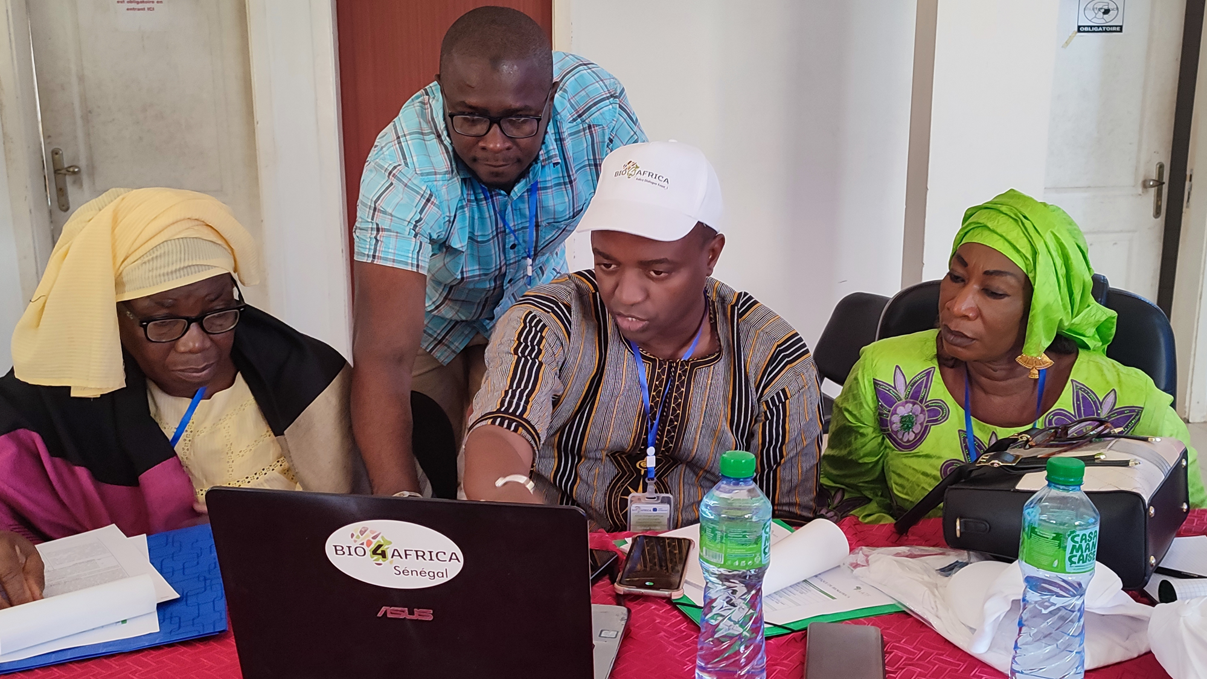



2. Policy Dialogue
Four locations where the policy dialogue events were hosted
Over 60 senior policy stakeholders in attendance
Over 20 Public and Private Institutions represented
Gender and Youth representation ensured

Slide 9

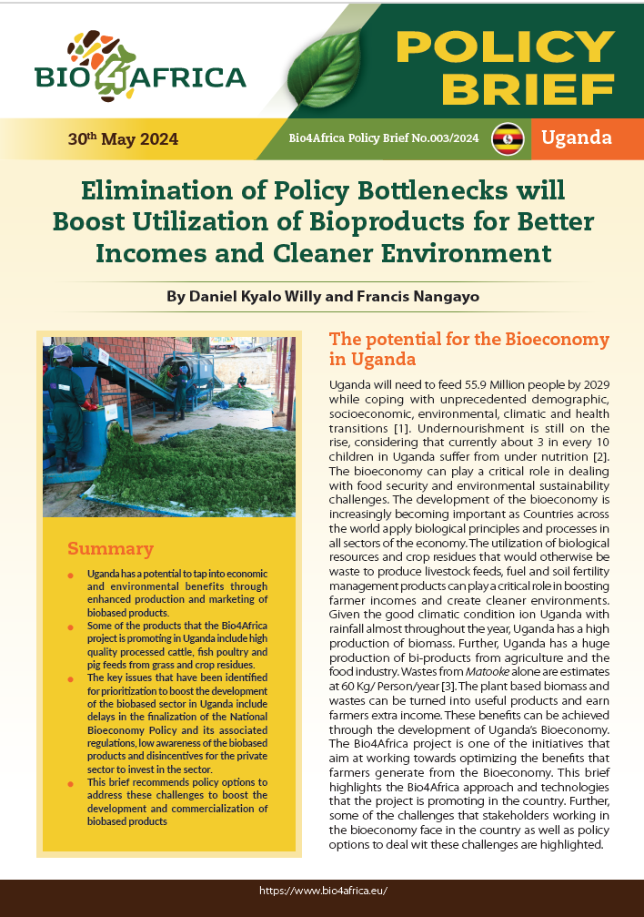
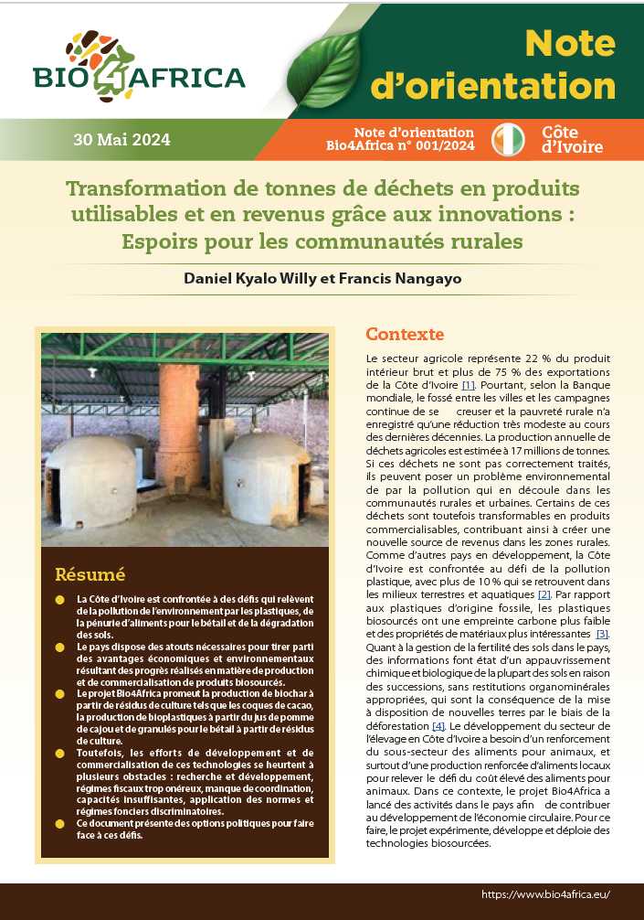
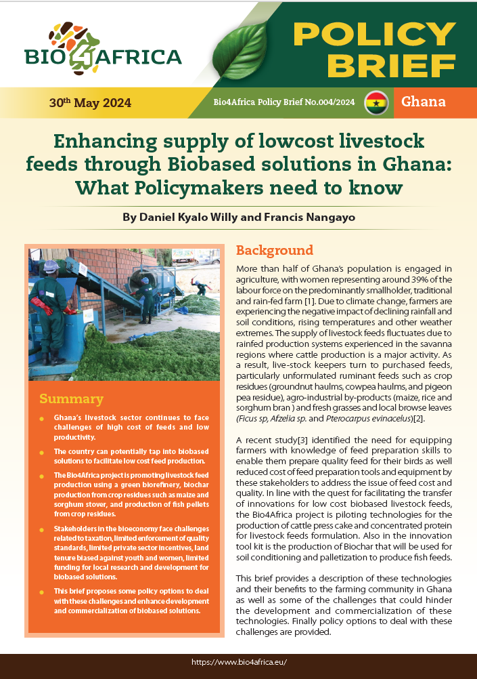
3. Final products: Policy Briefs
Four Policy Briefs, comprehensive content:
Bioeconomy benefits
The biobased technologies under focus
Key policy challenges
Recommendations

Slide 10
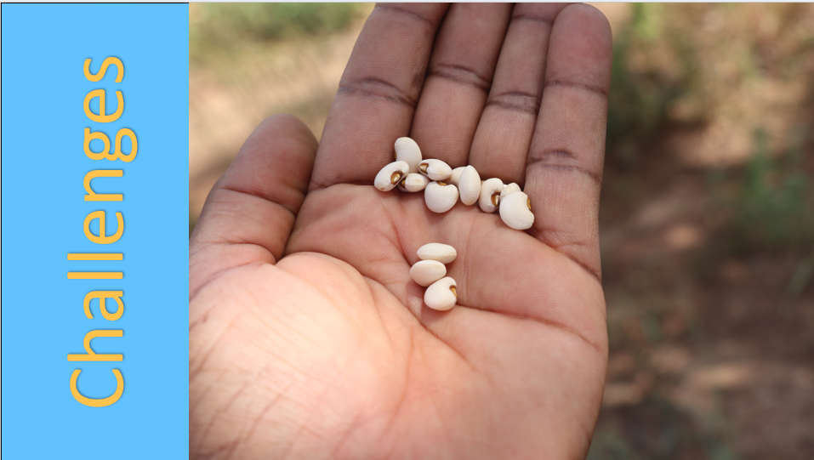

Slide 11
Policy relevant challenges
Senegal
High cost of small off grid electricity generation systems as a result of taxes
Limited private sector investment – No targeted incentives for renewable energy solutions
Low adoption of biobased products – low awareness
Land tenure limiting access to women and youth
Limited quality standards
Limited funding for renewable energy research and development
Lack of Government let technical and advisory services
Uganda
Limited number of enforcement officers - insufficient capacity for quality control to enforce quality standards for bio-based products
Limited adoption of products generated through biobased technologies
Limited dissemination of quality standards leading to low awareness by traders and consumers
Limited technical advice and external services to support acquisition and maintenance of new and advanced equipment and tools to shift to more innovative approaches
Weak linkages between actors in the innovation ecosystem and scaling entrepreneurs
Limited funding on renewable energy and Bioeconomy research.
Corte d’Ivoire
Limited access to credit facilities for investors seeking to venture into renewable energy
Weak linkages and limited cooperation between different ministries and stakeholders engaged in the bioeconomy
Land tenure that limits access to land by disadvantaged groups such as women and youth
Limited quality standards for Biobased products are limited and where standards are existing, their enforcement remains a challenge, due to capacity issues.
Ghana
Weak alignments between national strategies with regional and international frameworks
Limited enforcement of quality standards by the Ghana Standards Authority (GSA), Environ-mental Protection Agency (EPA) and Food and Drugs Authority (FDA)
The enabling environment regulating the bioeconomy is still weak and needs alignment.
Lack of sufficient incentives for women and youth to venture in biobased related businesses.
Land tenure that emphasizes on land ownership and control by men disadvantages women and the youth.

Slide 12
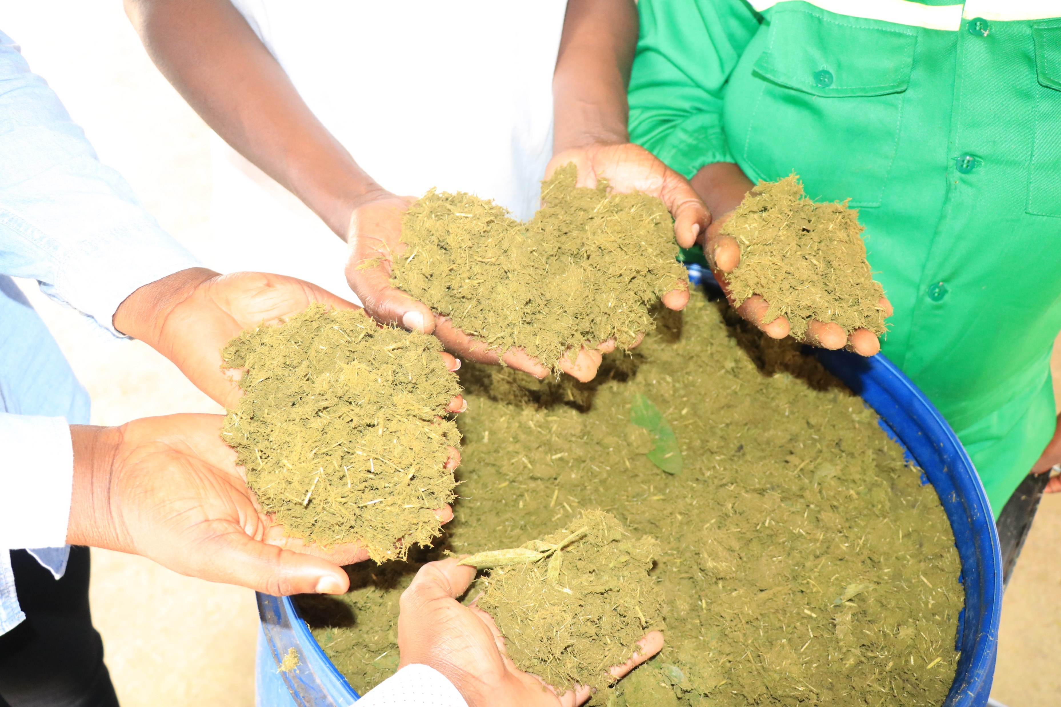
Recommendations

Slide 13

Establish a renewable energy fund and other policy support instruments for renewable energy such as tax breaks, subsidies and incentives for the investment in solar energy and other renewable energy.
Waive taxes on the equipment or Zero rate the import duty on renewable energy related equipment to encourage the importation of such equipment at low cost.
Popularize the National Agency for the Promotion of Investments and Major Projects (APIX) through awareness creation campaigns and linkages with investors.
To facilitate the access to low cost credit to finance investments in the bioeconomy and green energy, the Government of Senegal is encouraged to establish an investment guarantee fund.
Establish a policy to support the formulation and commercialization of bio-based fertilizers.
Enhancing the flexibility of existing guarantees to facilitate access to land by disadvantaged groups such as women and youth
Intensify and diversify the agricultural production through strategies that encourage production of certified seeds and adoption of hybrid varieties to boost the production of feed stock.

Slide 14

Fast track the finalization of the National Bioeconomy Policy (NBP) and the supporting regulations and guidelines to create an enabling environment to drive research, commercialization and development of bioeconomy
Value Added Tax (VAT) exemption for equipment used for Biobased equipment such as briquette making machines
Investment in capacity building and equipping the UBS including capacity strengthening through hiring and training of more standards officers.
Policy reforms towards establishment of waste management facilities and promoting waste segregation.
Encourage stakeholders to engage Uganda National Bureau of Standards (UNBS) to develop standards for new bio-based technologies and products and translate existing of standards into local languages for ease of dissemination
Increased mobilization of accessible research funds for bioeconomy innovation both from government and external sources

Slide 15

3. Establish relevant bi-laws, regulations and guidelines to facilitate commercialization of biobased technologies
2. Align Ghana’s trade initiatives and policies with the African Continental Free Trade Agreement (AfCFTA)
4. The Fiscal incentives in the sector including duty exemptions spearheaded by Ministry of Food and Agriculture (MOFA) and Ministry of Finance (MoF). .
5. Enhance the enforcement of quality standards by Ghana Standards Authority (GSA), Environmental Protection Agency (EPA) and Food and Drugs Authority (FDA).
1. Awareness creation among private sector companies and users of biobased products. This can be supported by technology demonstrations and setting up of technology parks.

Slide 16

Fiscal incentives to the private sector such as tax exemption, reduction of custom duties charged on renewable energy equipment
Facilitation of access to credit facilities (development fund; credit guarantee schemes and low interest loans)
Awareness and sensitization campaigns by the Government and partners
Redefining of the cooperation policy between different ministries in the framework of development to enhance synergies and eliminate duplication of mandates and enhance efficiency.
Inclusion of agricultural parcels in urban planning to facilitate low cost access to raw materials
Capacity enhancement for public institutions involved in research and innovation in renewable energy and the bioeconomy
Strengthening of the capacities of existing structures such as the Ivory Coast - Agence nationale d’appui au développement rural, ANADER (National Rural Development Support Agency).

Slide 17



Africa-EU Policy Round Table Discussion
Bio4Africa Project
AATF (2), CIRAD (2), FBCD(1), KRC(1)
Country REPs
One Senior Government representative from Ghana, Ivory Coast, Senegal, Uganda
Scoping presentation on the key results, policy gaps and priority actions
AU and Country presentations Insights and policy direction
Round table dissection into the issues based on the highlights
Final recommendations and common positions : next steps and options towards closing the gaps and implementation of common actions
Africa/EU Policy Round Table
EU Commission
DG- International Cooperation and Development;
DG Agri (Antonio Malta REIS)
DG Research
Policy Officer
Advisory Board member
AU Commission
Director Agriculture and Rural Development
Director – AU IBAR
April 2025
Brussels, Belgium

