Slide 1


Biomass pelletization for energy and biorefinery use
Benjamin RABDEAU
RAGT Energie
B4A Final Conference/BLP 2025,
28-30 January, Montpellier

Slide 2
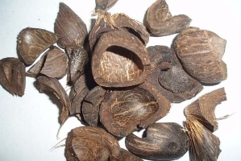
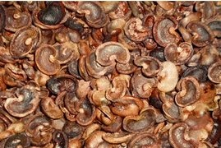
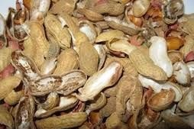
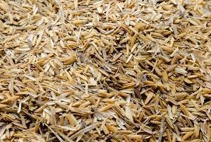
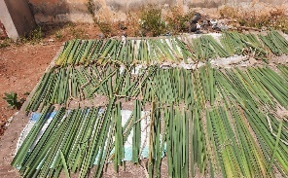
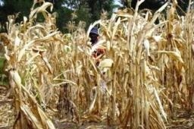
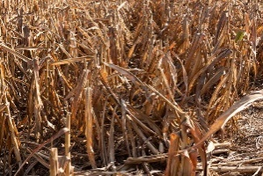
Purpose of biomass densification
Under-exploited agricultural by-product often have physical properties not adapted to their final use:
  High moisture content / not stabilized
  Low bulk density
  Inadequate particle size
  Not homogenous
The densification of these biomasses can alleviate these obstacles

Slide 3








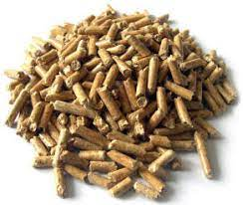
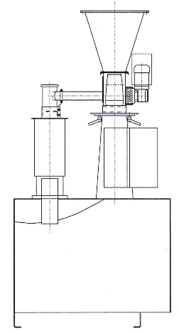

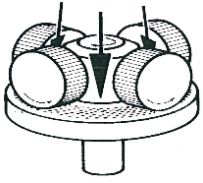
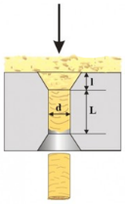
Principle
Clean fuel (energy/cooking)
Animal feeding production
Soil amendment production
Pelletizing
Biomass
Pellet
Pre-treatment
Dense
Homogenous

Slide 4

General pelletizing process
Pretreatment : optional steps that depend for each biomass
Biomass
Shredding
Drying
Grinding
Mixing
Pelletizing
Cooling
Pellets
Adaptation of pelletizing parameters are crucial :
Moisture content before pelletizing
Compression ratio of the pellet die

Slide 5
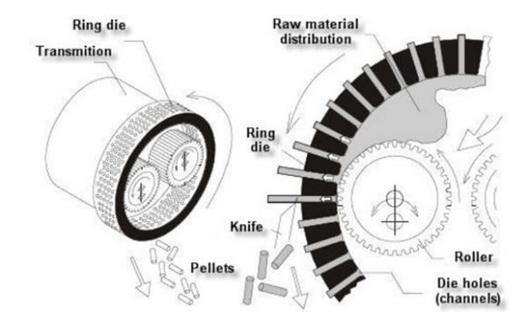
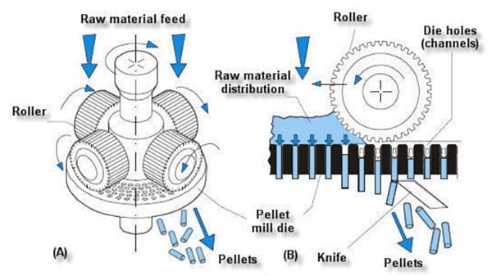
Main pellet mill technologies
Ring-die
Flat-die

Slide 6
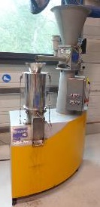
Pilot scale equipment for adaptation trials

Slide 7
Pelletization inputs and outputs
INPUT Variable parameters
[MC]
Moisture content
[CR]
Compression ratio
PELLET PRODUCTION
OUTPUT Pellet quality
INPUT Biomasses
[BD] Bulk density
[DU] Mechanical durability
[M] Moisture content
[D L] Diameter / Length
Pretreatment
Chemical properties
Physical properties
Die temperature
Energy consumed
Fines produced
Production flow rate
OUTPUT Production

Slide 8
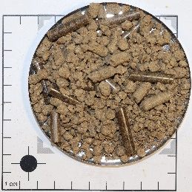
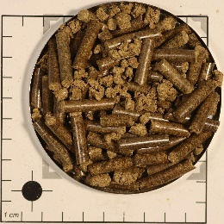
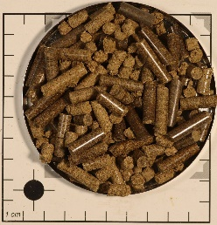
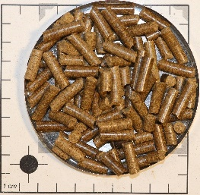
Iterative trials to improve pellet quality
Photos of different pellets produced with peanut shells
Moisture content | 12% | 16% | 14% | 16%
Compression ratio | 5 | 5 | 9 | 8
Fines (lower is better) | 40% | 25% | 10% | 6%
Mechanical durability (higher is better) | 43% | 83,7% | 81,3% | 95,5%
Bulk density (600-750 kg/m³) | 588 kg/m³ | 675 kg/m³ | 680 kg/m³ | 696 kg/m³
Pellet production performance and pellet physical properties improve at each step

Slide 9
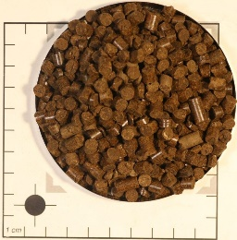
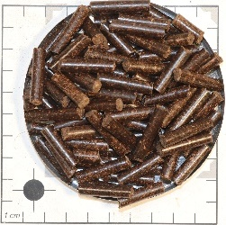
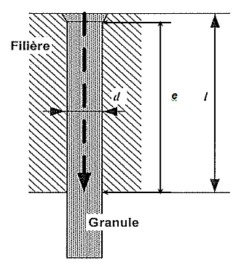
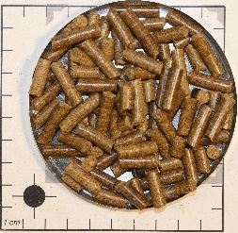
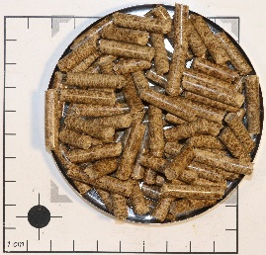

Adaptation of pelletizing parameters
Compression ratio
= e/d
e : length of compression canal
d : diameter of compression canal
Each biomass behaves differently during pelletizing :
Need more or less water
Need more or less compression
12
Palm seed shells
Cocoa pods
10
Peanut shells
8
Millet stalks
6
Moisture content
12%
13%
14%
15%
16%
Notes:
Changer emplacement des noms et photos

Slide 10
Best operating conditions on some biomasses
Photos of the best pellets obtained for four biomasses
Biomass | Palm seed shells | Peanut shells | Millet stalks | Cocoa pods
Moisture content | 12% | 16% | 13,5% | 14%
Compression ratio | 12 | 8 | 6,5 | 10
Mechanical durability (higher is better) | 88,1% | 95,5% | 98,8% | 99,2%
Bulk density (600-750 kg/m³) | 733 kg/m3 | 696 kg/m3 | 703 kg/m3 | 741 kg/m3
Promising results
Adequate pellet quality with different conditions

Slide 11
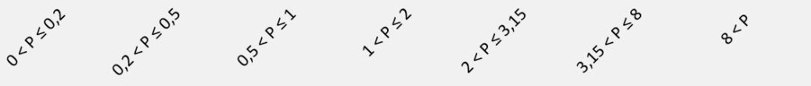
Difficulties of animal feed pellet production
Palm seed shells
Each of these ingredients has its own :
  Particle size
  Density
Millet stalks
Peanut shells
Cocoa pods
Starch

Slide 12
Difficulties of animal feed pellet production
From one biomass to a recipe/blend of multiple ingredients :
  Different pre-treated biomasses
  Protein concentrate from biorefinery
  Other
Each of these ingredients has its own :
  Particle size
  Density
→ It increases the challenge to produce good quality pellets

Slide 13
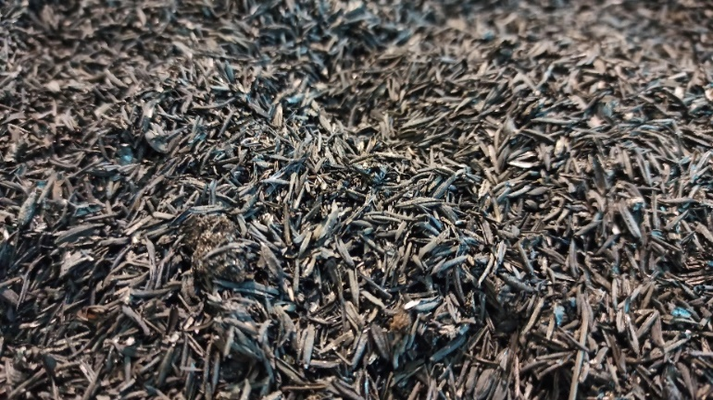
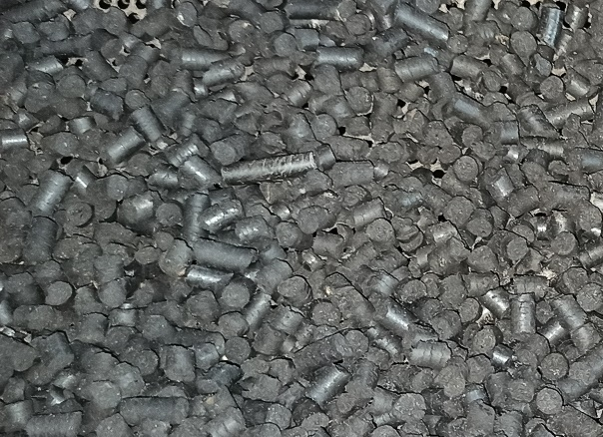
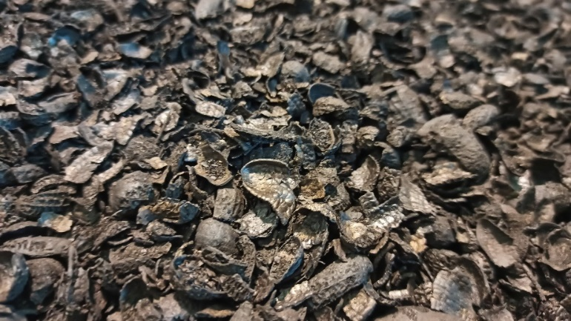
Outlook : Biochar pellet production
Rice husk biochar
Biochar pellets
Peanut shells biochar
Need higher moisture content (25-35%)
Need binder (5-15%)

